Slide 1

Growth and Development in Young Athletes
Physical Development & Growth‑Plate Considerations
Dr. Edwin Kiptolo Boit

Slide 2

Broken sports system
Talent picked too early without understanding development.
Early specialisation pushed by the 10,000-hour myth.
Higher injury and burnout risk from early specialisation.
Sports Medicine Practitioners should educate coaches and parents.

Slide 3

Chronological vs Biological Age
Chronological age ➜ birthdate
Biological age ➜ maturation status (pre‑, peri‑, post‑puberty)
2–3 year maturity gap is normal within one team
Many decisions in Sport are made based on chronological age and not Biological age

Slide 4
Why This Gap Matters
1️⃣ Injury risk
  Late maturers face bigger, faster peers
  Early maturers overload weaker growth cartilage
2️⃣ Performance & coaching
  Size & coordination mismatch hides true skill (adolescence awkwardness)
  Bio‑banding allows fairer training & competition

Slide 5
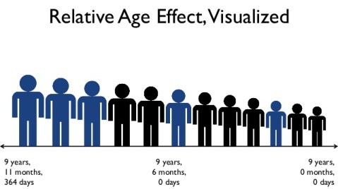
Birth‑quarter bias in talent selection.
Early‑born dominate early; later‑born risk dropout
Which leads to early specialisation/overtraining and increased injury risk
Takeaway ➜ evaluate skill, not just size/speed

Slide 6
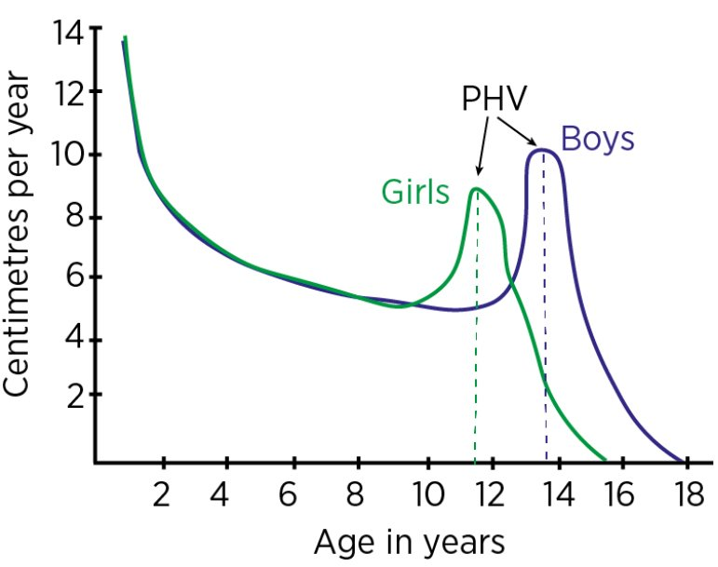
Importance of Understanding Physical Development
Rapid PHV predisposes children to increased growth plate injuries (Growth plate strength reduced)
Timing: Girls 11–12 y, Boys 13–14 y (±2 y

Slide 7
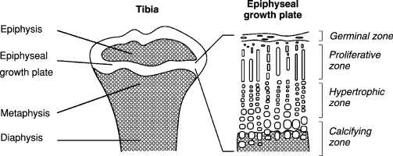
Importance of Understanding Physical Development
About 15 % of pubertal injuries hit the growth plate
About 50 % of pubertal sports injuries hit the growth plate
Growth plat is 2-3 X weaker in shear/tension than bone or ligament

Slide 8
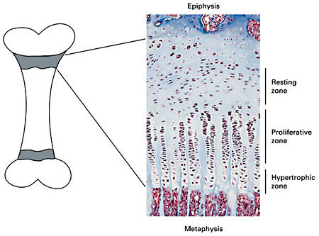
Importance of Understanding Physical Development
Overuse and acute physeal cases peak in the 6‑12 months around PHV
Early damage ➜ growth arrest, angular deformity or early joint arthritis
Track maturity and adjust load to catch issues early

Slide 9
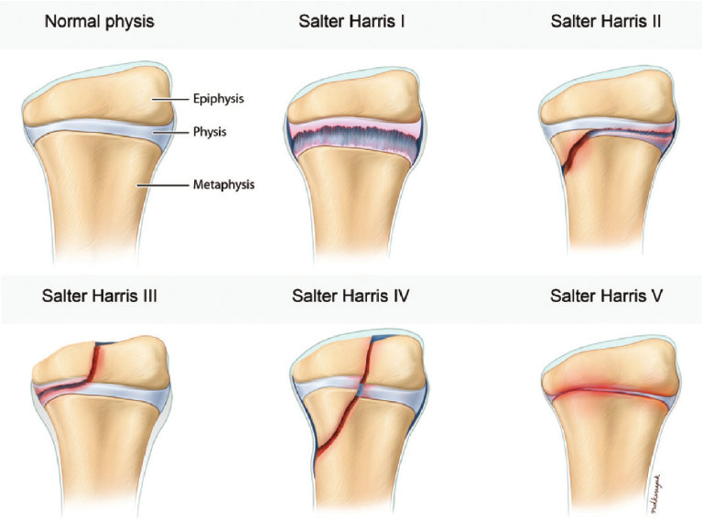
Acute injury
Salter‑Harris Acute Fractures
Type I
Area crossed: physis only
Care: cast for about 3 weeks
Type II
Area crossed: physis + metaphysis
Care: closed reduction, then cast
Type III
Area crossed: epiphysis + physis (intra-articular)
Care: screw fixation

Slide 10
Acute Injury
Salter‑Harris Acute Fractures
Type IV
Area crossed: epiphysis, physis, and metaphysis
Care: open reduction and internal fixation
Type V
Area crossed: physis (crush injury, diaphysis spared)
Care: serial growth checks; corrective surgery if needed

Slide 11
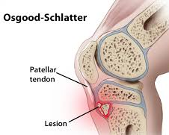
Chronic Apophyseal & Stress Injuries
Osgood‑Schlatter disease – tibial‑tubercle apophysitis (jumping, soccer, basketball)
Sever’s disease – calcaneal apophysitis (running, soccer)
Sinding‑Larsen‑Johansson – inferior‑patellar‑pole apophysitis (basketball, volleyball)
Little‑League elbow – medial‑epicondyle apophysitis (baseball, cricket, javelin)
Little‑League shoulder – proximal‑humeral physeal stress (throwing, swimming)
Gymnast’s wrist – distal‑radial physeal stress (gymnastics, cheer)
Distal ulnar physeal stress – ulnar‑side wrist pain in load‑bearing sports

Slide 12

Key Risk Drivers (PHV Hot‑Zone)
Rapid growth spurt without adaptation
Weekly load spikes > 10 %
Single‑sport > 8–9 months / year
Nutrition: Ca < 1300 mg, Vit D < 600 IU, Protein < 1.4 g kg⁻¹
Sleep < 8 h raises injury risk
Poor technique & weak neuromuscular control

Slide 13
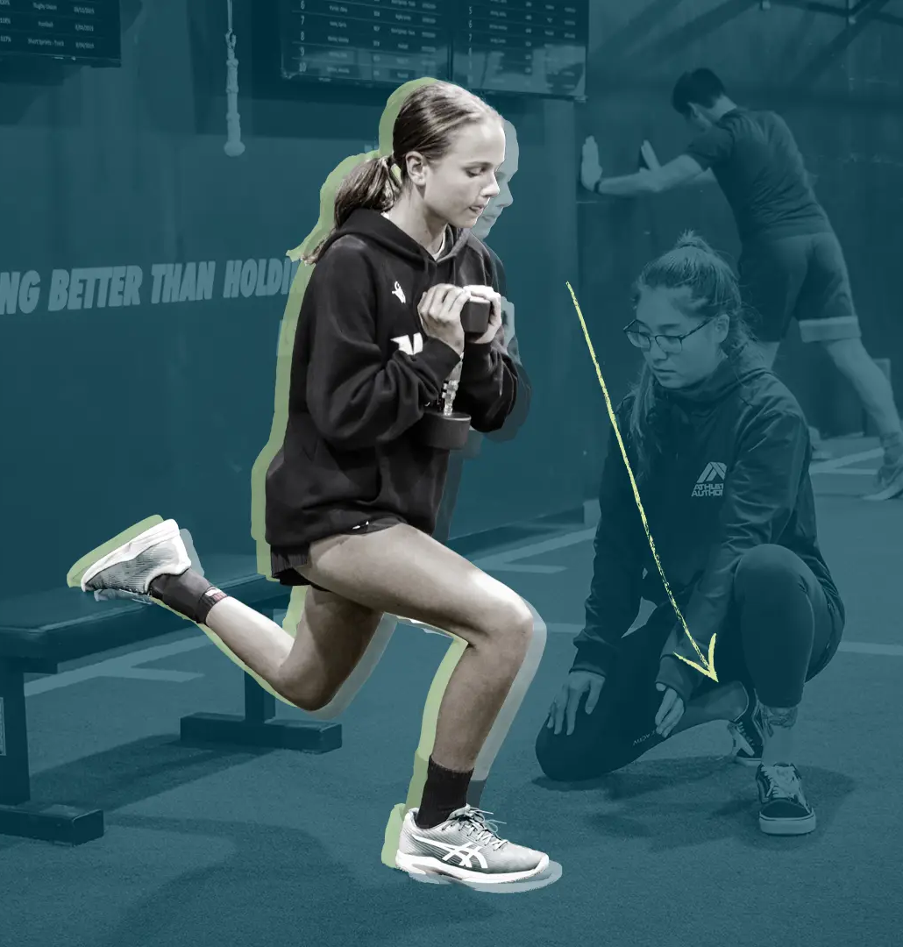
Prevention & Load Management Toolkit
Measure height each term; cut impact during PHV
Limit load rise < 10 %; 48 h between hard sessions
Periodize: build → peak → deload; 1–2 rest days / week
Multi‑sport play through age 12-14
Dynamic neuromuscular warm‑up 3× week; teach perfect form
Supervised strength + balance circuits protect growth plates (Yes, it is safe and protective)
Athlete parent and coach education

Slide 14

Monitoring Growth & Maturation
Measure standing and sitting height every 3 months
  Normal growth: ~0.5–1 cm/month
  PHV: ~6–10 cm/year or 2+ cm every 3 months
Use the Mirwald maturity offset method (age, sex, height, sitting height, weight) to estimate time to PHV

Slide 15
Monitoring Growth & Maturation
Calculate % of adult height
  Based on current height, weight, average of parents’ heights, and sex
  91–92% of adult height = likely at PHV
Track pain and fatigue using a wellness traffic-light system
Use all data to guide bio-banding and training load adjustments

Slide 16
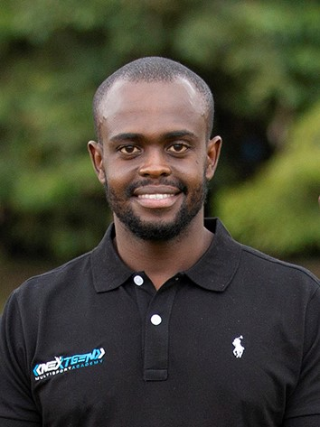
THE END
CONTACT
0706807219
drboit@nextgenkenya.com
Dr Kiptolo Boit

