Slide 1
Hormonal influences on female athletes
Dr.Muriuki charles

Slide 2
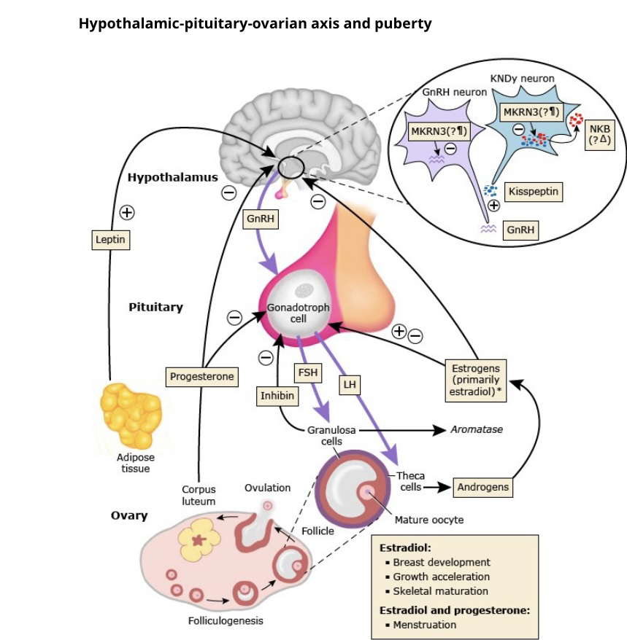

Slide 3
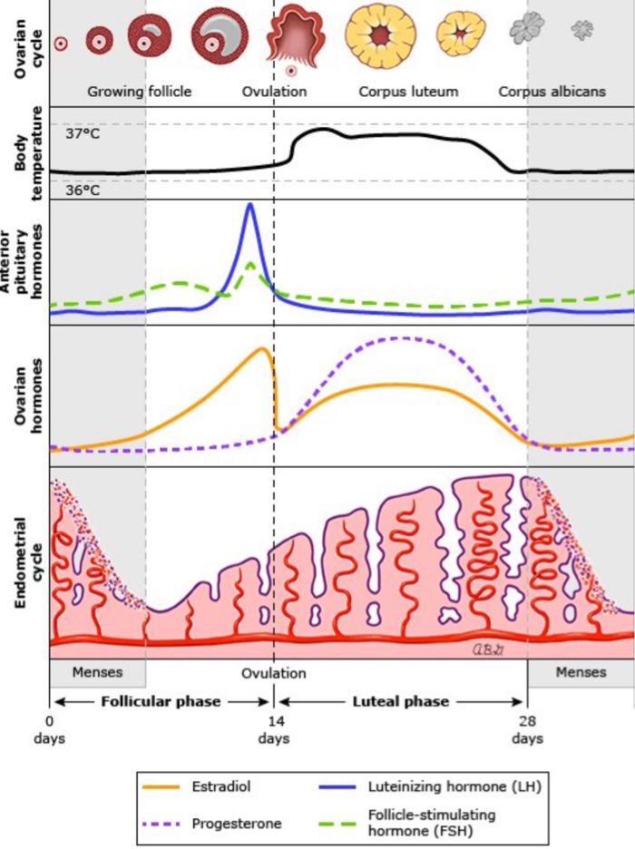

Slide 4
Menstrual cycle
Fluctuations in Estrogen and Relaxin-Correlated with increased risk of ACL injury.
Menses- Heavy flow-risk of anaemia-impairement in oxygen carrying capacity,fatigue.Symptomatic fibroids are more common in women of African descent.Menstrual pain-impairement in activity,psychological effect.
Follicular Phase-rising estrogen is associated with improved mood,strength and endurance-ideally the best time for training.
Ovulation-estrogen peak with LH surge is associated with peak performance, increased confidence and energy.
Luteal Phase-high progesterone and lower estrogen-associated with possible bloating and fatigue,mood swings and reduced endurance.

Slide 5
Contraception
Hormonal Contraception
Combined oral contraceptive pills-reduces pain and heavy flow but can cause fluid retention and reduced muscle protein synthesis
Progesterone based- some can cause weight gain,unscheduled bleeding and decreased BMD.Minimal effects with hormonal IUD-MIRENA
Non-Hormonal Contraception
Copper IUD-Can cause heavier bleeding and cramps
Condoms-no hormonal effect,no impact on performance.
Impact on performance -influenced by contraceptive choice, individual physiology and type of sport.

Slide 6
Pregnancy and Lactation
Maternal adaptations-Progesterone, estrogen and relaxin
Respiratory-physiologic dyspnoea
Cardiovascular-INCREASE in plasma volume (causing physiologic anaemia),cardiac output,heart rate(causing palpitations).DECREASE in blood pressure(causing hypotension).
Pregnancy-related changes in body weight, shape, and hormones are associated with musculoskeletal consequences, including lordosis, joint laxity, widening and increased mobility of the sacroiliac joints and pubic symphysis, and increase in the anterior tilt of the pelvis.
Common complaints-Low back pain,pelvic girdle pain, hip Pain, hand and wrist pain(carpal tunnel and DeQuervain’s),leg cramps.

Slide 7
Special considerations
Pregnancy and lactation-associated osteoporosis — Pregnancy and lactation-associated osteoporosis (PLO) is a rare condition in which women typically present with painful fractures, often vertebral, in the third trimester of pregnancy or in the early postpartum period. In a minority of cases, presentation with femoral neck fracture(s) during or after pregnancy has been described.
.

Slide 8
TRIMESTER | HORMONAL INFLUENCE | EFFECT ON PERFORMANCE
First | Rapid increase in hormones, nausea,fatigue | Decrease in stamina and concentration
Second | Hormones stabilize | Improved energy
Third | Elevated relaxin,increased weight and fatigue | Decreased mobility,balance and performance.Musculoskeletal strain
Post-Partum | Decrease in Estrogen/Progesterone | Fatigue,postpartum blues,depression
Lactation | High Prolactin,low estrogen | Low energy,reduction in BMD

Slide 9
Perimenopause/Menopause
Hormonal Changes include:
Irregular estrogen and progesterone levels-Can be associated with mood instability,sleep disturbance,hot flashes,joint aches,fatigue.
Lower testosterone-Can be associated with reduced muscle mass,lower libido and slower recovery.
All postmenopausal women should continue or adopt general lifestyle measures to reduce bone loss. Lifestyle measures include:
adequate intake of calcium and vitamin D
exercise
smoking cessation
avoidance of heavy alcohol use.
Women also should receive counseling on fall prevention and, if possible, avoid drugs that increase bone loss (eg, glucocorticoids)

Slide 10
Female athlete triad
Refers to the interrelationship between energy availability, menstrual function, and bone density. Each component of the Triad includes a spectrum.Present with features of estrogen deficiency, including low bone density, infertility, breast and possibly vaginal atrophy, and sexual dysfunction.
Energy availability – Ranges in athletes from normal to inadvertent undereating to disordered eating to a frank eating disorder
Menstrual function – Ranges from normal ovulatory cycles to luteal phase defects and anovulatory eumenorrhea to hypothalamic oligo-amenorrhea (HA).Also leads to subfertility and psychiatric disorders-mood and anxiety.
Bone density – Ranges from normal to low to frank osteoporosis due to estrogen deficiency.

Slide 11
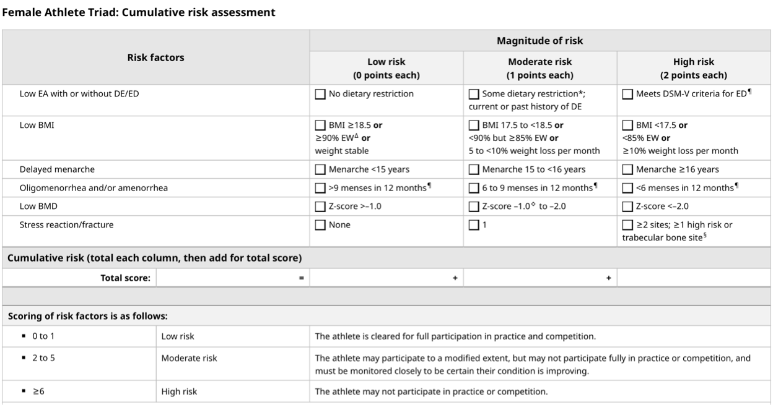

Slide 12
Female athlete triad
Treatment options
Patients with exercise-induced amenorrhea require a team approach that includes their primary care or sports medicine clinician, a sports dietitian, psychologist and/or psychiatrist (when there is an associated eating disorder), and optimally an athletic trainer, exercise physiologist, and/or coach
Adequate caloric intake for energy expenditure.
Stress reduction
Hormone therapy

Slide 13
References
UptoDate

