Slide 1
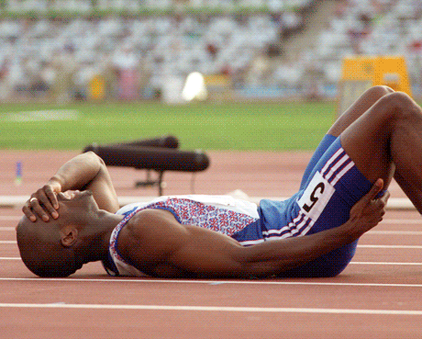
The Role of Sports Medicine in Modern Era
FASU – SYMPOSIUM 2022, Kenyatta University
Lamech Bogonko
BSc (Hons) MSc Sports Physio
Cert Sports Medicine, UWC, CPT
South Africa

Slide 2
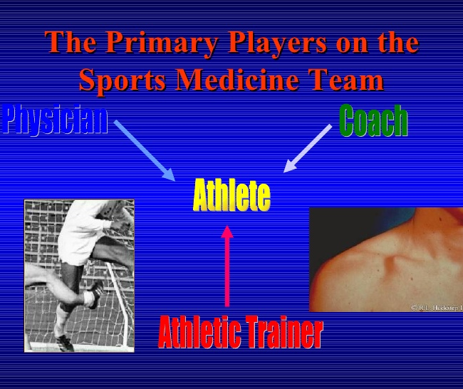
Sports Medicine
Family physician
Physiotherapist
Sports physician
Massage therapist
Athletic trainer
Orthopedic surgeon
Radiologist
Podiatrist
Psychologist
Dietitian/nutritionist
Exercise physiologist
Coach
Fitness advisor

Slide 3
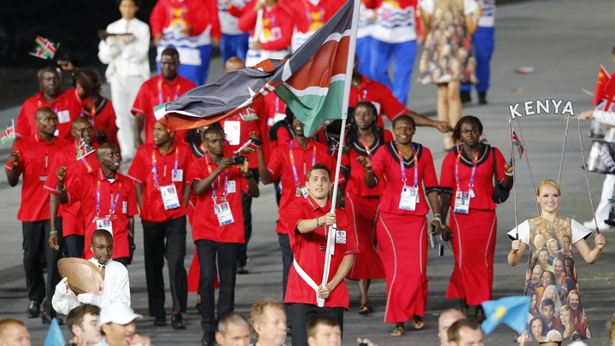
Wide range of sports disciplines
Soccer
Track & Field
Boxing
Hockey
Soft ball
Tennis
Rugby
Cycling
Motor sport

Slide 4
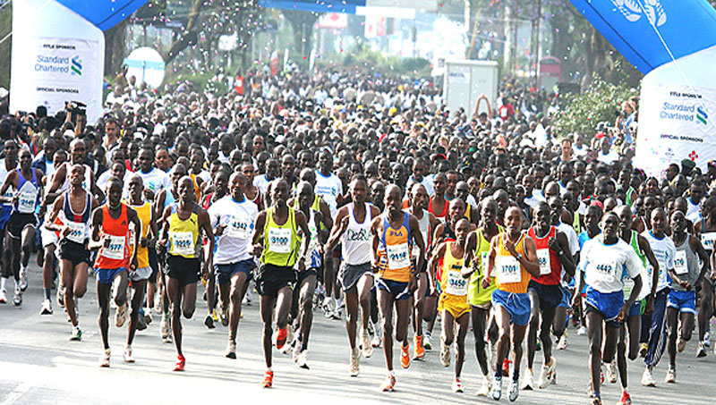

Slide 5
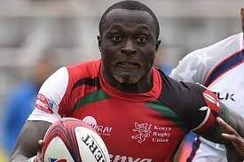
https://www.youtube.com/watch?v=sYUKLMwTfiM

Slide 6
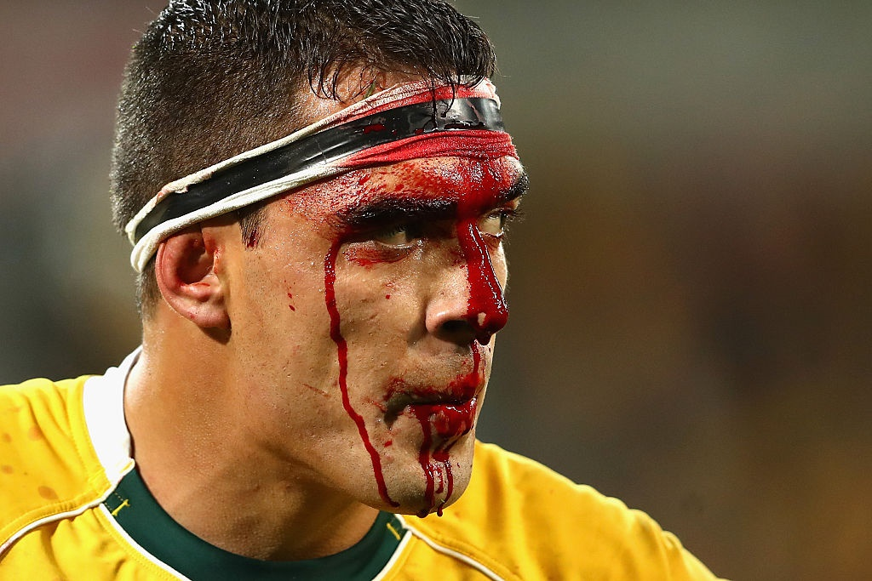
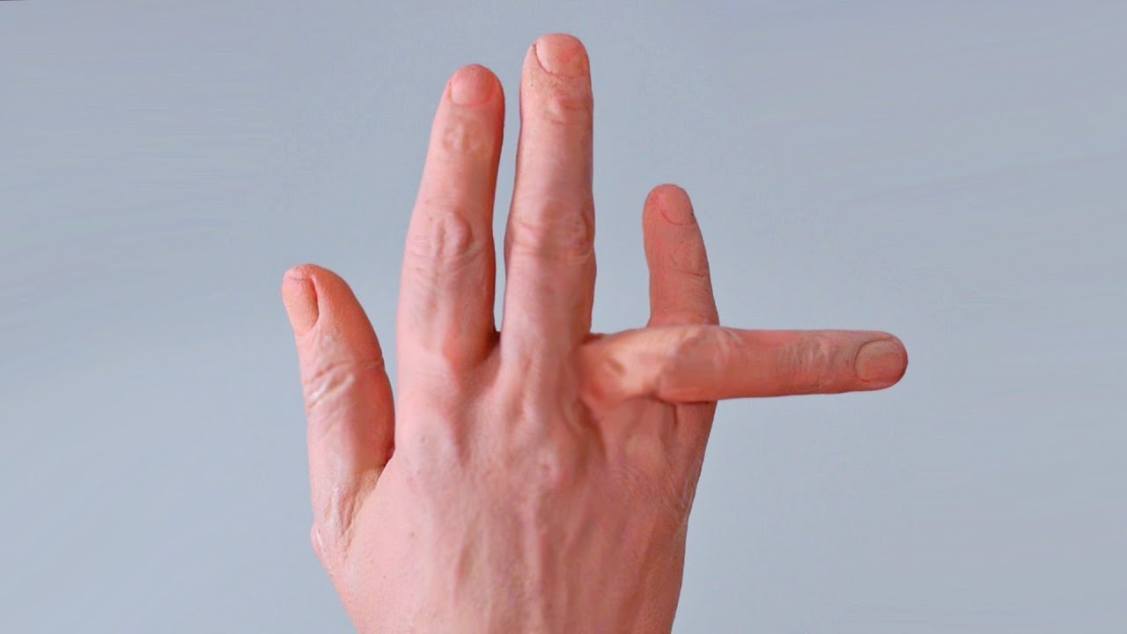
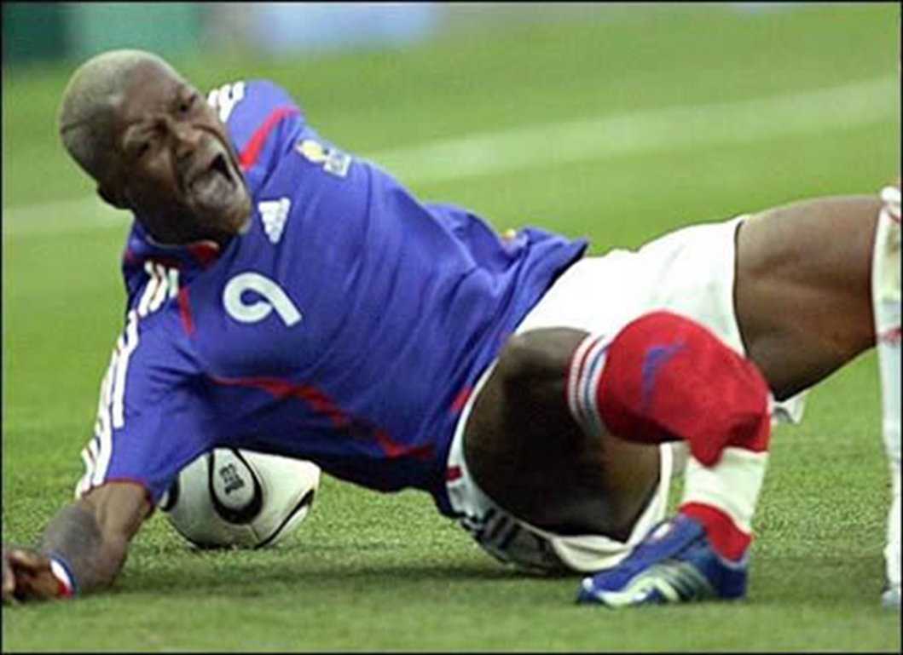
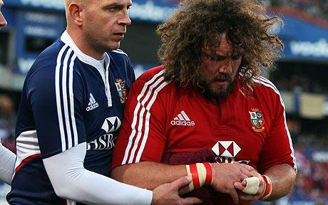

Slide 7
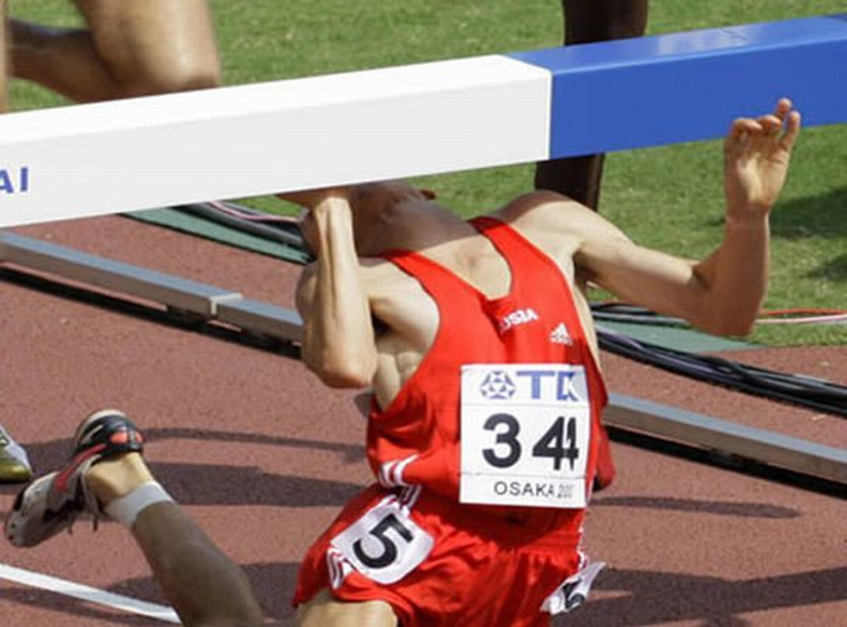

Slide 8
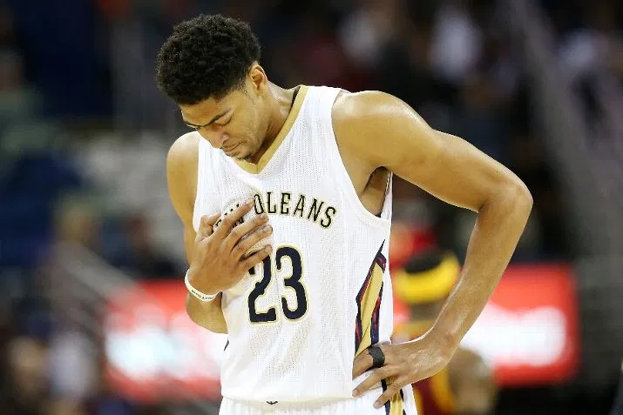
Think Cardiac Arrest

Slide 9
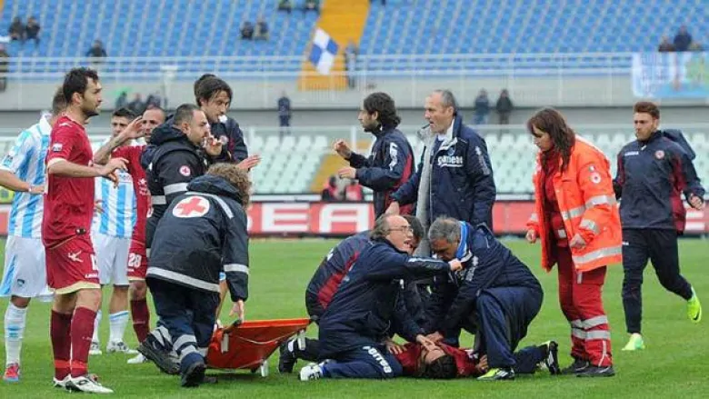

Slide 11
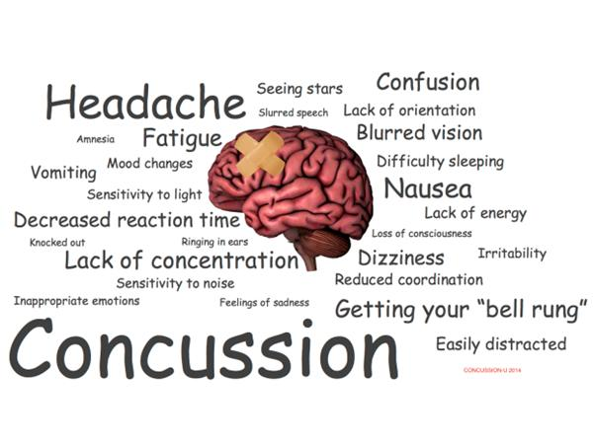
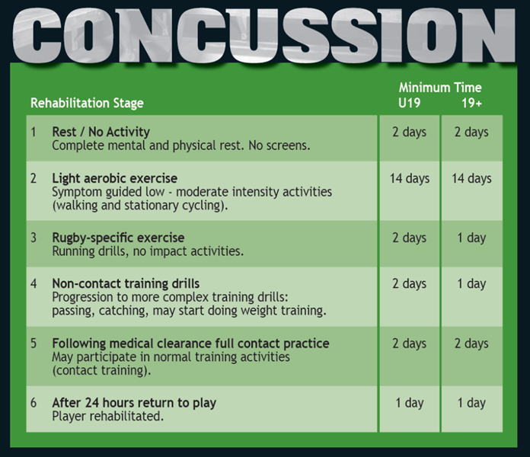
GRTP (HIA1/2/3
Concussion in Sport

Slide 12


Slide 13
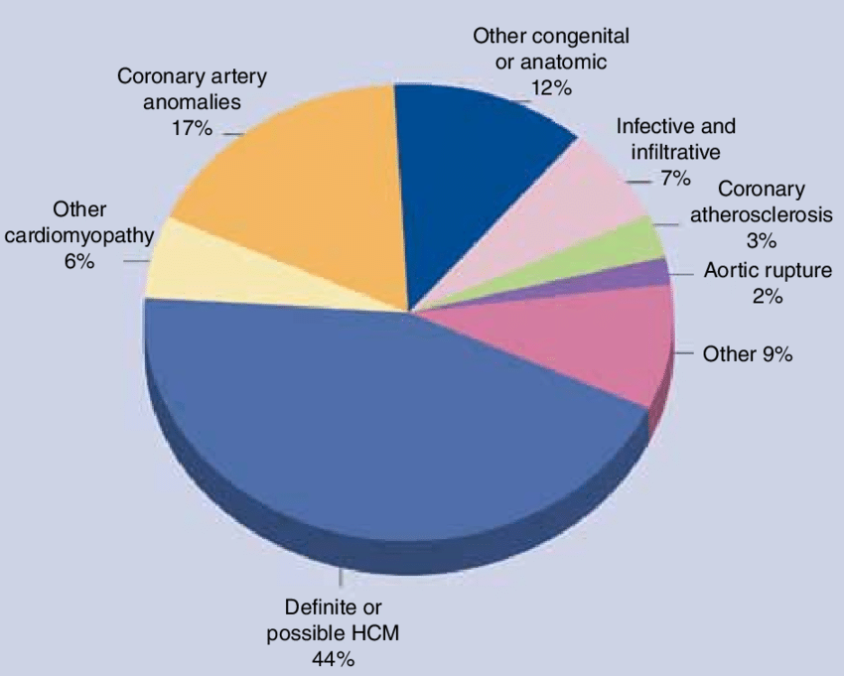
Hypertrophic Cardiomyopathy

Slide 15
Notes:
2.1, 6.17

Slide 16
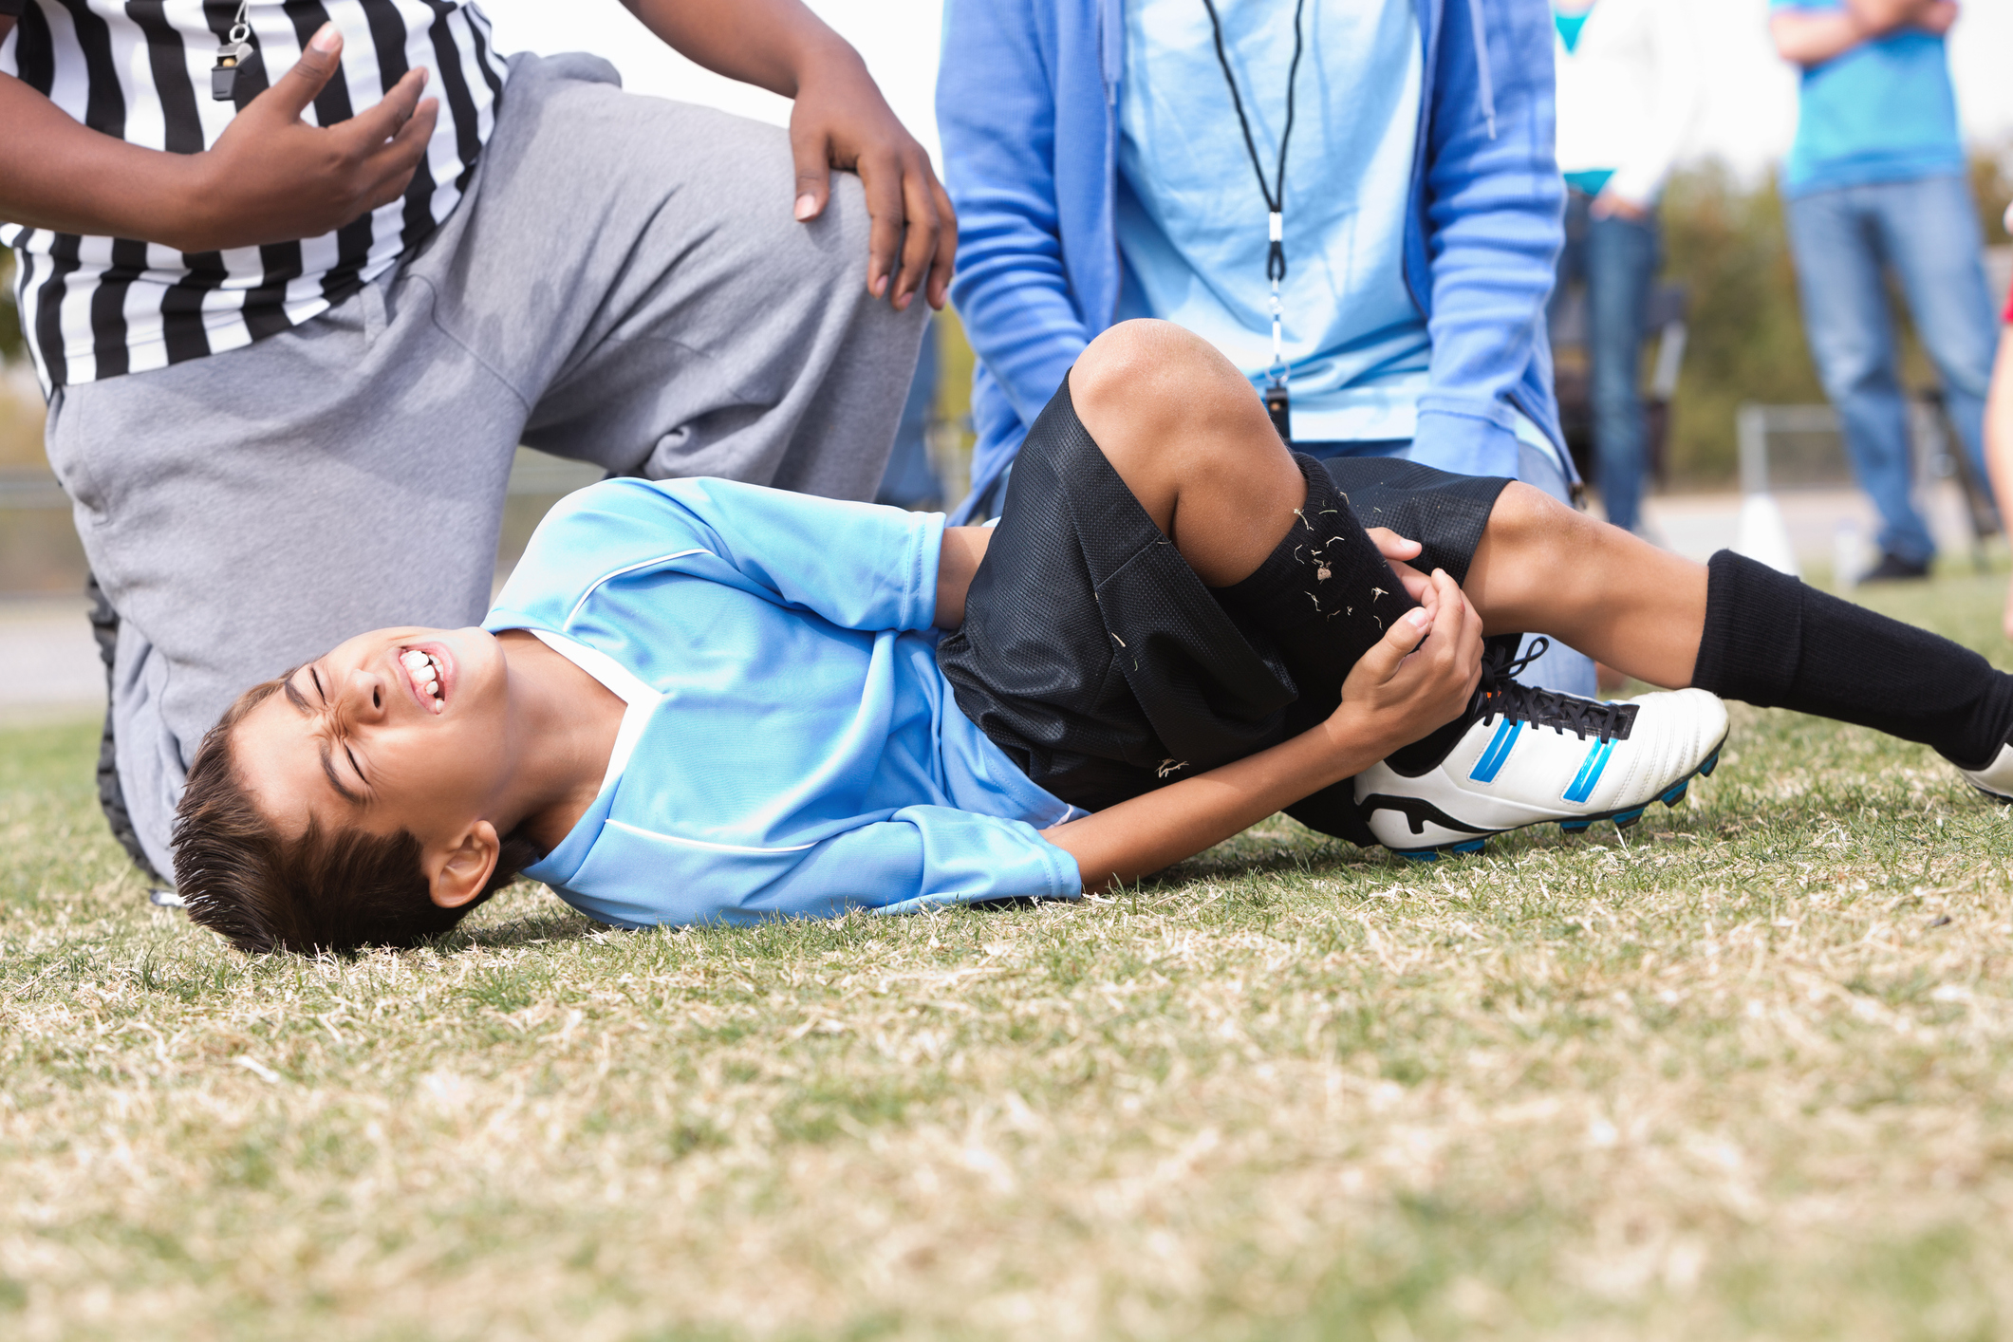

Slide 17
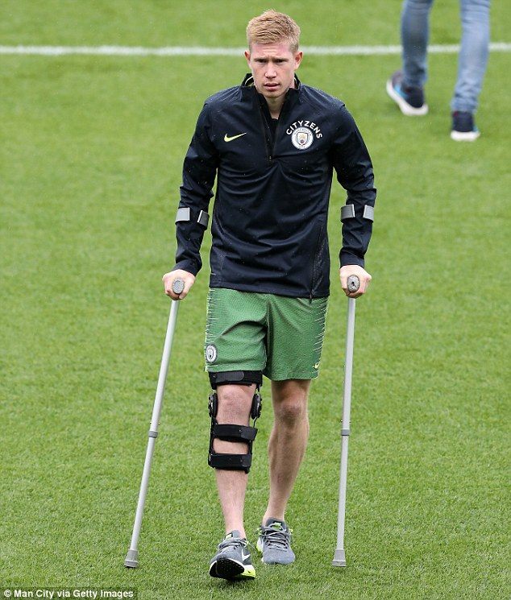
Sports Injury Rehabilitation Phases
Phase 1: Acute Management/Early Motion and Basic Movement Retraining (1- 4 weeks)
Phase 2: Basic Strength and Proprioception
(2-6 weeks)
Phase 3: Dynamic Neuromotor Strength, Endurance and Coordination (6-8 weeks)
Phase 4: Athletic Enhancement and Return to Activity (RTT) (12-16 Weeks)
Phase 5: Sports Perfomance and Injury Prevention (RTP) (16> Weeks)

Slide 18
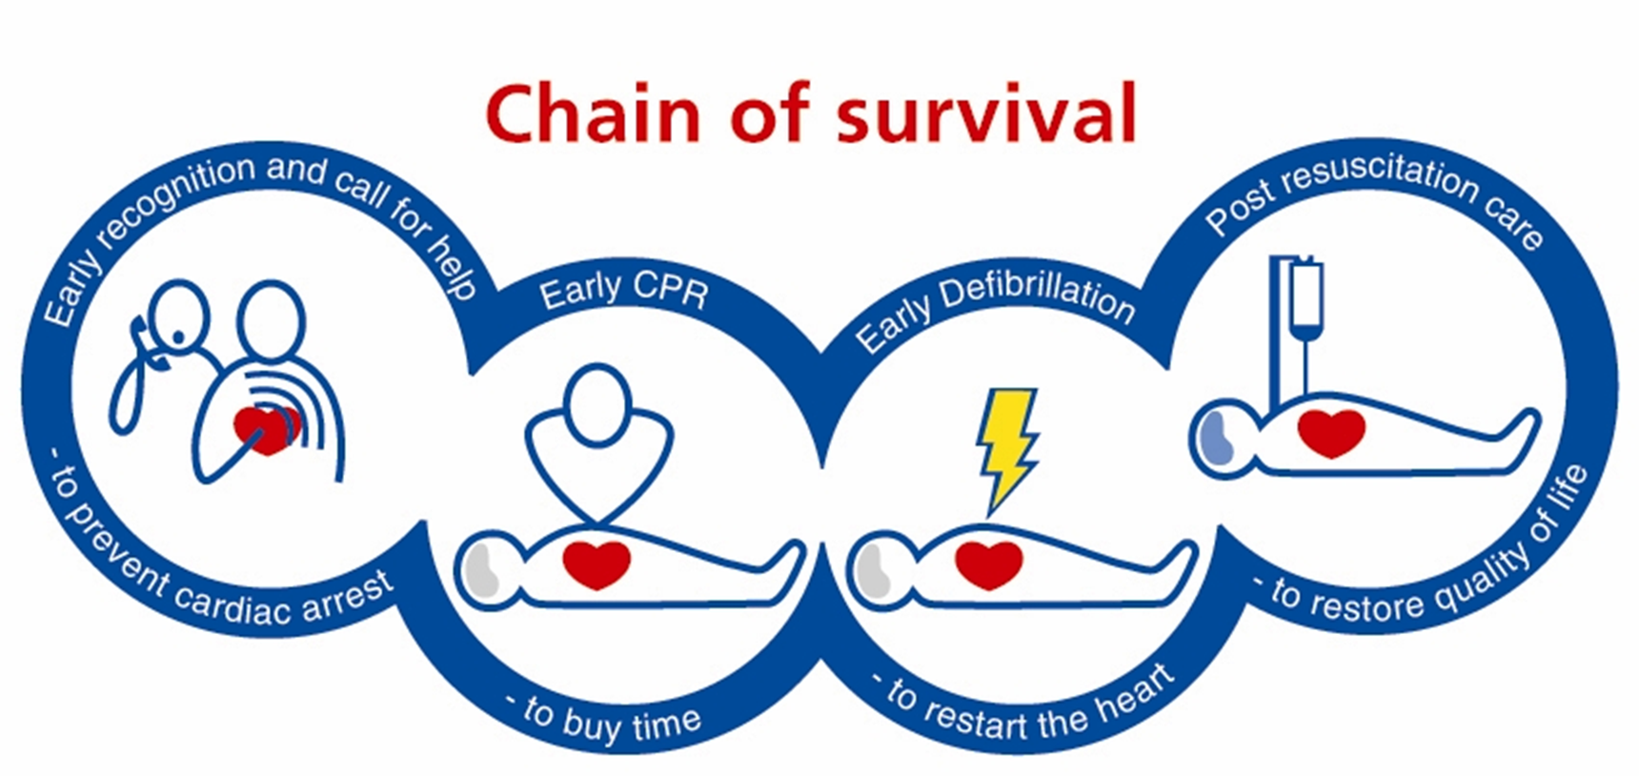

Slide 19
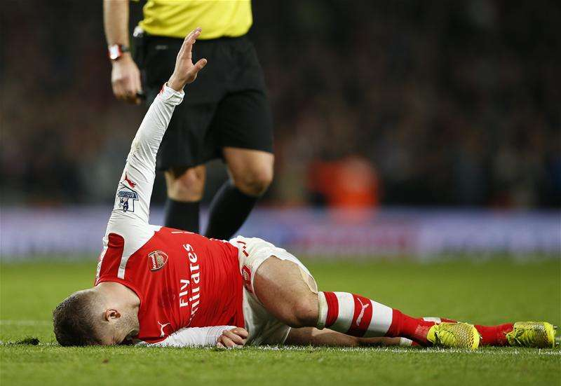
The athlete`s journey…………………….
Pre-incident
Incident
Immediate care
Transportation
Emergency care
Damage control
Definitive care
Rehab

Slide 21


Slide 22
Possible injuries/ illnesses………….
Bleeding- External/ Internal
Cranial- Epidural/Subdural
Cardiac- MI, Angina
Musculo-skeletal - strains, sprains, fractures, dislocations
Respiratory- Fractures, pneumothorax, haemothorax, PE
Medical Emergencies- Asthma, epilepsy, DM, Heat stroke, Near drowning,

Slide 23
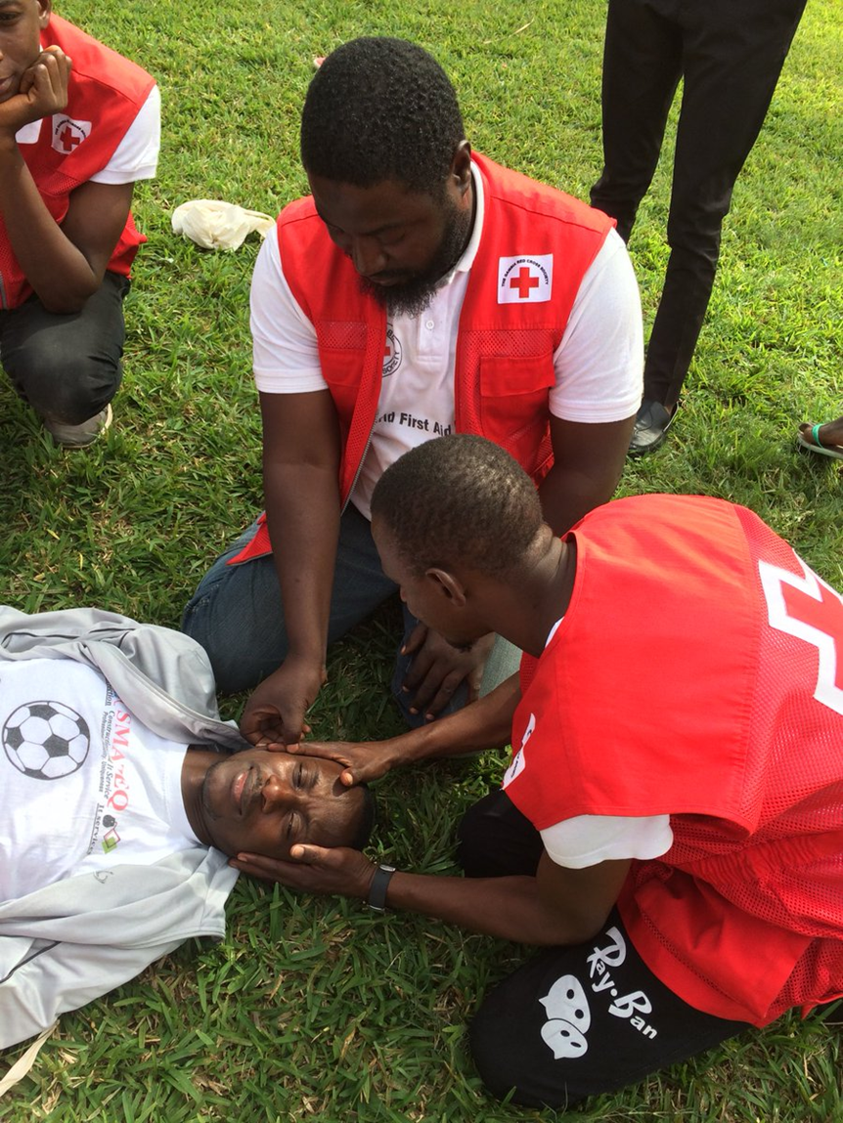
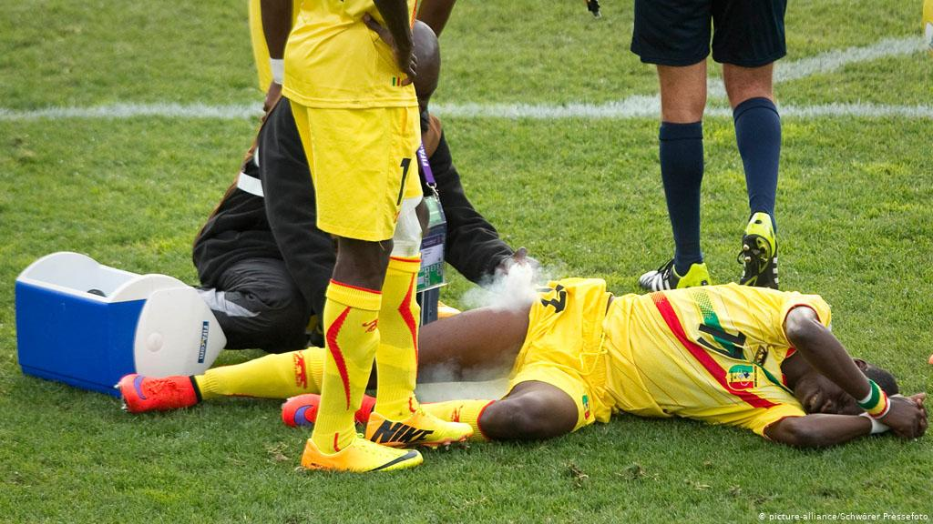
Immediate Care

Slide 24
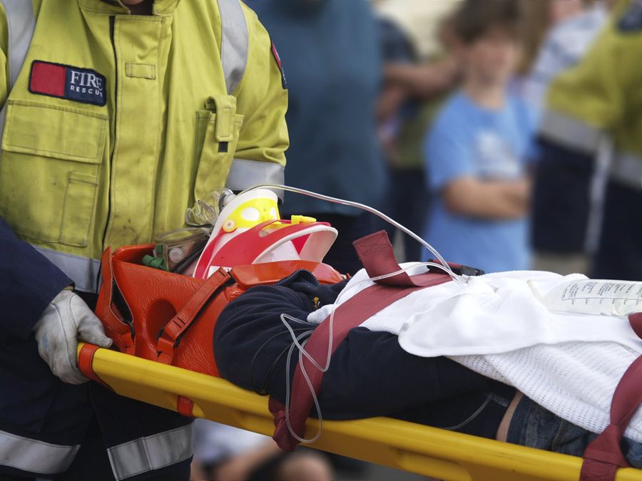
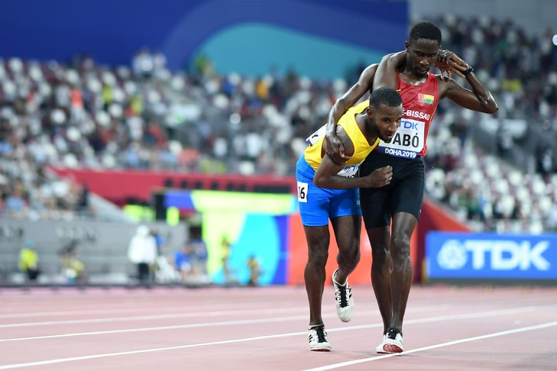
Safe Movement

Slide 25
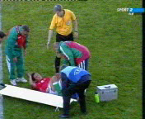
Improper planning and debrief

Slide 26
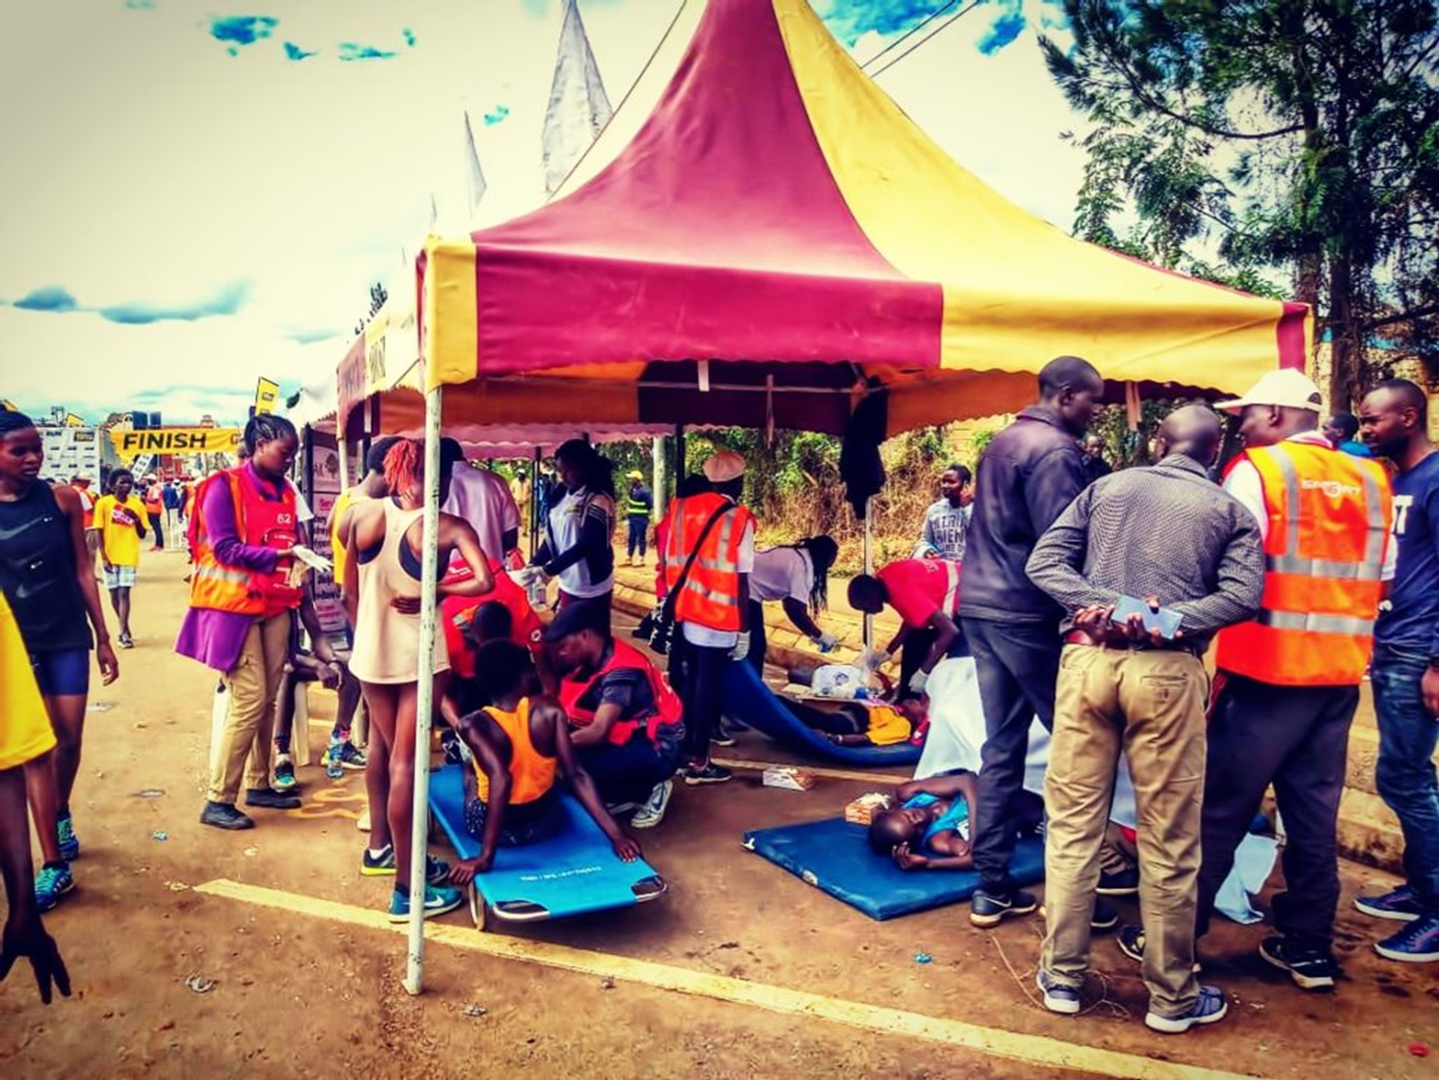

Slide 27
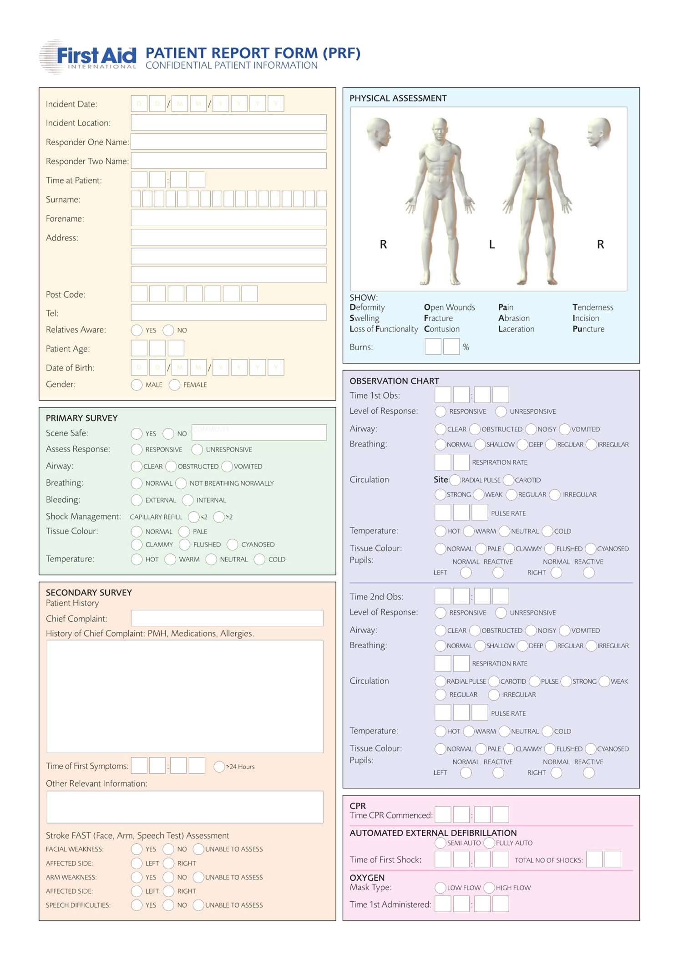
Record of Care……..

Slide 28
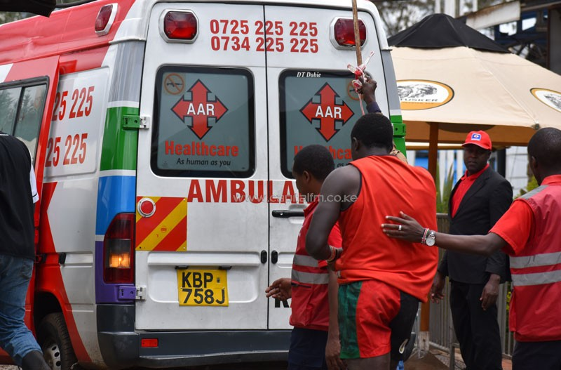
Transportation

Slide 29
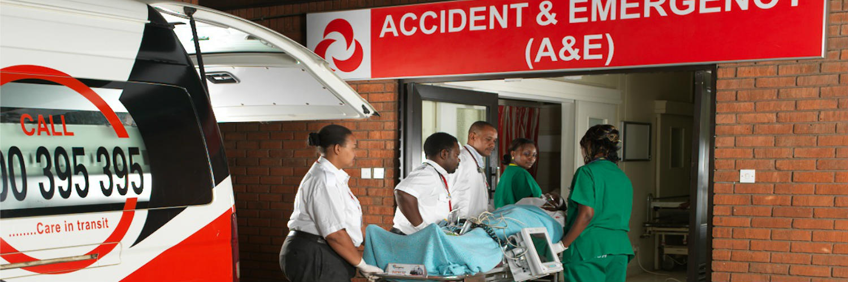

Slide 30
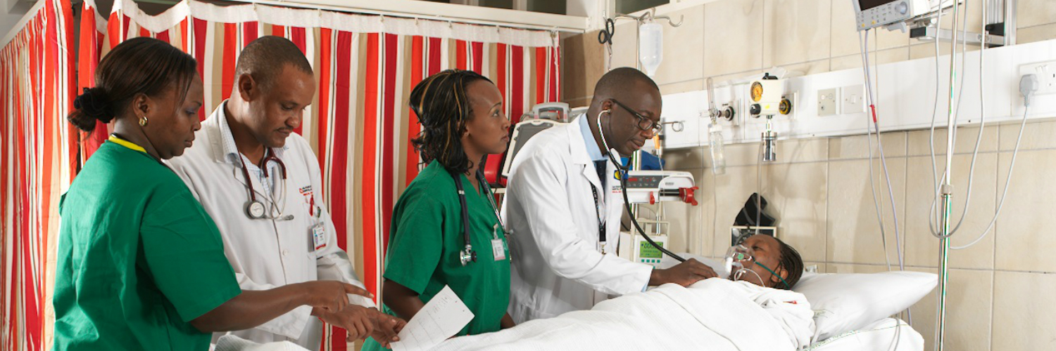
Hand over management…….

Slide 31
Record of Care……..

Slide 33
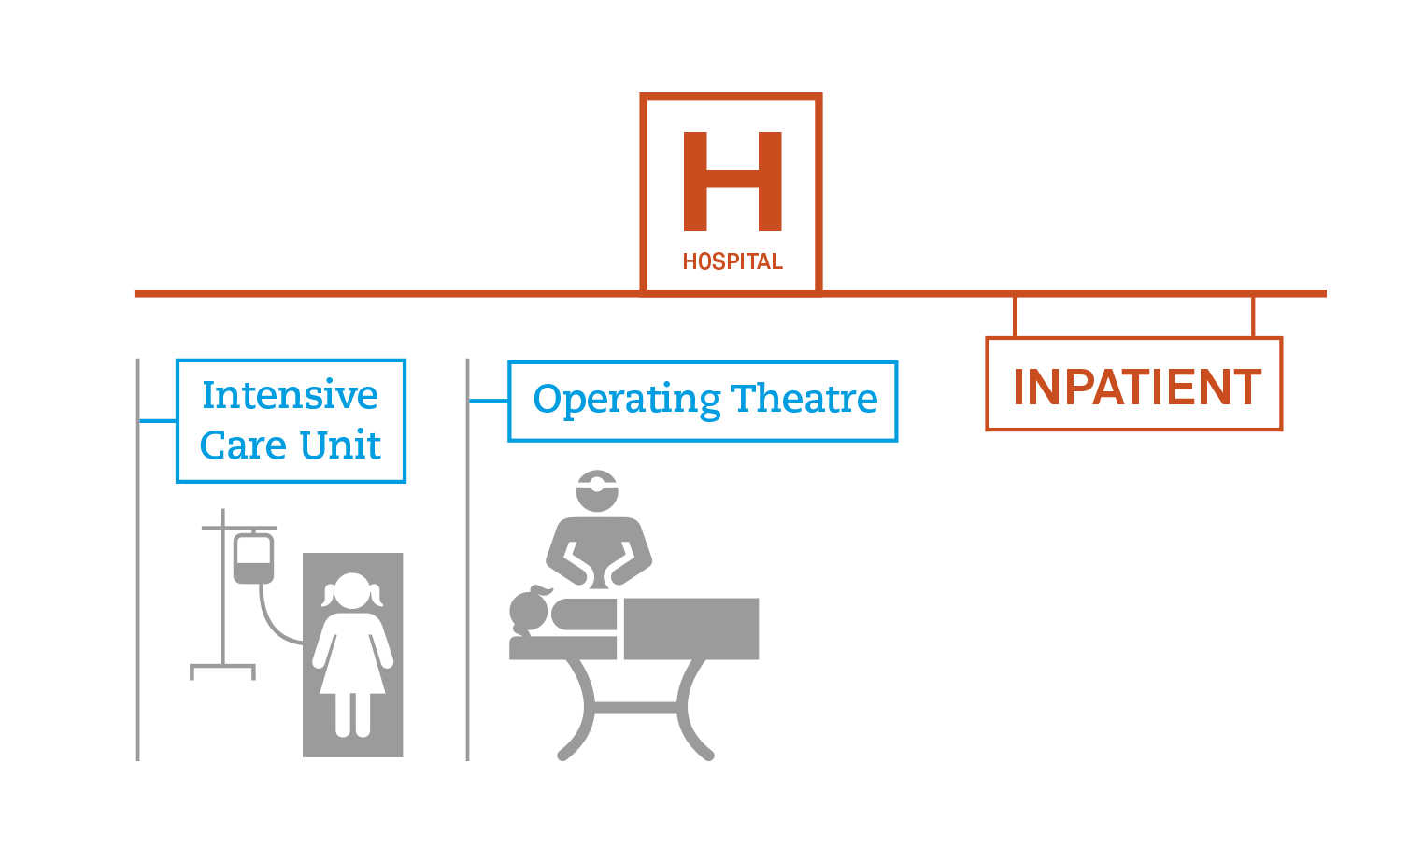
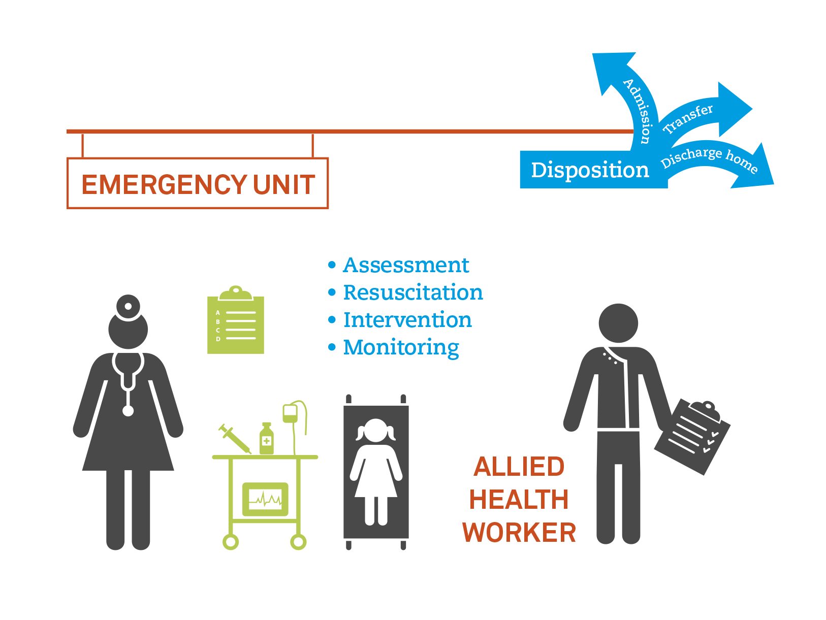
Emergency care at Hospital

Slide 34
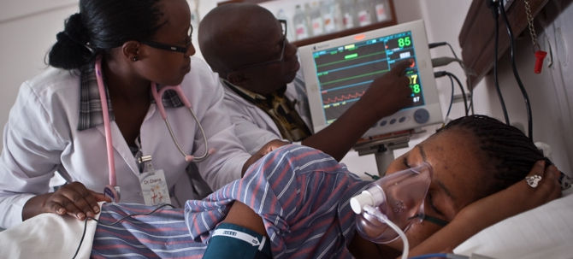
Emergency Unit phase…………
Assessment
Resuscitation
Intervention
Monitoring

Slide 35
Definitive care
Team
Injury- Surgeons, Ortho, Neuro, OMF, Dental
Decisions ??? Surgeon, Physio, Sports physician
Damage control Vs Reconstruction

Slide 36
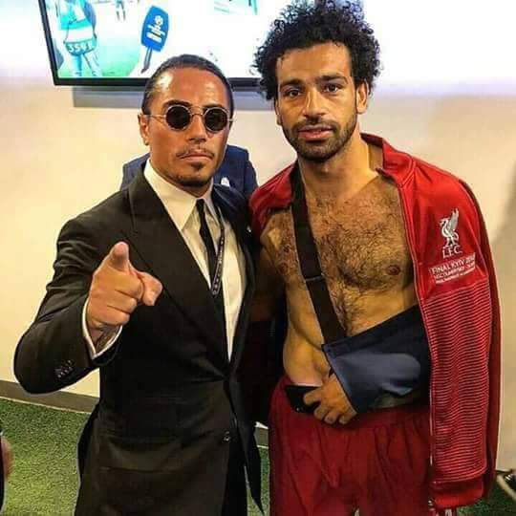
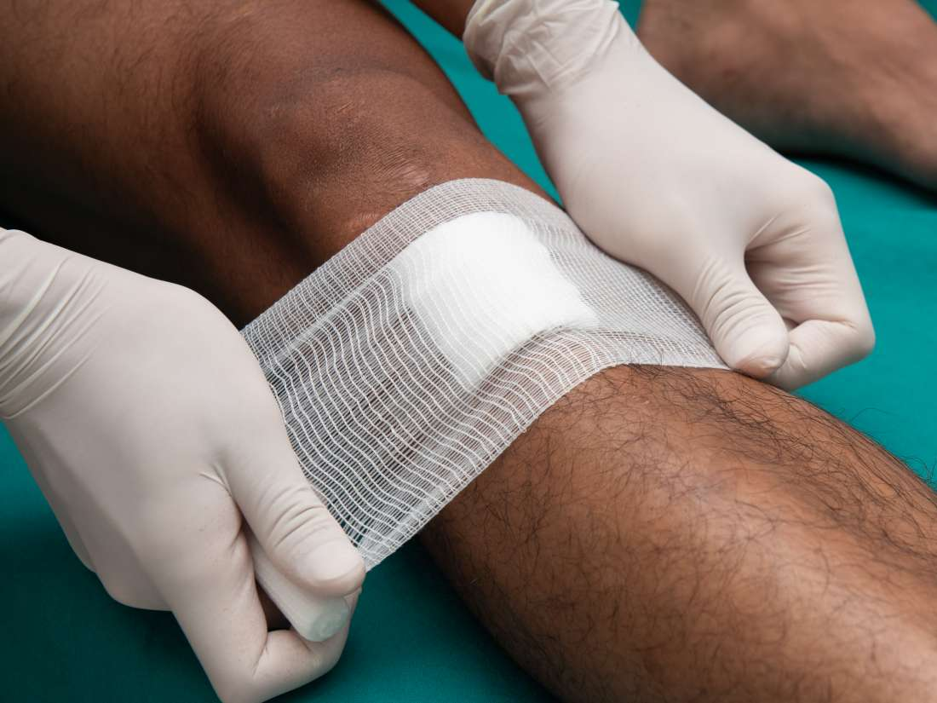

Slide 37
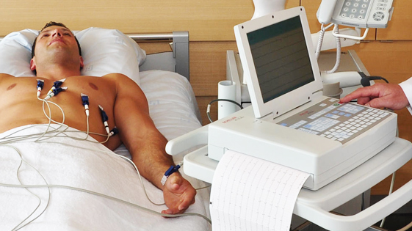
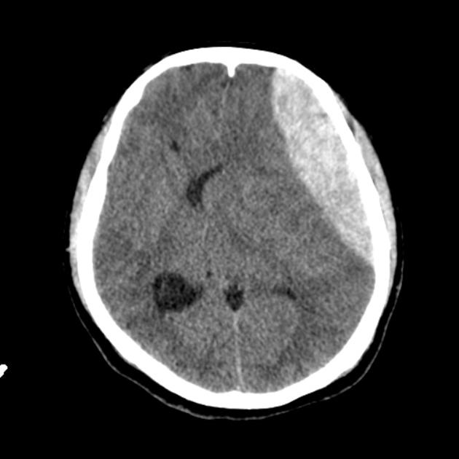
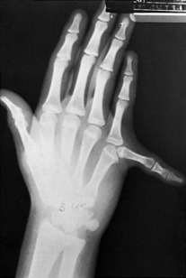

Slide 38

Unique considerations for definitive care..
To cut ……..or not to cut???
Athlete
Athlete Medical Team:
physio, sports physician
Hospital team:
ED, Surgical, Cardio

Slide 39
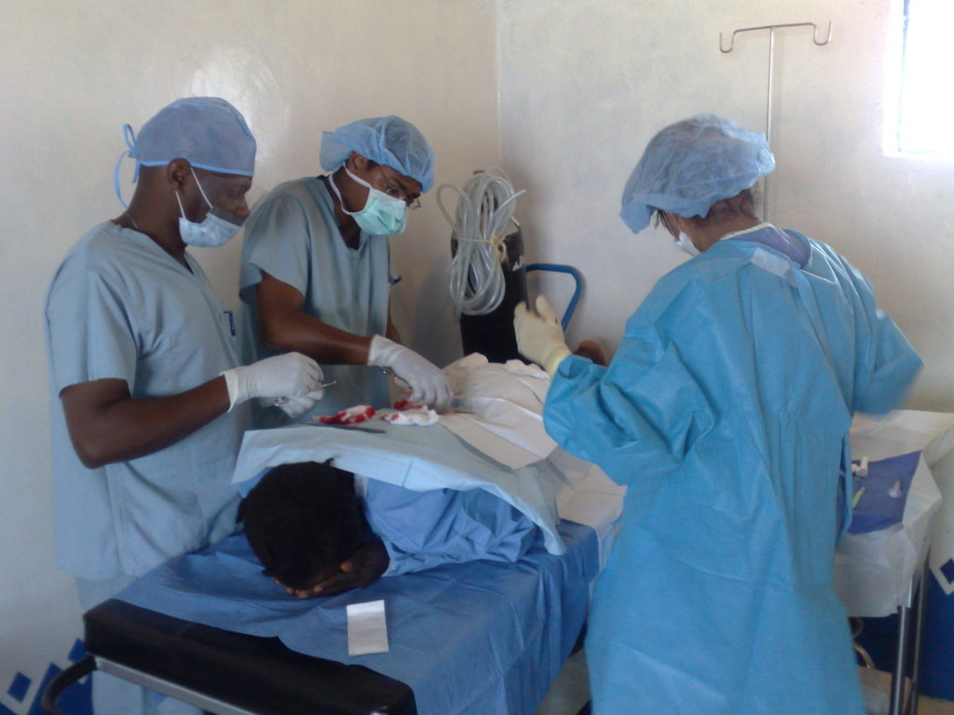

Slide 40
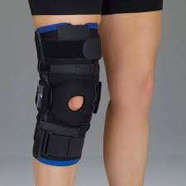
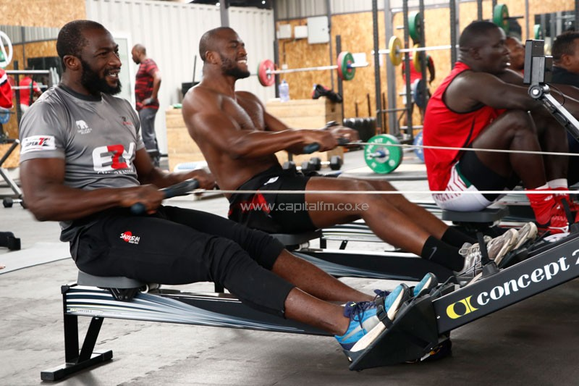
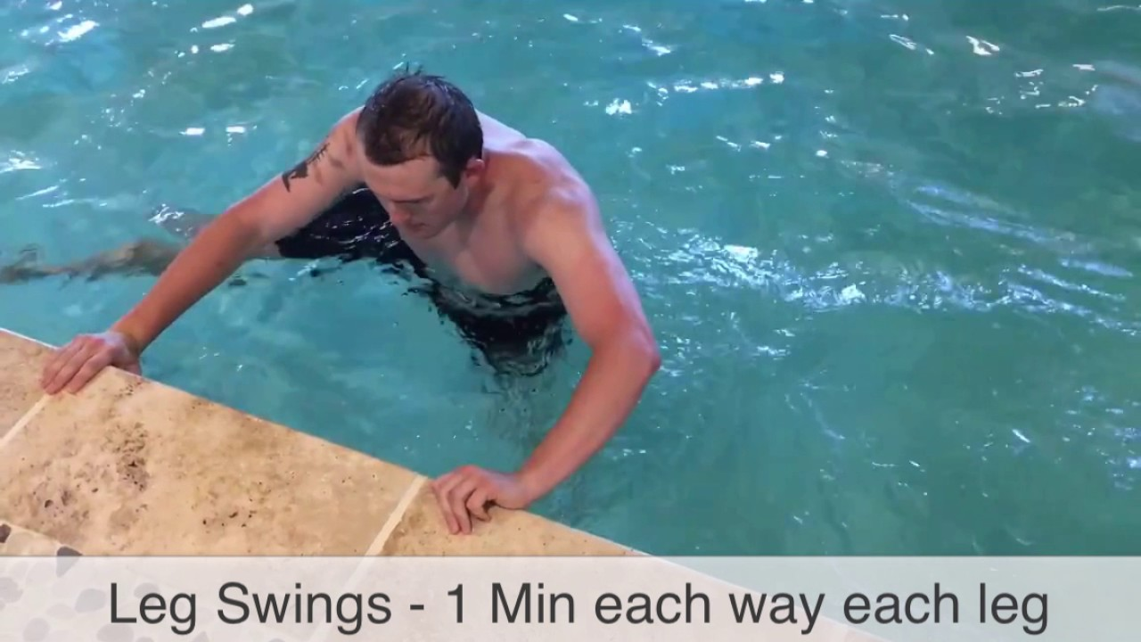
Rehabilitation and Follow up…………

Slide 41
