Slide 1
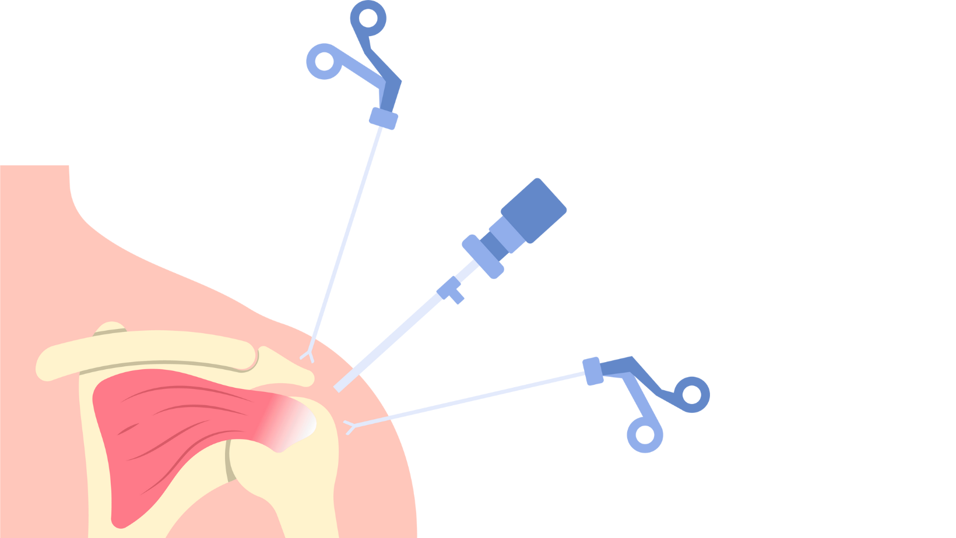
Current trends in shoulder instability surgery
Dr Eva Langat
Consultant Orthopedic Surgeon
Sports medicine Fellow

Slide 2
Outline
Anterior shoulder instability surgeries:
  Soft tissue procedures
  Bony block procedures
Posterior shoulder instability management:
  Soft tissue procedures
  Bony procedures
Multidirectional shoulder instability surgery
Notes:
Anteriors 95-97% , Posterior 2-4%, MDI

Slide 3
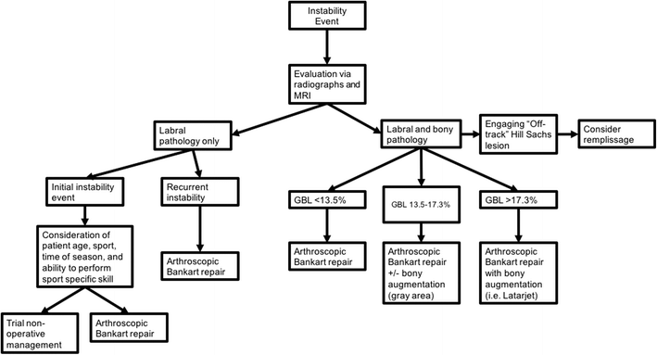
Anterior shoulder instability
Notes:
Bankart failure rate 5-15% at 6-14yr follow-up
Arthroscopic bankart recurrence as high as 26% vs open: open restores capsulolabral complex, retentioning the pathologogic capsule by plication and manage rotator interval lesions ( better capacity to resist high stress in collision sports

Slide 4
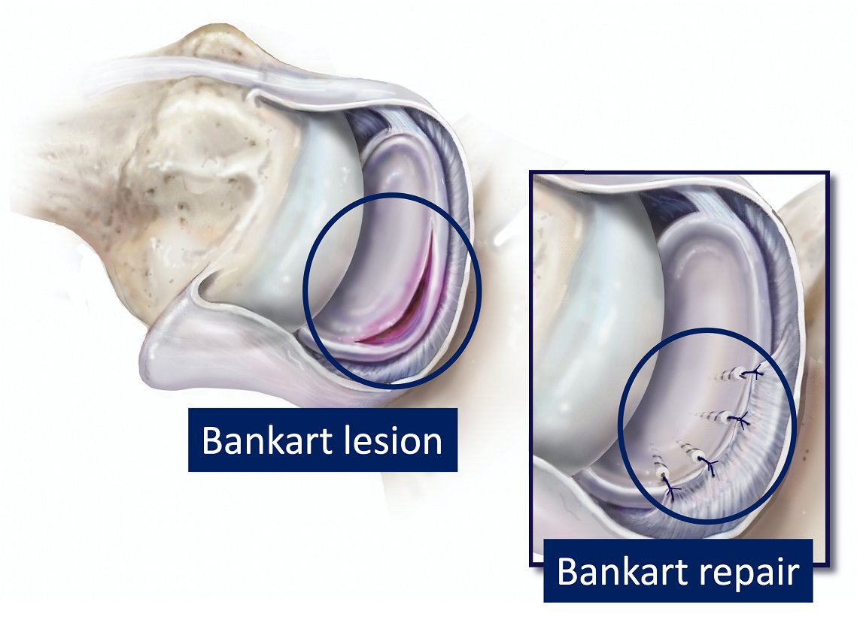
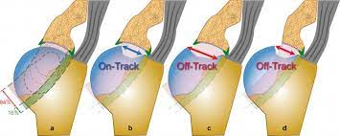
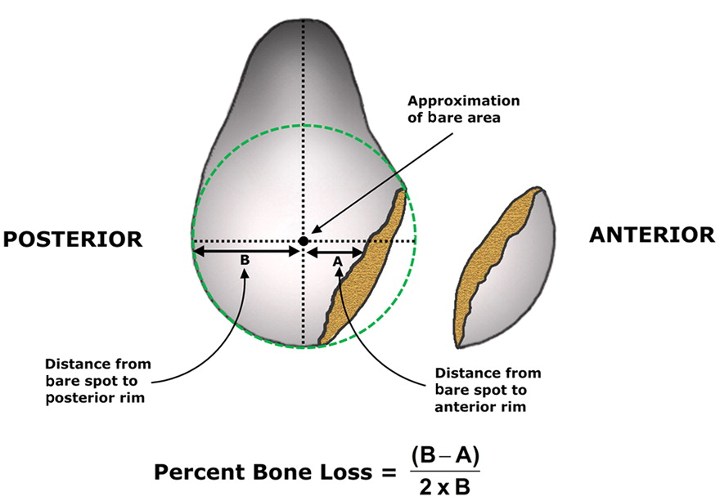
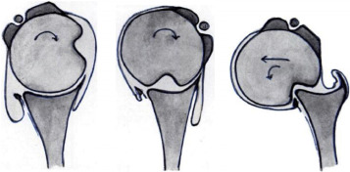
Key concepts
Notes:
On-track, off track and GBL %
GBL: Surface area of glenoid bone loss was defined as low- (≤10% GBL), moderate- (11%-20% GBL), and high-grade (≥20% GBL). These values were arbitrarily based on previous anterior shoulder instability literature suggesting that critical or clinically relevant bone loss can occur anywhere from 13.5% to 25%.

Slide 5
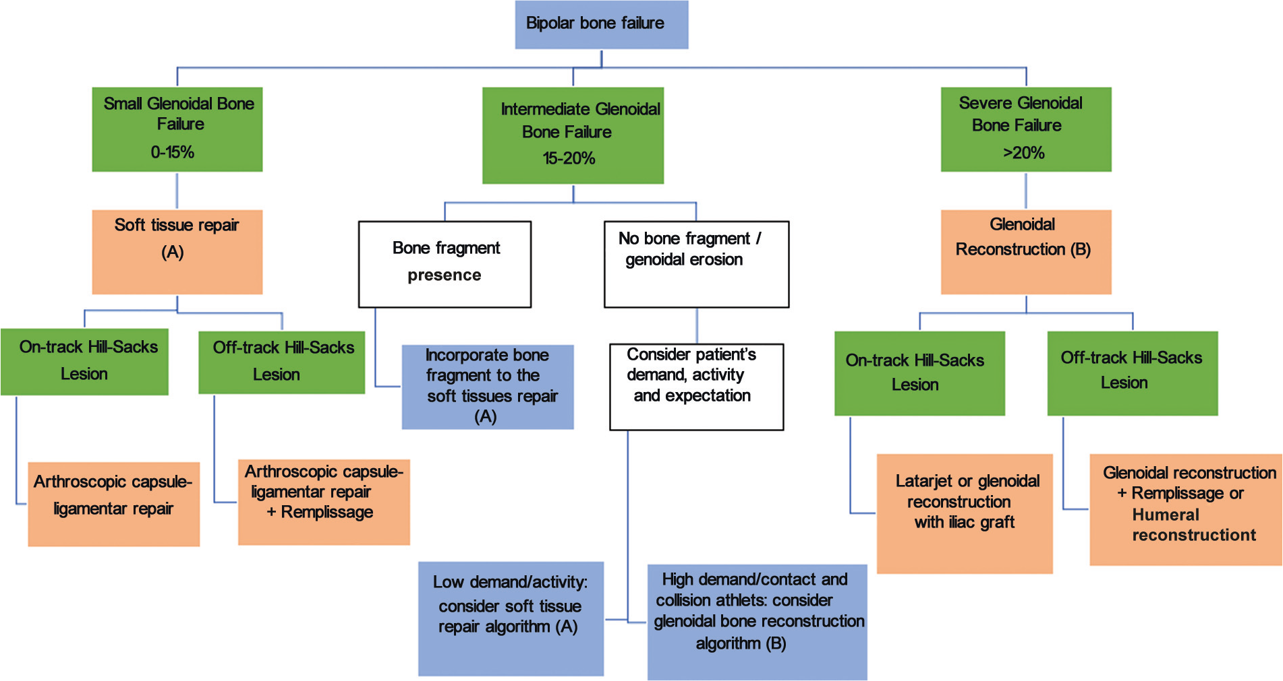
Notes:
Indications: revision surgery, Prior coracoid fracture,

Slide 6
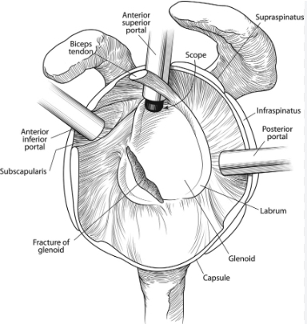
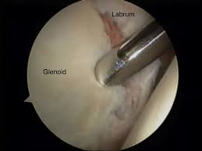
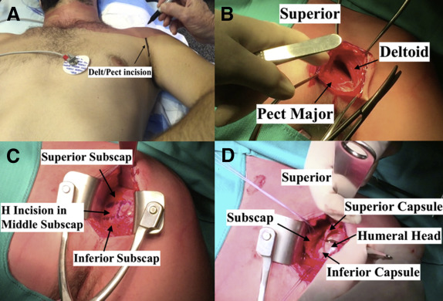
Soft tissue Repair
Bankart Repair: Open vs arthroscopic
Notes:
Open: bigger scar, higher post-op morbidity/pain, ROM reduction
Arthroscopic bankart recurrence as high as 26% vs open: open restores capsulolabral complex, retensioning the pathologogic capsule by plication and manage rotator interval lesions ( better capacity to resist high stress in collision sports)

Slide 7
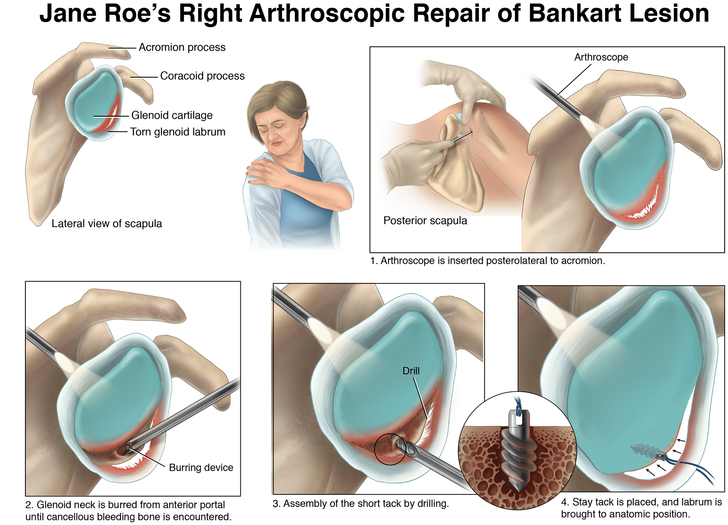
Notes:
Minimum 3 anchors ( 4 are preferred). Lowest at 5:30position
Bankart failure rate 5-15% at 6-14yr follow-up
Arthroscopic bankart recurrence as high as 26% vs open: open restores capsulolabral complex, retensioning the pathologogic capsule by plication and manage rotator interval lesions ( better capacity to resist high stress in collision sports)

Slide 8
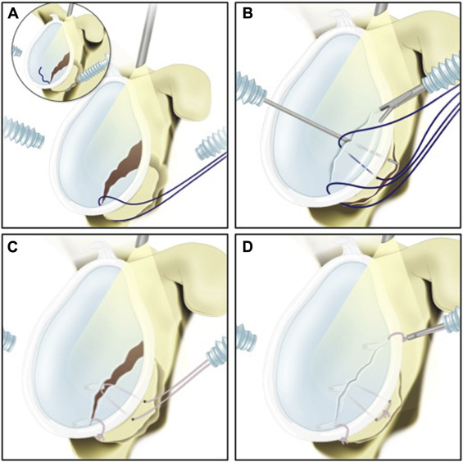
Bony Bankart Lesion Management

Slide 9
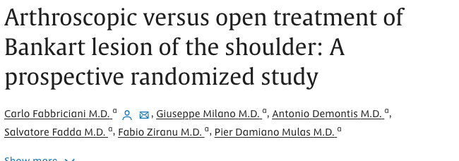
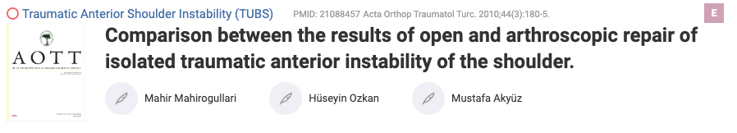
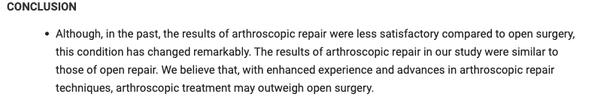
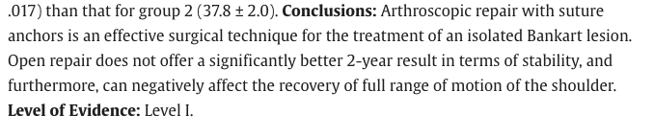
Notes:
Arthroscopic bankart recurrence as high as 26% vs open
Open vs arthroscopic: higher recurrence rate in the arthroscopic group, Not deemed statistically significant.

Slide 10
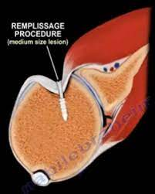
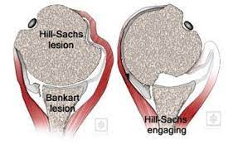
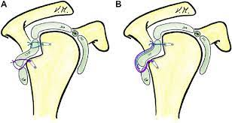
Bankart Repair + Reimplissage
  Indicated for Bankart lesion with an off-track hill sach lesion and minor/subcritical Glenoid bone loss.
  Posterior capsulodesis and infraspinatus tenodesis
Notes:
Bankart + Reimplissage “4* reduction in recurrence compared to bankart alone
Disadv: ER limitation in abduction

Slide 11
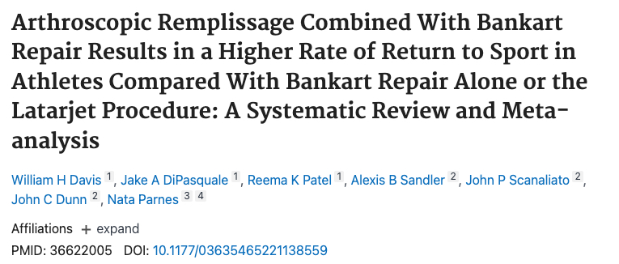

Notes:
538 athletes: 86% RTS
2-9deg loss of ER: not clinically/statistically significant

Slide 12
Bony block procedures/Glenoid reconstruction procedures
Notes:
Bone loss greater than 25%Primary vs revision surgery
Open vs arthroscopic

Slide 13
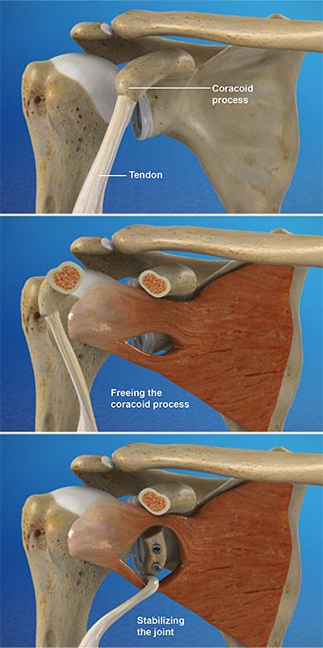
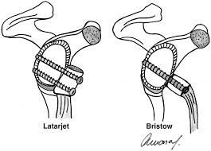
Latarjet Procedure
Notes:
Open vs arthroscopic
Triple effect: bone block restores glenois bone loss, Conjoined tendon sling effect limits anterior humeral head anterior translation in abduction and ER, CA ligament stump attached to the medial capsule gives the ligament effect
RF for poor results: Atraumatic dislocation ( failure rate 5* higher), bilateral dislocation (4* chance of recurrence), female patient (3*- anatomy, smaller glenoid)

Slide 14
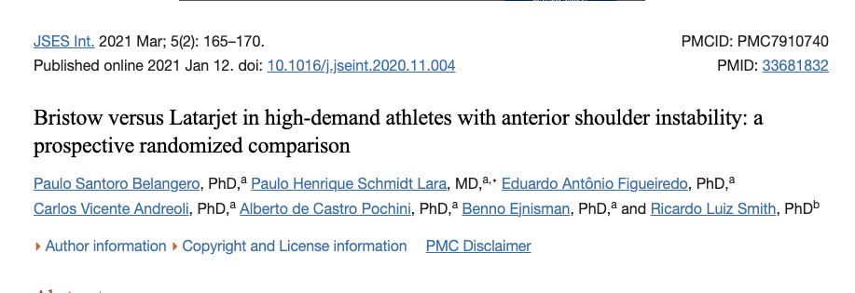
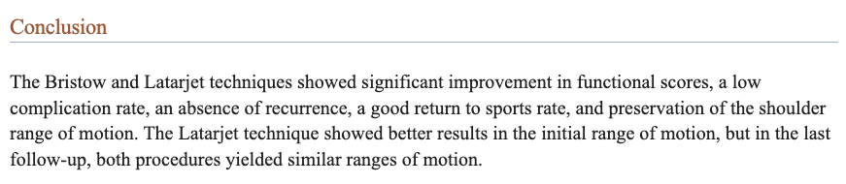

Slide 15
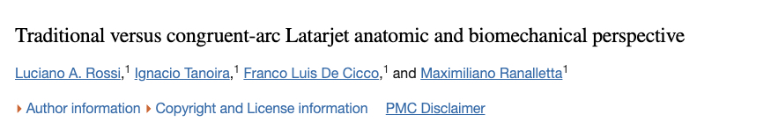
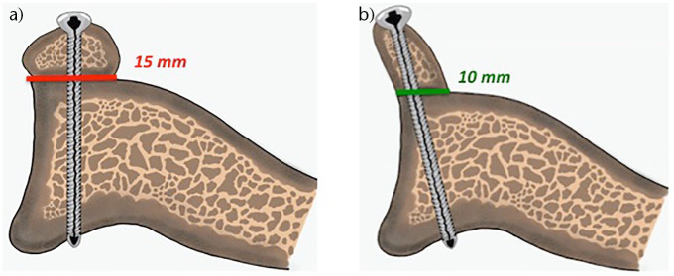
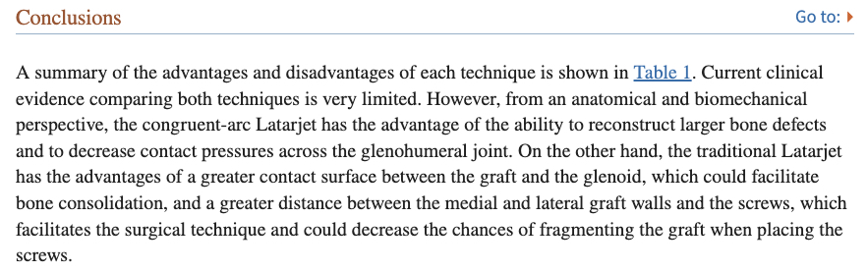
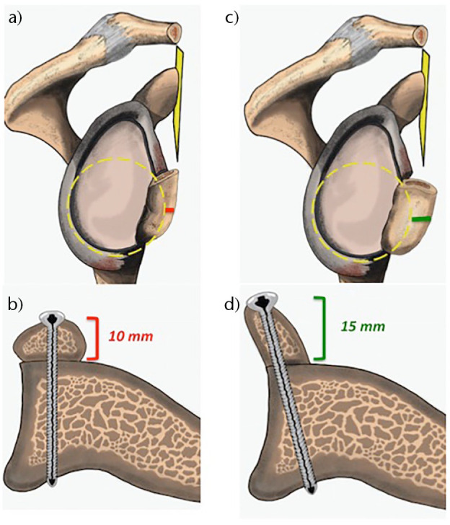
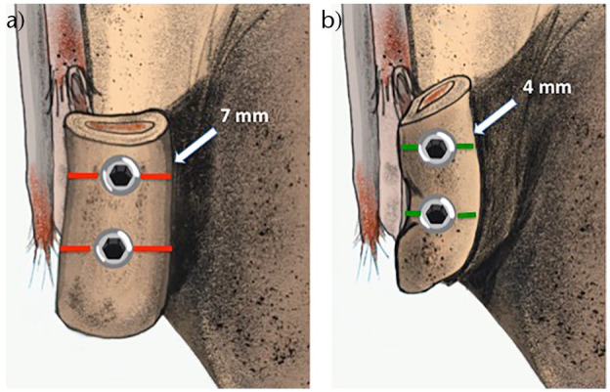
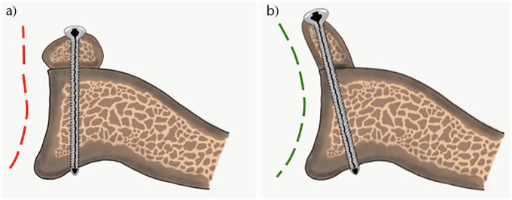

Slide 16
Bone Graft:
Notes:
Iliac crest, tibia, femur, scapular spine
Open vs arthroscopic ( arthroscopic is fully intra-articular no compromise to the subscapularis ( suture button fixation)
2018 study following 26 ptns for 29months- no redislocations
Sensory disturbances in donor site in ICBG
The congruent-arc Latarjet (CAL) allows reconstruction of a greater percentage of glenoid bone deficit because the inferior surface of the coracoid is wider than the lateral edge of the coracoid used with the traditional Latarjet (TL).

Slide 17
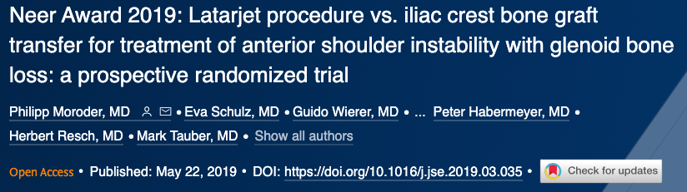
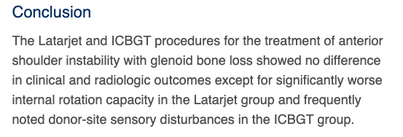

Slide 18
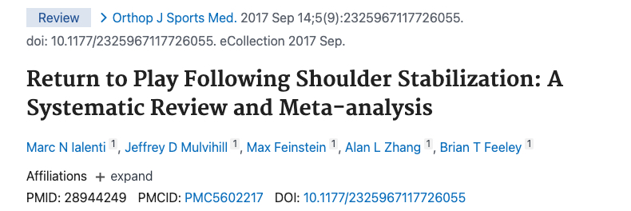
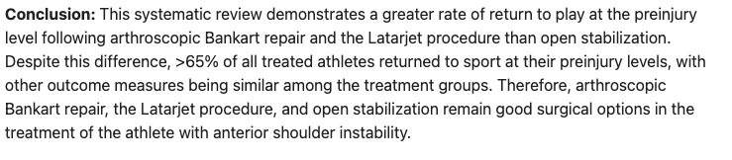

Slide 19
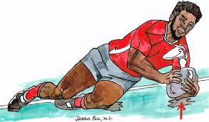
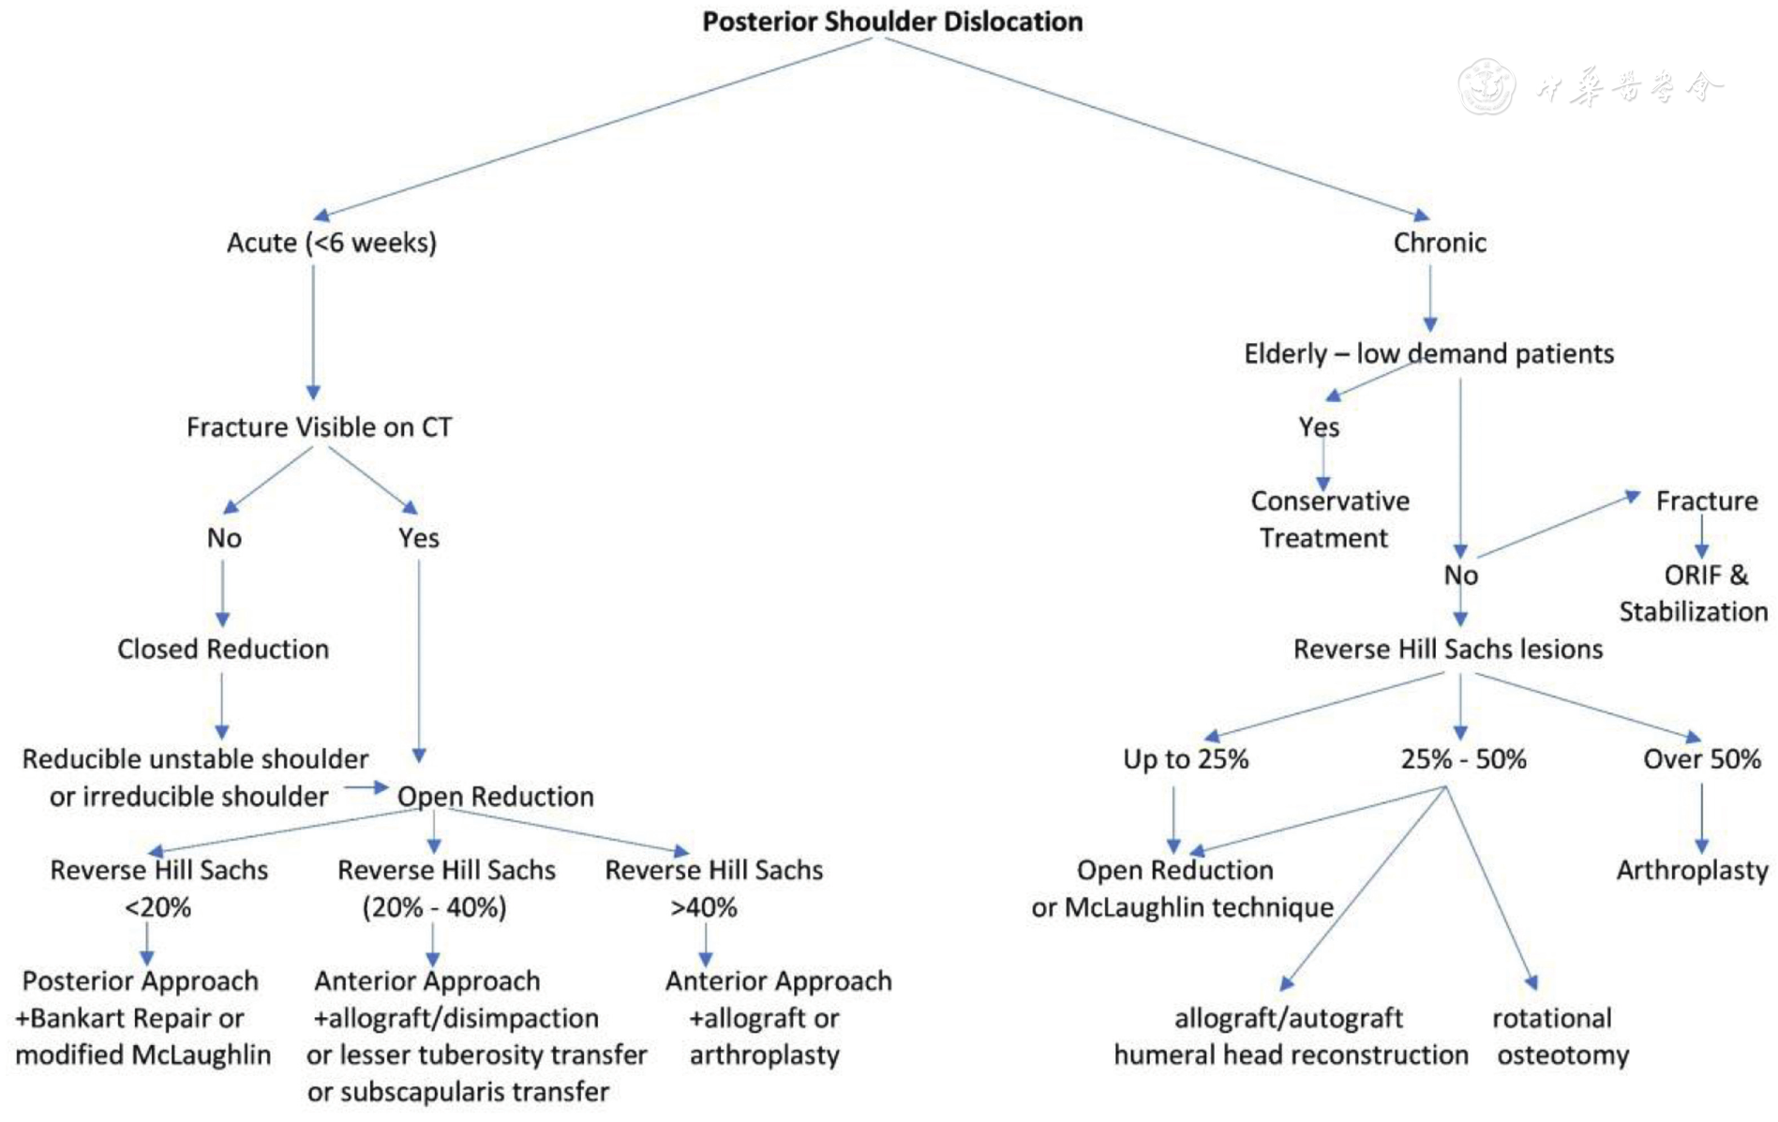
Posterior Shoulder Instability
Notes:
Posterior shoulder instability accounts for about 3% of instability
Non-specific vague symptoms: posterior shoulder pain with flexion, adduction and IR

Slide 20
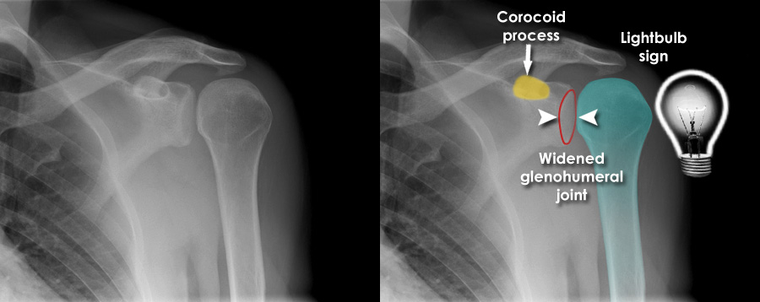
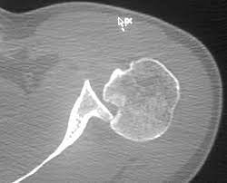
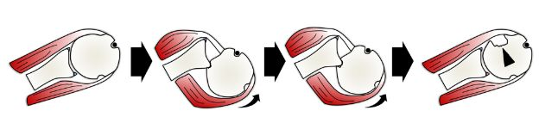

Slide 21
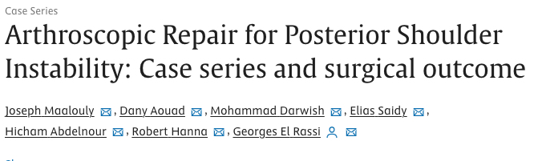
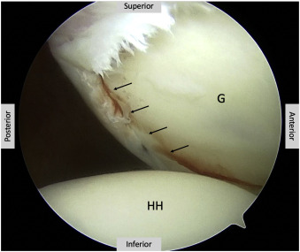
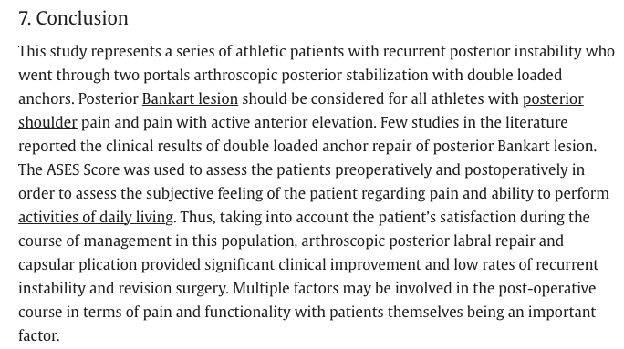
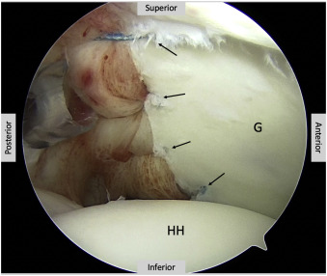

Slide 22
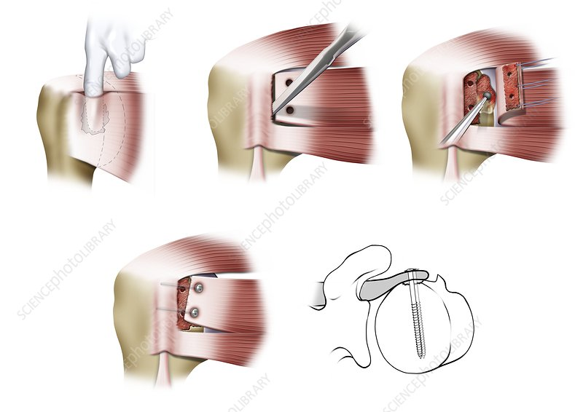
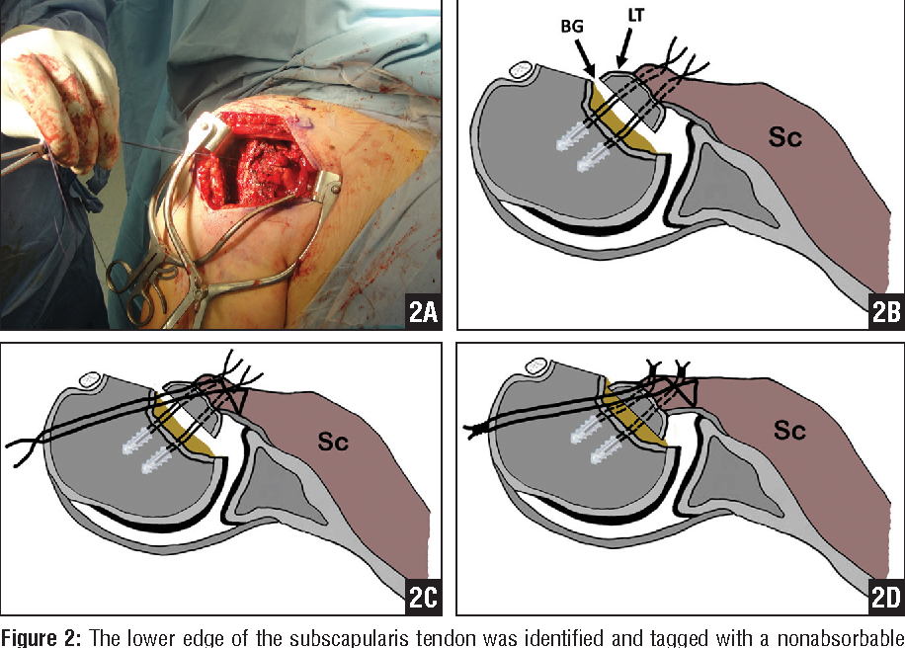
Chronic dislocation/recurrent dislocation
Open reduction + Maclaughlin/ Modified Maclaughlin
Notes:
Generally used when the articular bone loss is <50%

Slide 23
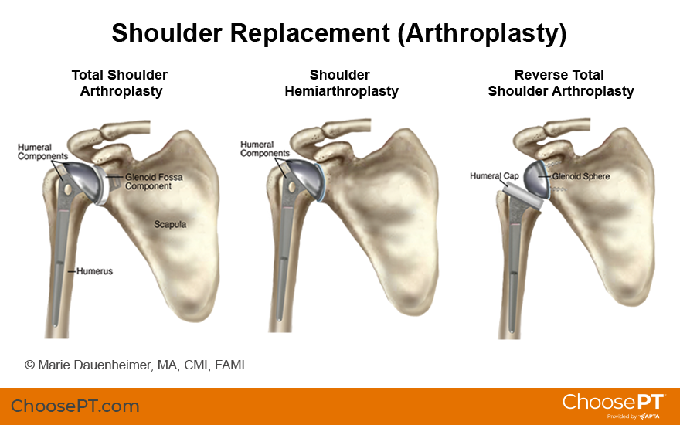
Arthroplasty
Notes:
Articular defects >50%: reserved for the elderly

Slide 24
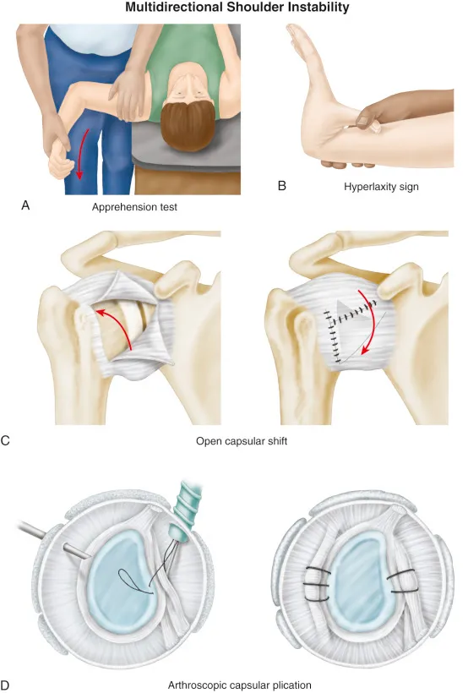
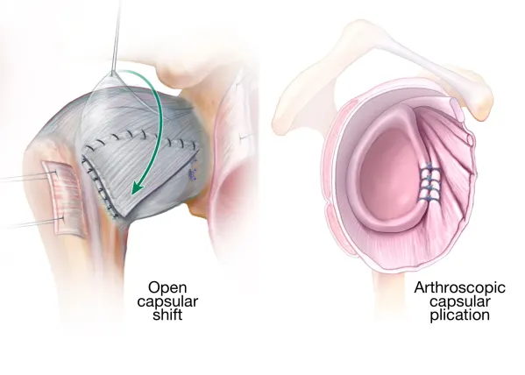
Multidirectional instability
Notes:
Distinction between the terms ‘laxity and instability’ must be clearly made in order to diagnose and treat MDI. The concept of laxity can be defined as an increase in physiological range of motion and increase in joint elasticity; however, it is an asymptomatic condition, considered physiological and may be one of the predisposing factors causing instability (6, 7). On the contrary, instability is a symptomatic and pathological condition and may develop after repetitive microtrauma or a single macrotrauma.

Slide 25

Final common pathway
Notes:
4-6 in arm sling
Passive and active ROM
Isometric exercises from week 6
Band work from week 8
ASI: Limit ER
PSI: Abduction and in 20deg ER

Slide 26


