Slide 1

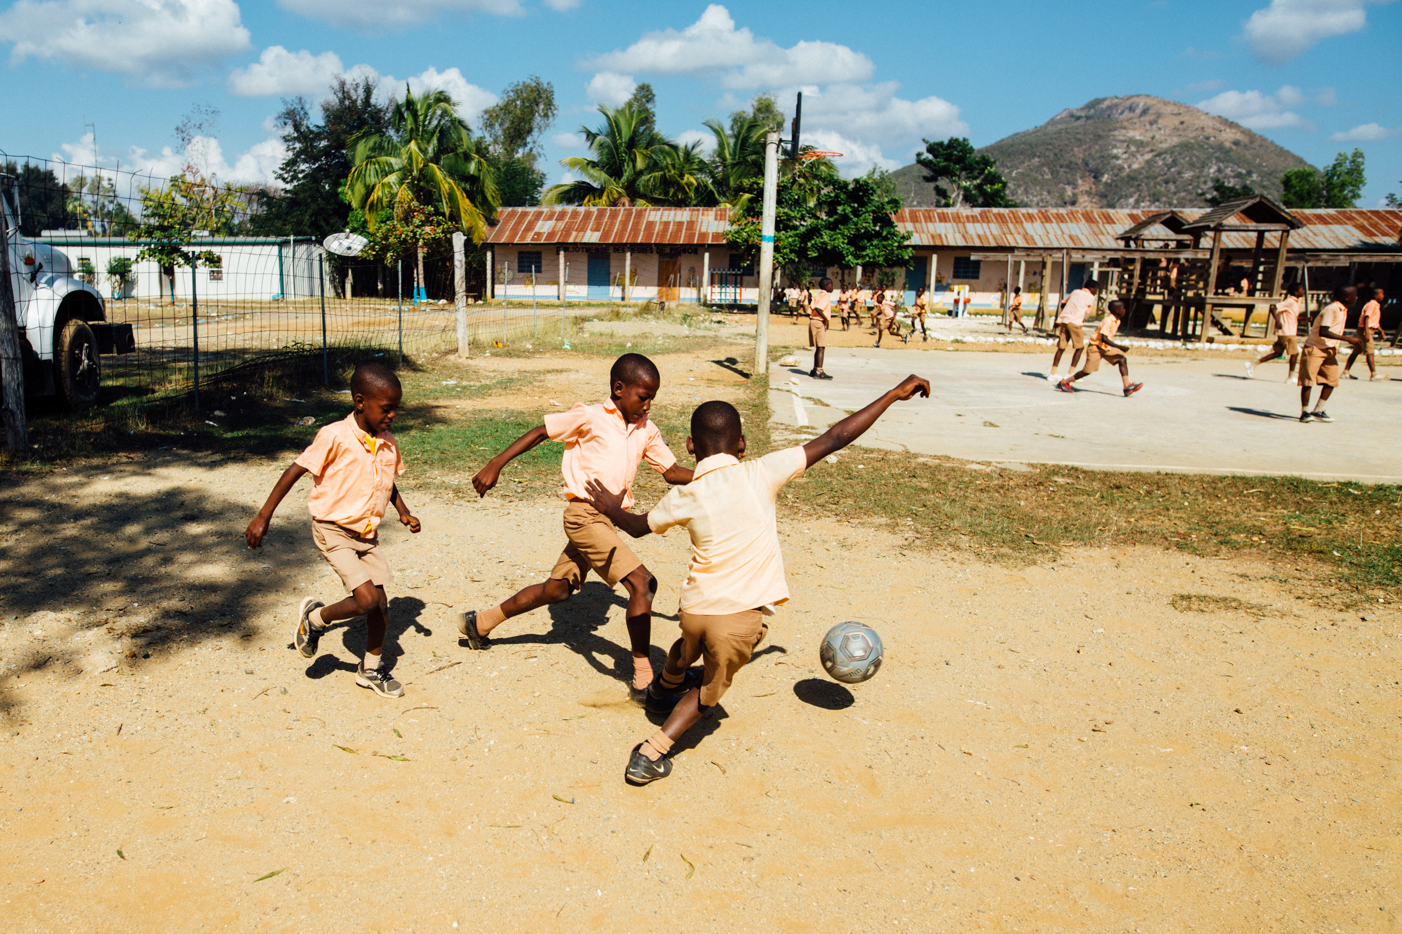
NUTRITION, HYDRATION AND SAFE SUPPLEMENTATION IN YOUNG ATHLETES
PRESENTED BY
PURITY KAMANDE,MSC,RDN

Slide 2
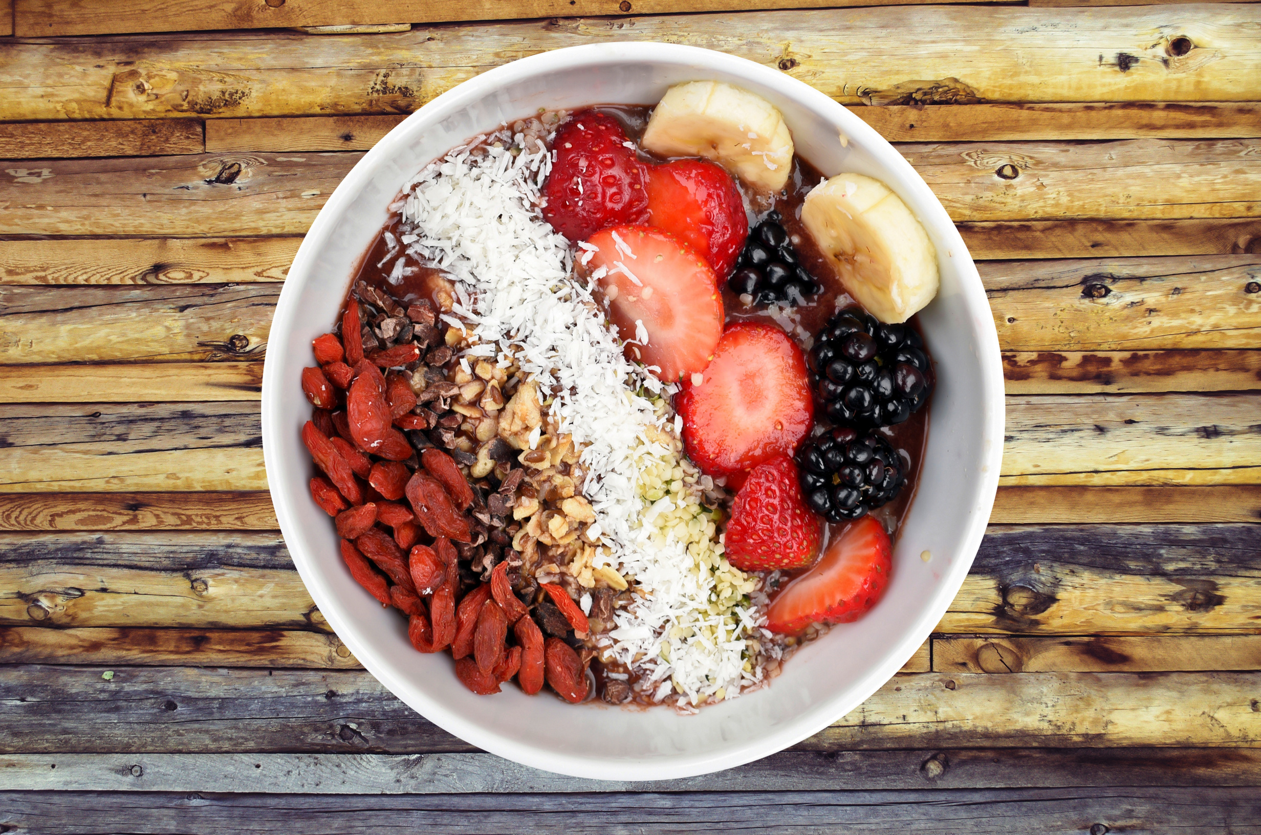
INTRODUCTION
SIGNIFICANCE OF NUTRITION IN YOUNG ATHLETES
Growth
Good health
Scholastic achievement
Provision of energy

Slide 3
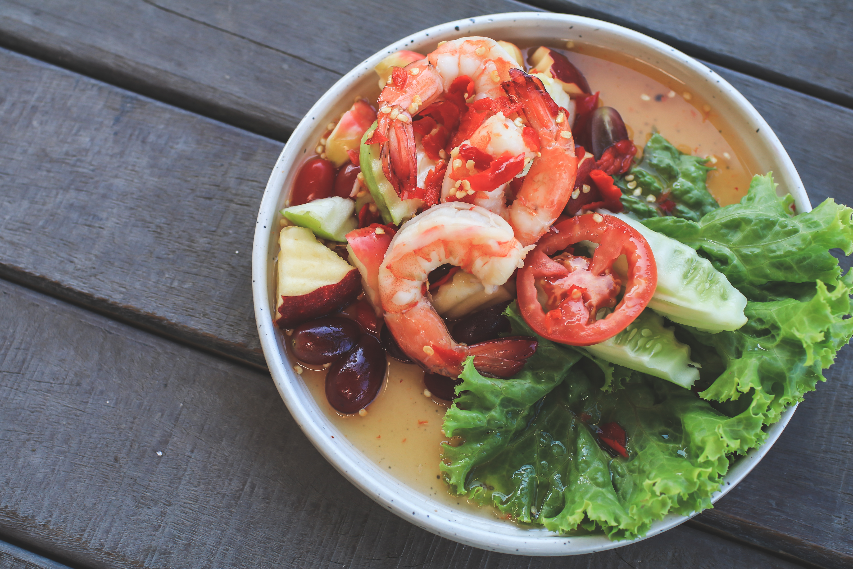
Significance of Sports Nutrition in Young Athletes
Achieve/maintain ideal body mass
Preserve lean body mass with essential amino acids
Develop high density skeletal structures
Maintain proper hydration and electrolyte balance
Provide adequate carbohydrates to optimize respiratory metabolism
Maximize oxygen delivery and oxidative phosphorylation with trace elements
Improve performance via increased muscle fiber number and speed of contraction
Promote recovery from training

Slide 4
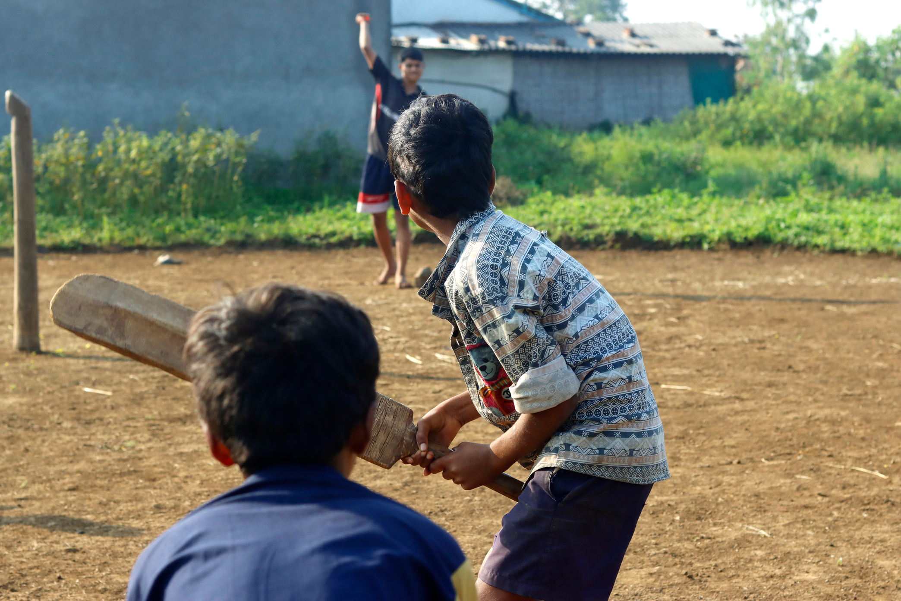
KEY NUTRIENTS AND THEIR FUNCTIONS
  Carbohydrates: Main source of energy
  Proteins: Essential for growth and repair,helps maintain blood glucose in increased duration activities
  Fats: Important for energy and cell function
  Calcium: optimum bone health, normal enzyme activity and muscle contraction
  Vitamin D: bone health, absorption and regulation of calcium
  Iron: oxygen delivery to tissues, supports growth, increase in blood volume and lean muscle mass

Slide 5

COMPONENTS OF A BALANCED DIET
Healthy Fats
Lean Proteins
Found in avocados, nuts, and olive oil.
Sources include poultry, fish, legumes, and nuts.
Whole Grains
Fruits and Vegetables
Provide sustained energy and essential nutrients.
Rich in vitamins, minerals, and fiber.

Slide 7
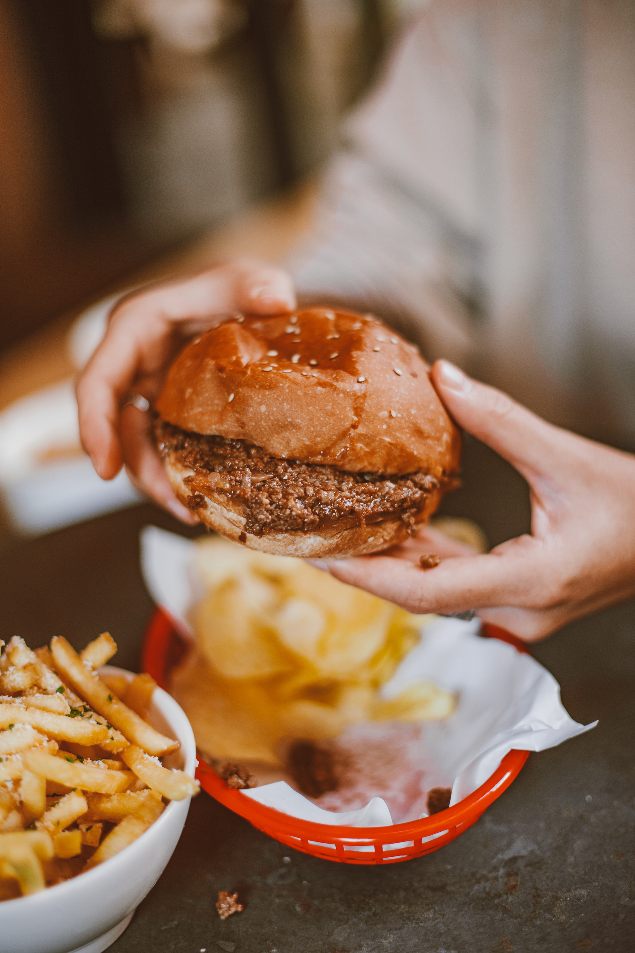
COMMON NUTRITIONAL CONCERNS
  Overconsumption of Processed Foods: High in sugars, unhealthy fats, and additives.
  Skipping Meals: Can lead to overeating later and nutrient deficiencies.
  Inadequate Hydration: Essential for digestion and overall health.
  Higher nutrition demands
  Disordered eating and eating disorders
  Unhealthy weight control practices e g . restrictive eating, over exercising, dehydration techniques, vomiting and use of diuretics

Slide 8
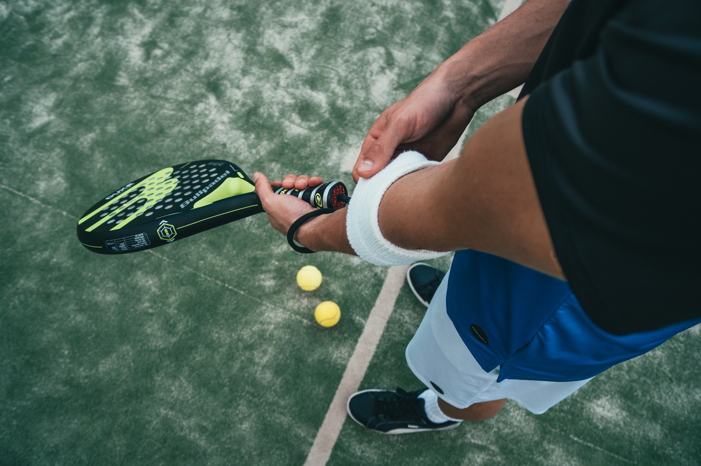
CONSEQUENCES OF ENERGY RESTRICTION
RISK FACTORS
  Playing sports that require weight checks
  Exercising more than necessary for a sport
  Pressure to win at all costs
Look out for;
Reduced performance
Fatigue
Inability to finish workout
Getting slower and weaker
Lost focus and inability to concentrate

Slide 9

  Incorporate Variety: Include different food groups to cover all nutrient needs.
  Meal Timing: Eat regular meals and snacks to maintain energy levels throughout the day.
  Need to consume extra food to meet energy and growth demands
  Always have something to eat before, during and after training/ competition
CREATING HEALTHY MEALS

Slide 10
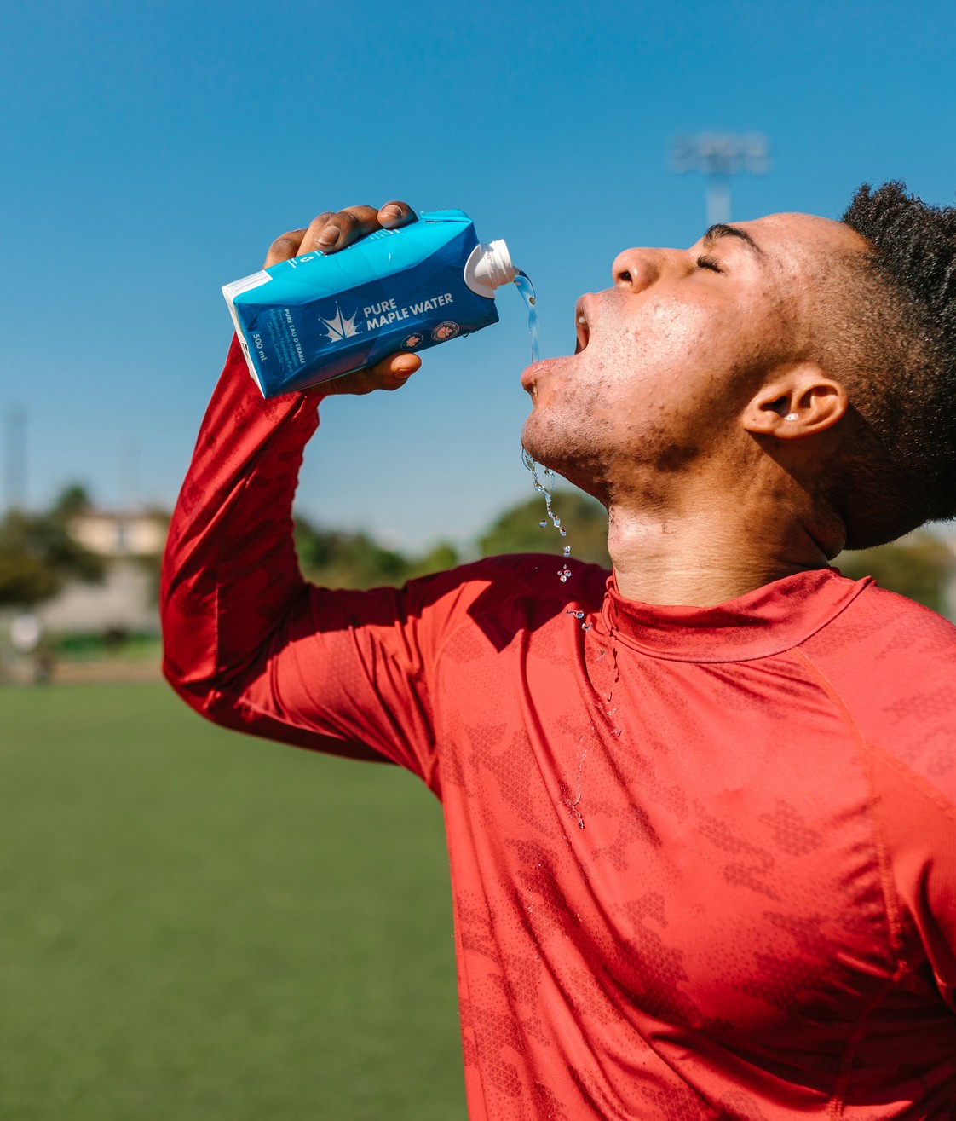
HYDRATION
  Take up to 500mls per hour 2hrs before event.
  Every 15mins during exercise, take 150-300mls
  After exercise for every 1kg lost, take up to 1 liter.
  For exercise lasting less than 1hr,water is best.
  Isotonic drinks are best for events longer than 1hr or in hot/humid conditions eg. Powerade, Gatorade, Lucozade sport
1.
2.
3.

Slide 11
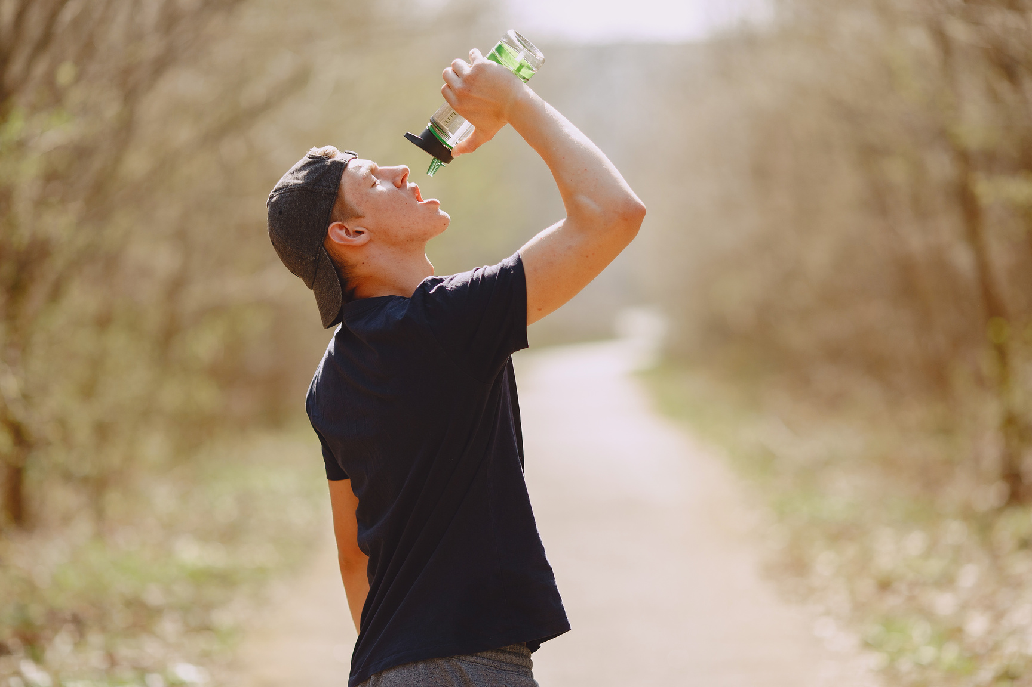
FLUID TYPE
Fluids from all foods and beverages contribute to one’s overall hydration status.
For exercise lasting less than 1hr,water is best.
Isotonic drinks(containing 6-8% CHO and electrolytes) are best for events longer than 1hr or in hot/humid conditions eg. Powerade, Gatorade,Lucozade sport
Sport drinks help prompt better overall fluid intake as well as help maintain blood glucose and delay fatigue during intense activities lasting more than 45-60 minutes and endurance activities lasting several hours.

Slide 12
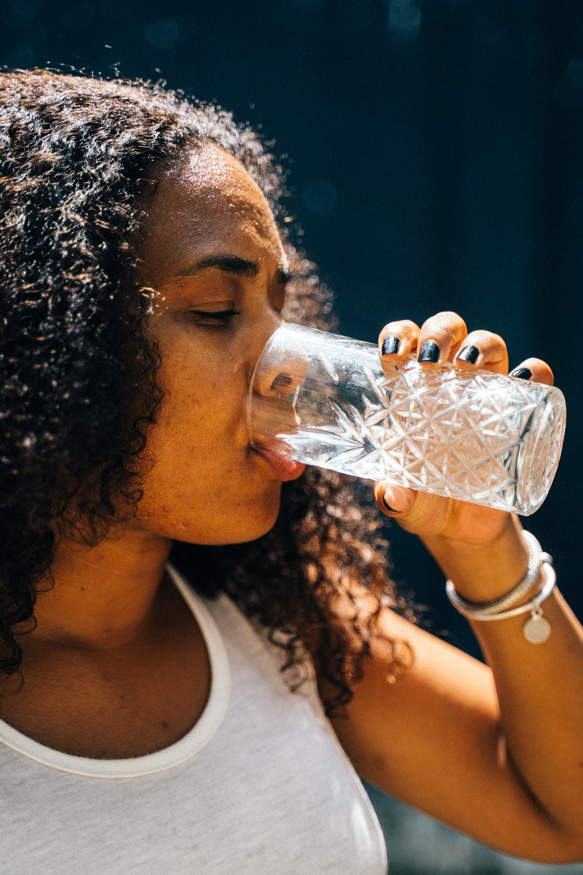
Maintaining and Monitoring hydration status
Preferred strategy for maintaining fluid balance at all times is to consume fluid before, during and after training.
Athletes should obtain a pre-and post-exercise body weight and consume 700mls per 450gms lost.
Fluid replacement beverages should be easily accessible in individual containers.
Be on the lookout for signs of dehydration: infrequent urination, dark yellow urine, headache and weakness. In case of the above , the athlete should stop and drink adequate fluids.

Slide 13
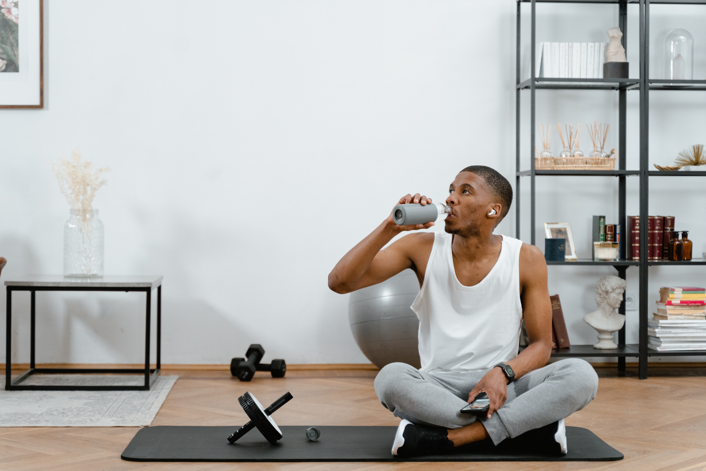
EFFECTS OF DEHYDRATION
increased heart rate
increased perception of effort
increased fatigue
impaired physical performance (for example, strength, endurance)
impaired cognitive performance (for example, concentration, decision-making, skill and coordination)
gastrointestinal issues, such as nausea, vomiting and diarrhoea
increased risk of heat illness.

Slide 14
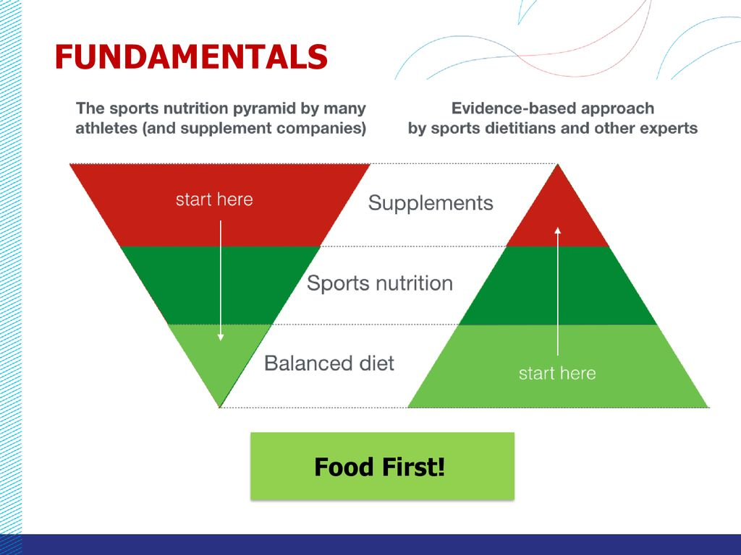
SAFE SUPPLEMENTATION
Many sports supplements have the placebo effect
Beliefs that supplements are more effective than a healthy diet and provide a quick fix
Food first approach!!!
1.
2.
3.

Slide 15
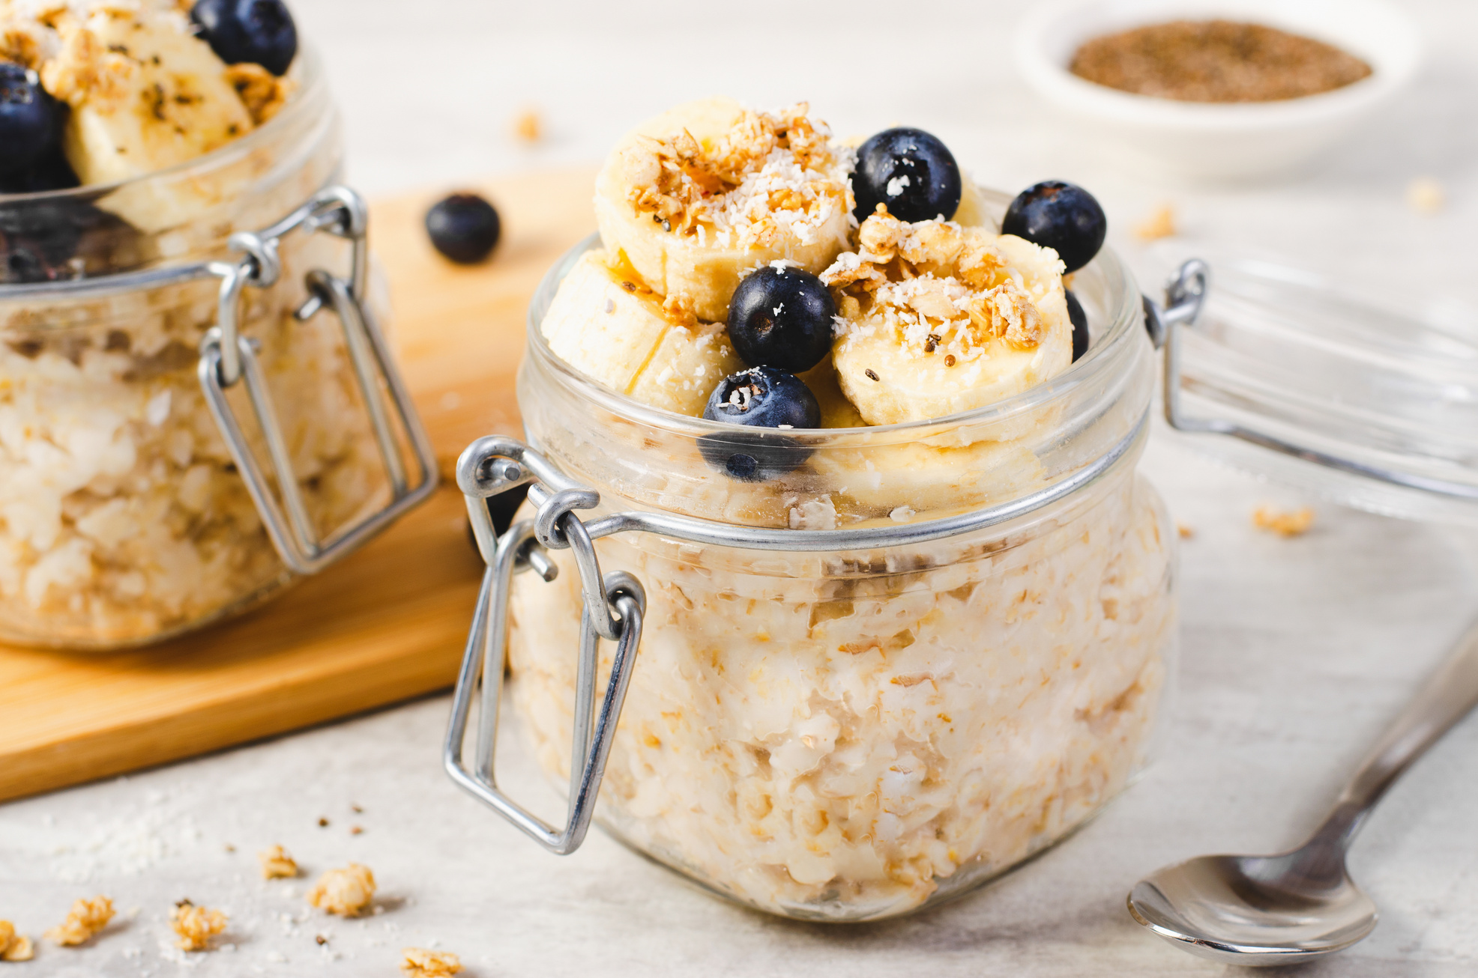
Considerations for Supplement Use
  Consult a professional i.e a sports dietitian or physician
  Third party testing- consider those tested for purity and potency by reputable 3rd party org.
  Dosage and timing- follow recommendations by provider
  Potential interactions- especially between medications and supplements you may be taking
  Monitor effectiveness- track progress and assess effectiveness of the supplementation strategy
  NOTE: Risk of contamination should always be considered by athletes as governed by the WADA code.

Slide 16
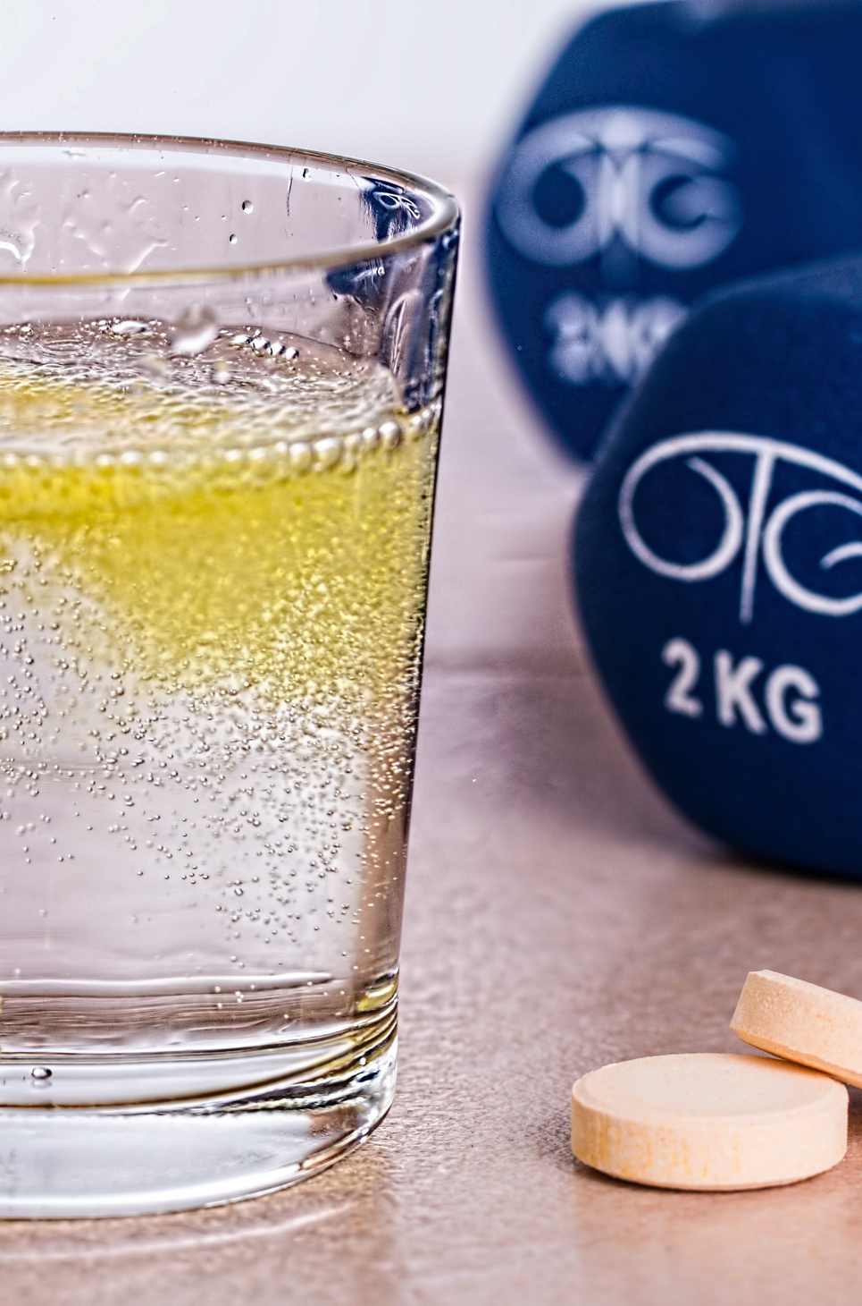
Supplements for young athletes
Creatine Monohydrate: Robust literature to support the beneficial effects on body composition,physical performance and injury prevention. Safe for use in <18 y.o(Antonio et al.,2021, Dover et al.,2020)
Beta alanine: increases lean body mass, improve exercise performance, reduce neuromuscular fatigue during training (Trexler et al., 2015)
Omega 3: supports cognitive function, building blocks for healthy body and mind
1.
2.
3.

Slide 17

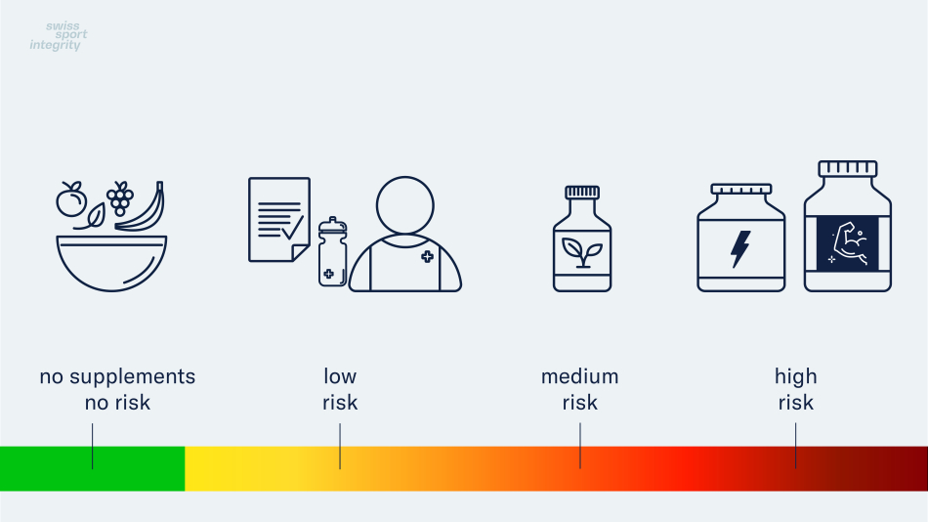

Reducing Risk
Only way to avoid the risk of contaminated supplements is to completely avoid using these products
Focus on a healthy, balanced diet
If the use of a nutritional supplement is recommended by a specialist, opt for products that are independently certified.
Exclusion Criteria applies. For safety reasons, it is best to avoid these substances.
Avoid ordering products from sources that aren’t certified.
AVOID such products at all costs.
These include:
-Products intended for the fitness or bodybuilding market
-Products which make big claims.
-Products that use terms such as testo, anabo, Andro, boost
-Products which claim to be doping-free

Slide 18
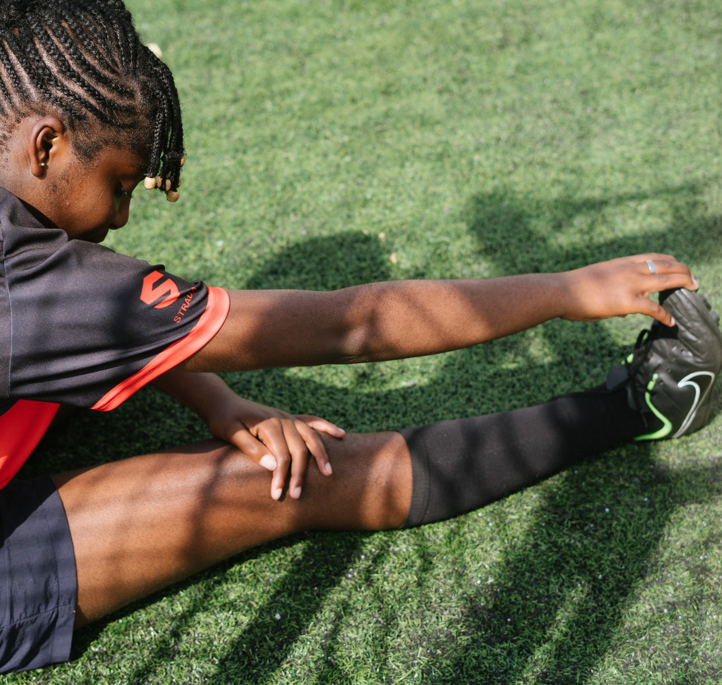
CONCLUSION
  Proper nutrition is crucial for a healthy and active life.
  Make informed food choices and strive for balance in young athletes’ diets.
  Start implementing small changes today to improve eating habits and overall health.

Slide 19
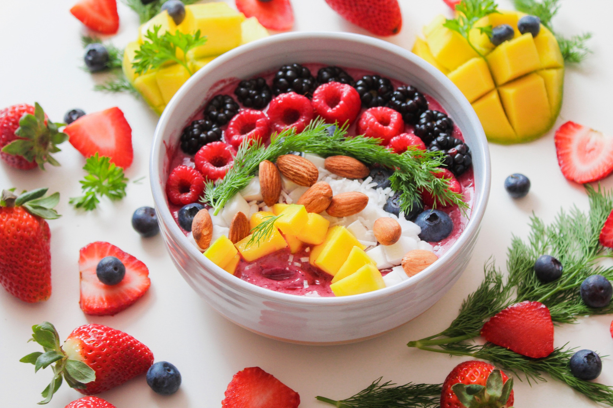
THANK YOU

