Slide 1

Rotator Cuff
Overuse Tendinopathy:
Conservative Treatment
Chris Nelson, MD, CAQSM
Assistant Professor
Family and Community Medicine
Wake Forest University
Notes:
More you read on tendinopathy the more you realize we just don’t get it yet

Slide 2
Disclosures
I have no financial relationships with commercial interests/organizations that provide goods or services directly or indirectly to patients that relates to this presentation.

Slide 3
Overview
Current Theories on Tendinopathy
Conservative Treatment Options
  Review of Evidence for Higher Yield Solutions
Examples of Ultrasound-Guided (US-Guided) Interventions
Notes:
Evidence for treatment based on systematic reviews when available

Slide 4
Current Theories on Tendinopathy

Slide 5
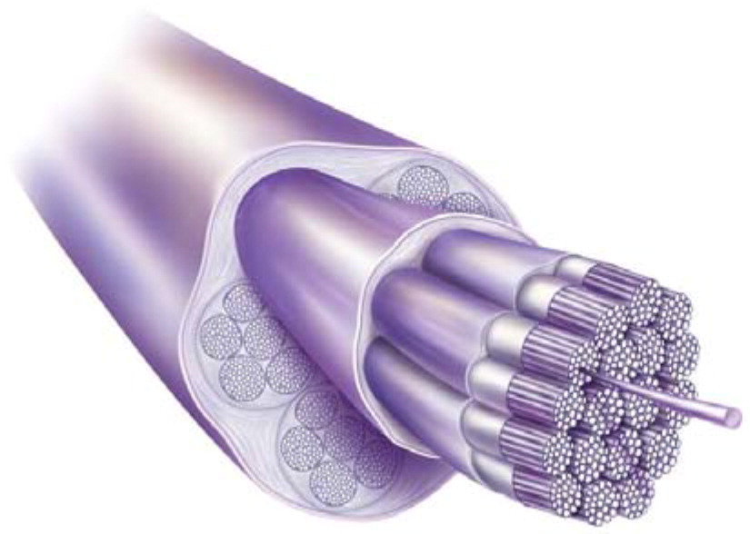
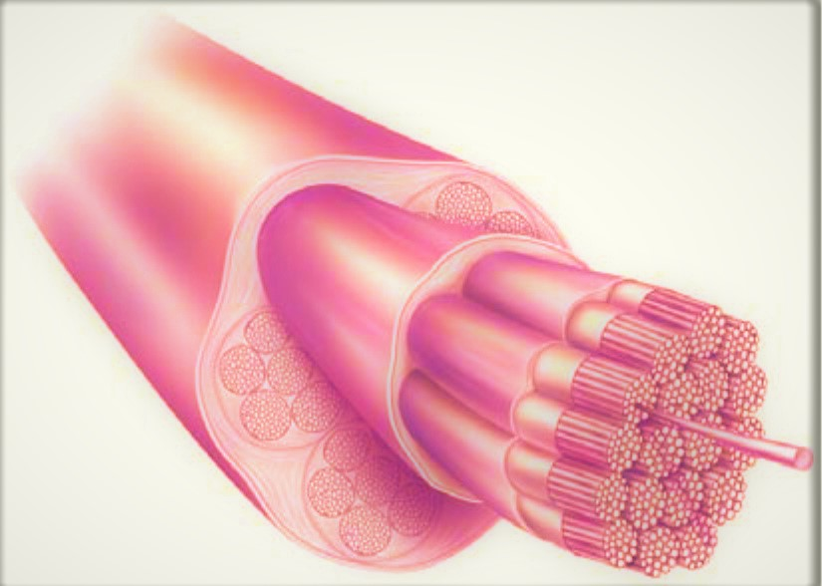
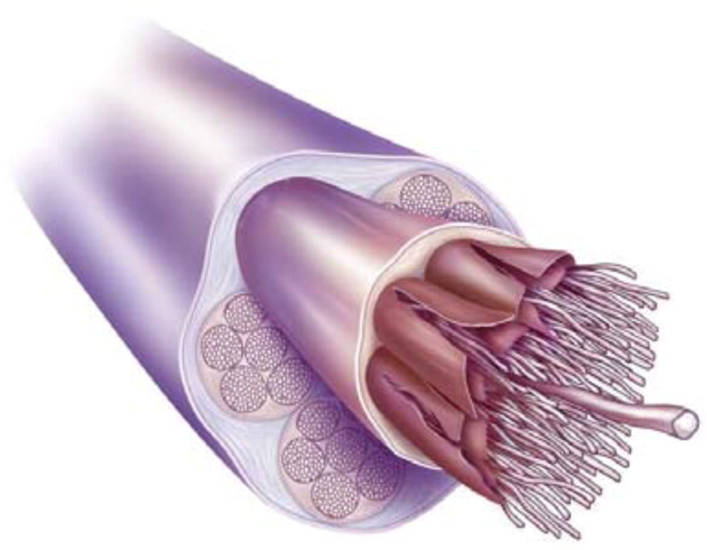
Tendon Pathology: A Straightforward Path?
Normal Tendon
Tendinitis
Tendinosis
Notes:
Tendon purpose-strength for muscle(tensile force transmission), release of energy like spring
Failed healing
Tendiinitis-inflammation
-its a slick and much more intelligible way to discuss things with patients where as whats really going on something less straight forward
Important to consider what stage you are in because how we treat needs to change with what stage of tendinopathy we are in
No inflammatory cells in surg path from tennis elbow

Slide 6
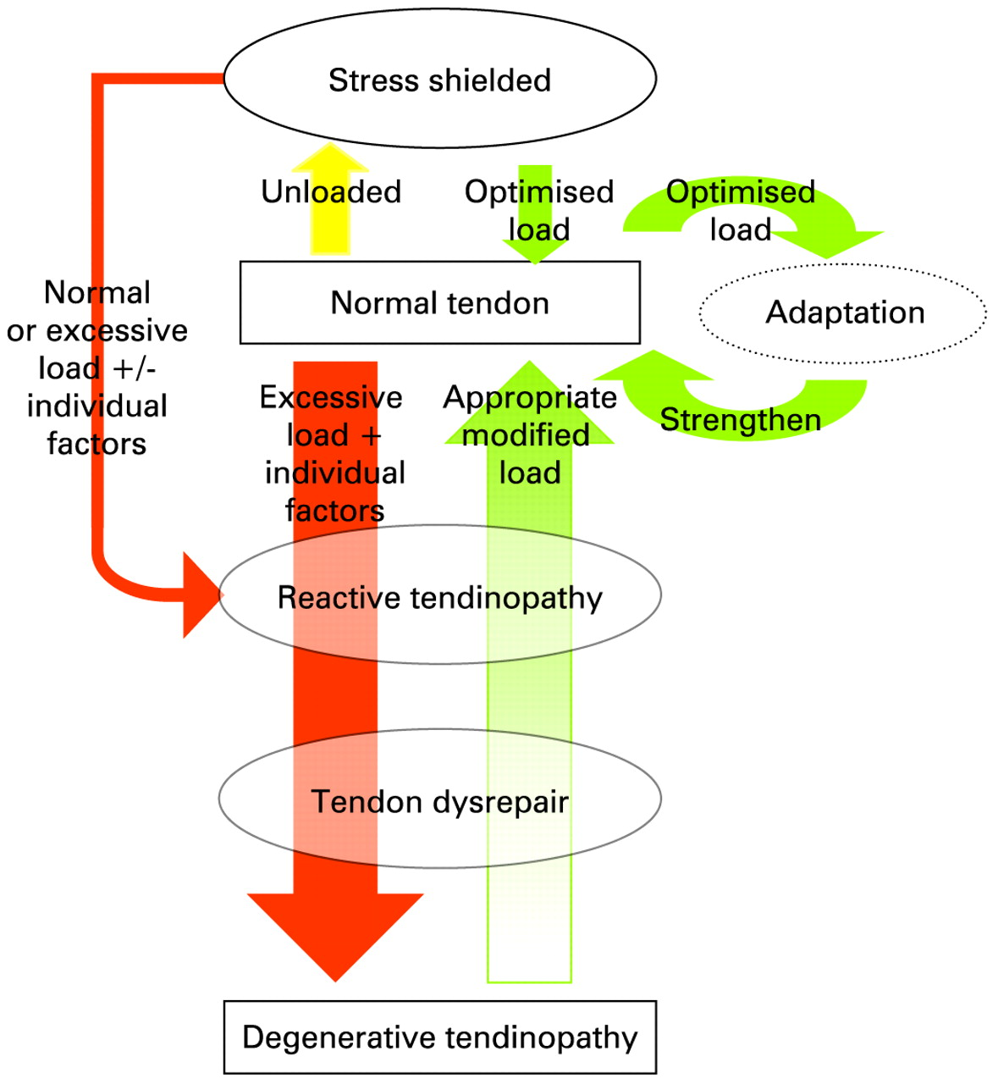


Notes:
Taken from a BJSM 2009 article
Not understanding how to treat tendinosis is going to inherently limit our ability to treat it more effectively
Moving along these different stages should result in changing the treatment we offer
In a way this is analogous to how stress fractures develop. There is a mis match between synthesis and degradation on the tendon in response to overload. Right amount of load is helpful, too much leads to tendinosis
On right there is the normal adaptation cycle when the tenocyte is able to keep up and results in a stronger tendon
Stress shielded is the un-used tendon, under relative or complete rest
Fails to give tendinitis any place at the table
ANgiofibroblastic process in tendon =tendinosis
Reactive tendinopathy:Increase CSA. non inflammatory, fusiform swelling
Tendon dysrepair: attempt at tendon healing, increased haphazard vascularity and neural growth. CSA increases, more thickening and collage fascicle organization starts to get lost
Degenerative tendinopathy-little organised tendon fascicle left, more cell death, increased haphazard vascularity

Slide 7
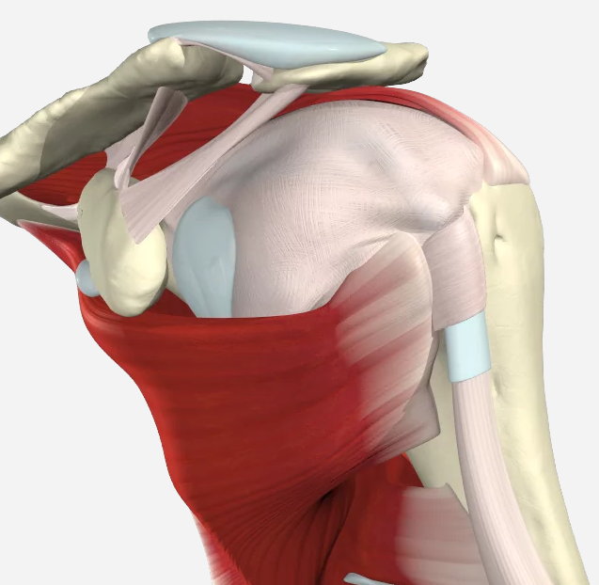
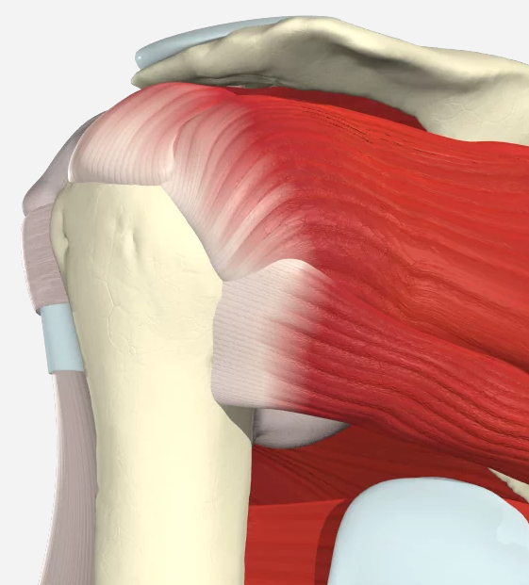
Rotator Cuff Anatomy
Anterior Shoulder
Posterior Shoulder
Supraspinatus
Infraspinatus
Subscapularis
Teres Minor

Slide 8
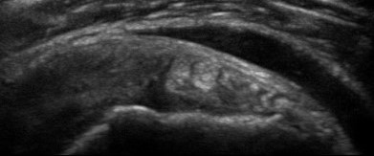
Tendinopathy: Practical Framework
Normal
Inflammation: Bursitis
Tendinosis
Pathology | Tendonitis | Tendinosis
Prevalence | Less common | Common
Disease Process | Inflammatory? | Degenerative
Time Course | Days to weeks | 3-9 Months
Focus of Treatment | Anti-inflammatory | Collagen synthesis
Notes:
Introduce Ultrasound-shoulder supraspinatus
If theres a story its probably tendinitis
Tendinitis is a small piece of the pie
Typically this time course is after treatment is after treatment begins
Just like with a stress fracture in an active person, athletic or duty related, find the source of the increased load and give it a relative decrease

Slide 9
Overuse Tendinopathy
Treatment Options
Notes:
Explain treatment options and the verdict will be my opinion based on evidence and my own experience
Chin scratcher, can’t recommend for or against

Slide 10
So many options...
NSAIDs
Rest
Physical Therapy
Ice
Heat
Cold
Cold/Hot Contrast
Bracing
Casting
Work restrictions
Compression
Gluten free diet
Sugar free diet
Gate retraining
Barefoot running
Forefoot running
Blood flow restriction
CBD
Collagen Peptides
Oral Prednisone
Turmeric
Nitroglycerin patches
Lidocaine cream
Voltaren cream
DMSO
New shoes
Orthotics
Toe spacers
Bike fit
Extracorporeal shockwave treatment
Tenex
Ultrasound-guided needling
Hydrodissection
Notes:
Picked ones I felt were more common with widespread discussion or recommendation by colleagues-PCPs, sports med, PTs
Studies used are all included in a more detailed works cited at the end
Patient stories-topical turmeric, so much topical cbd and THC, calorie deprivation
Some are promising but hard to come by shock wave and tenex and are quite costly

Slide 11
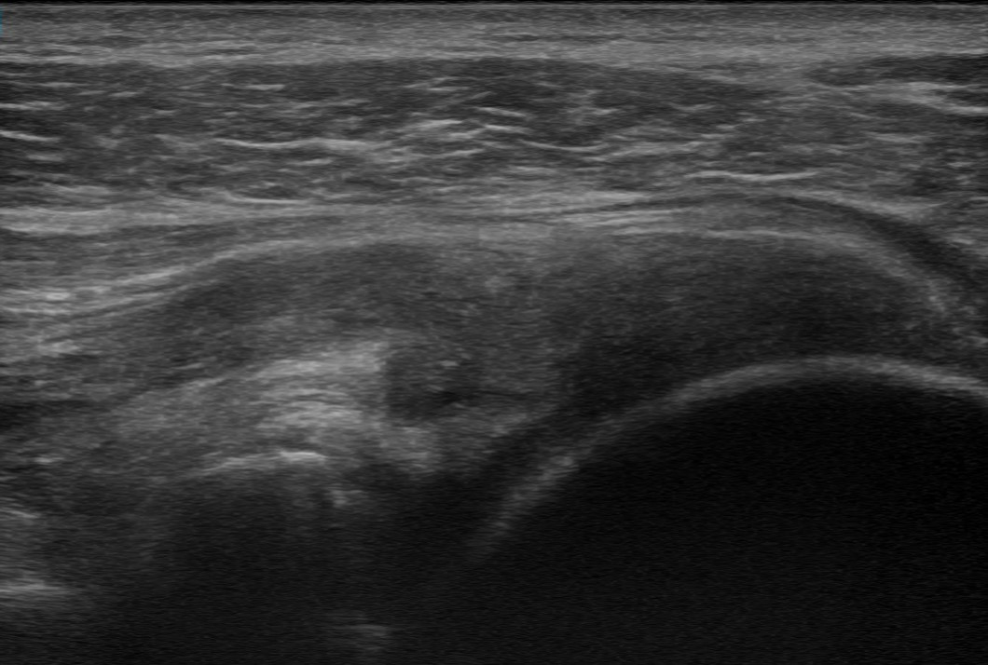
Topical Nitroglycerin
Normal Infraspiantus
Benefit likely related to Nitric Oxide
  Increased blood flow
  Collagen synthesis
BJSM systematic review:
  Rotator Cuff and others
  Improvement in pain with ADLs and exercise
  Increased peak strength
Cheap, 0.4 mg patch cut in ¼ piece,
Tendinosis
Notes:
NORMAL IS 0.8, ABNORMAL IS 1.3. MAN WITH SS TEAR AND COMPENSATORY TENDINOSIS
NO is a free radical-appears in to increase collagen synthesis, local blood flow
Nearly all tendinosis covered in this review
Often think about this for achilles, elbow but forest described in the 90s for rotator cuff
Few SE. IN literature drop out rate 20% for for larger doses. Anecdotally I would say 5% drop out rate
Improvement in pain ranged wildly from 0-70%

Slide 12
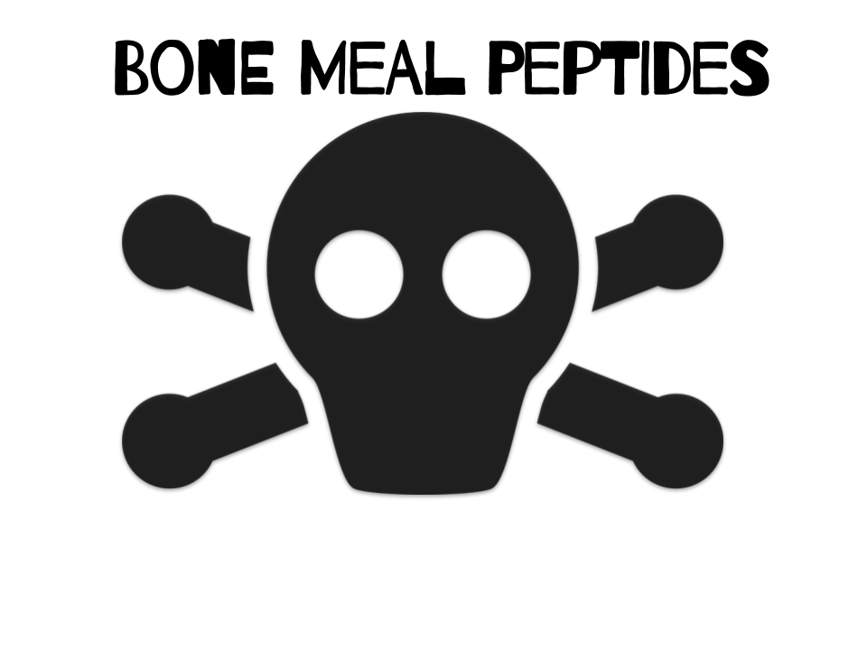
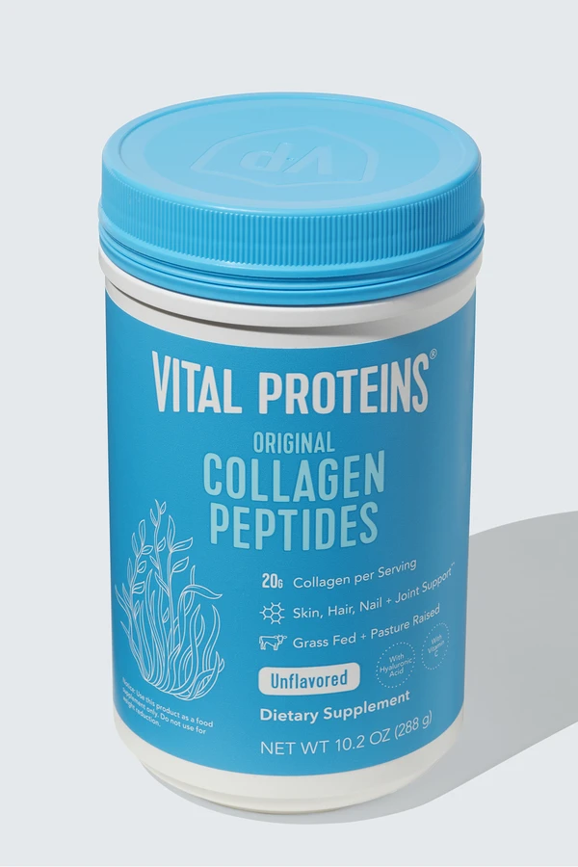
Collagen Peptides
Nutritional supplement
In vitro studies demonstrate tendon synthesis
Smaller studies, demonstrating help with injuries and injury prevention
  Small RCT: 12% improvement in pain and function (VISA-A) at 6 months
No large reviews with great methodology
Replace current pre- or post-workout supplement
Notes:
Tried to use basic beef gelatin, same stuff that you use as a thickener, its about $5. Did not go well and basically had a gelatin meatball I couldn’t get down. Stick with the hydrolyzed powder like the blue container
Placebo effect twinkling in patients eyes with a supplement
This RCT was sponsored by a gelatin company

Slide 13
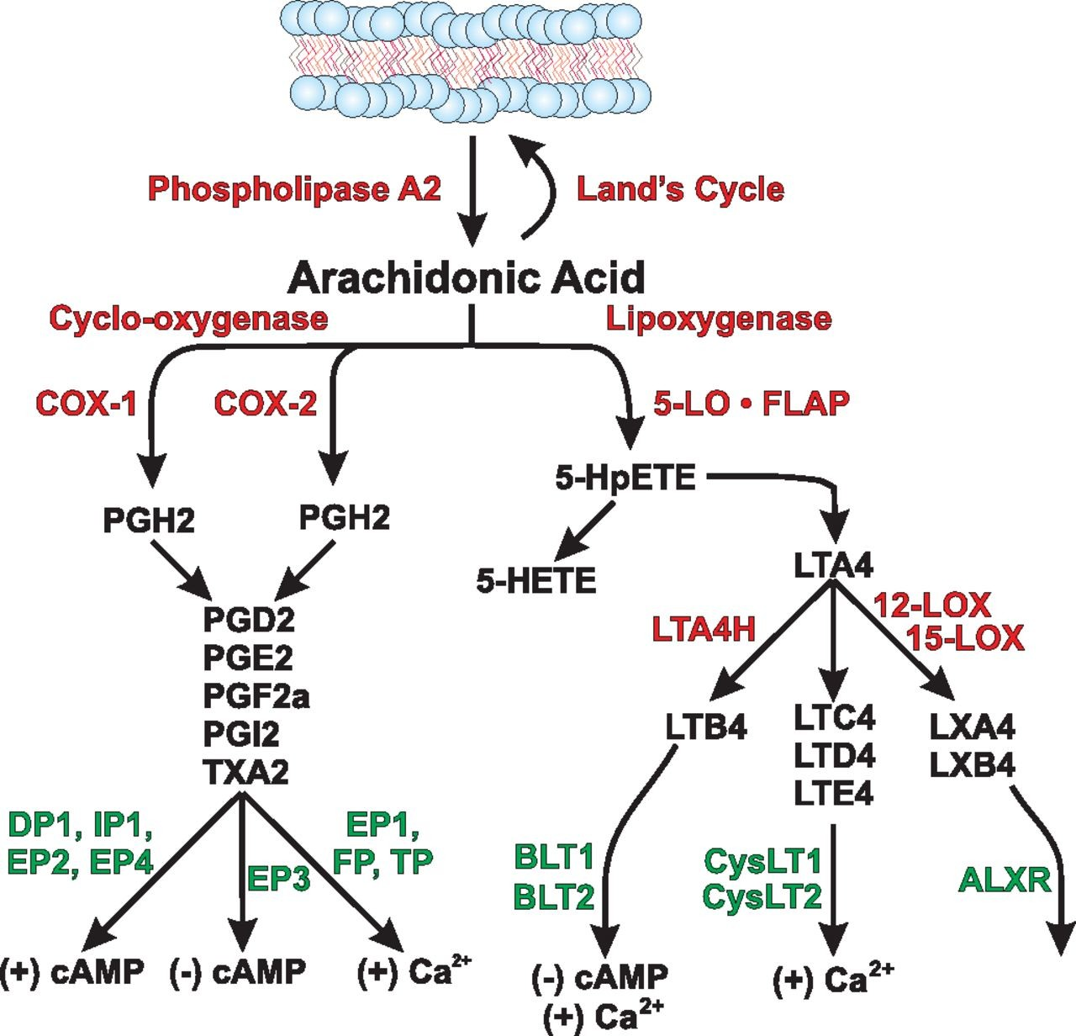
NSAIDs
Clear evidence NSAIDs negatively affect:
  Post-op healing after tendon repair
  Bone fracture healing
Cyclooxygenase, prostaglandins effect on tendon biology are not well understood
If needing NSAIDs to exercise:
  Modify your training
  NSAIDs pre-exercise increase AKI
Established increased CV disease risk
Bottom line--use NSAIDs as needed
Notes:
NSAIDs prevent bridging of osetoclasts
20% nonunion rate with patients getting indomethacin post op for ORIF after hip fracture. Helped prevent HO for the THA but non unions for their other traumatic incidental fractures
Smaller studies do show no effect for achilles tendinosis. Thought is at some stages could be helpful for preventing adhesions in the tendon

Slide 14

Flexibility-Stretching
Should not be the focus of therapy
Should not be excluded
Significant improvement in treatment with eccentric strengthening when combined with stretching
Notes:
Exercise for tendinoathy article 2015
Eccentric exercises significant improved when stretching added with

Slide 15
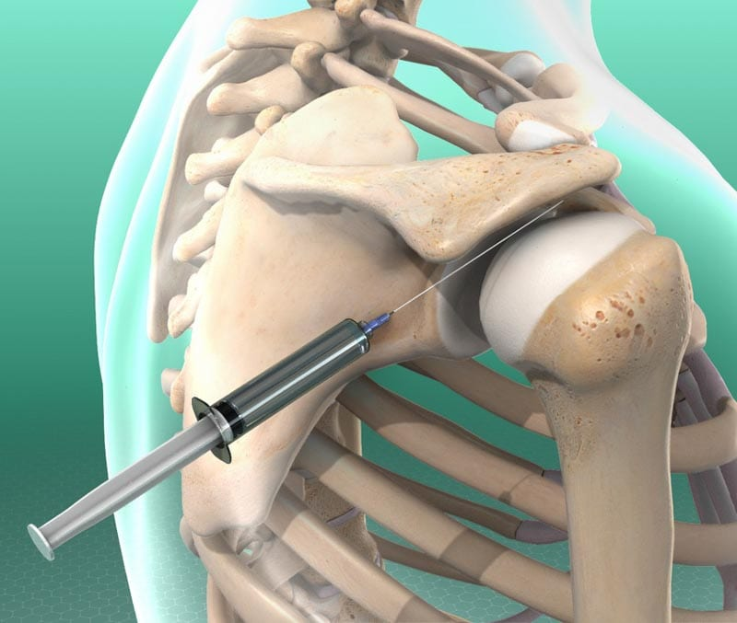
Corticosteroids
Short-term benefit, <8 weeks
  Efficacy further confuses noninflammatory nature of tendinosis
  Corticosteroids inhibit collagen synthesis
Areas with clear harm, lateral epicondylosis
  Dose dependent: serial injections lead to more pain at 1 year
Inconsistent results, rotator cuff and achilles
  Even short term relief questionable
Notes:
I do plenty of steroid injections but try to avoid them in tendinosis, I used to routinely use up all the steroids we had at my clinic before they knew how much to order when I started there
also this picture is insane, from a PM&R jounrals website

Slide 16
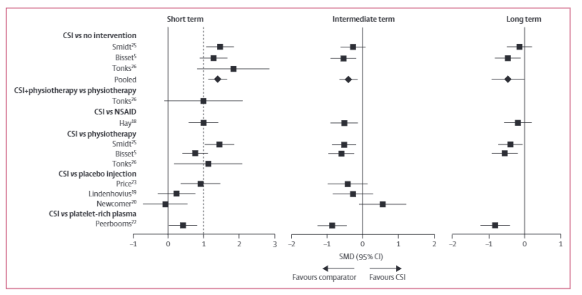
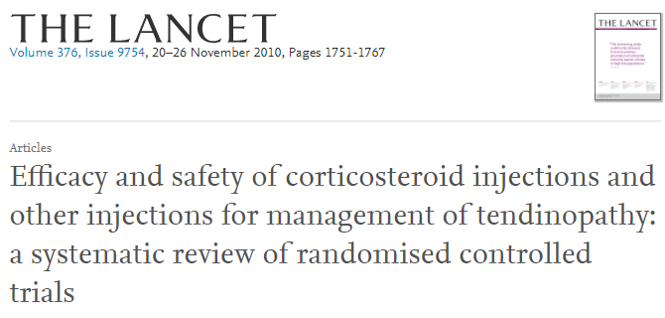
Notes:
Short term-weeks
Intermediate-months
1 year-long term

Slide 17
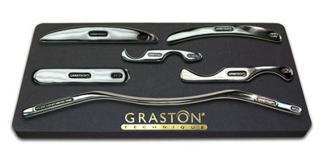
Soft Tissue Mobilization
Mobilize soft tissue
  Release adhesions and scar tissue
Instrument Assisted Soft Tissue Mobilization (Graston), Deep friction massage, Astym, Gua sha, and many others
Animal models show collagen repair and synthesis, maturation and alignment
  Human trials do not support this
Systematic review of 7 studies:
  Limited evidence of any efficacy
Notes:
Tool board reminiscent of a movie villains torture table...
Allow for feedback to clinician
Myofascial treatment
Done by many with little support. Likely pain relief from short term help of the pain blockade provided by direct pressure
I would not refer someone just for this but some therapists and patients really like it so while they are already sure. Break out the torture board!
Deep friction massage review of 9 studies. No benefit seen in solation
Graston was copyright free image from google
Same is true for manual therapy with therapists, analogous to OMT in 2014 review

Slide 18
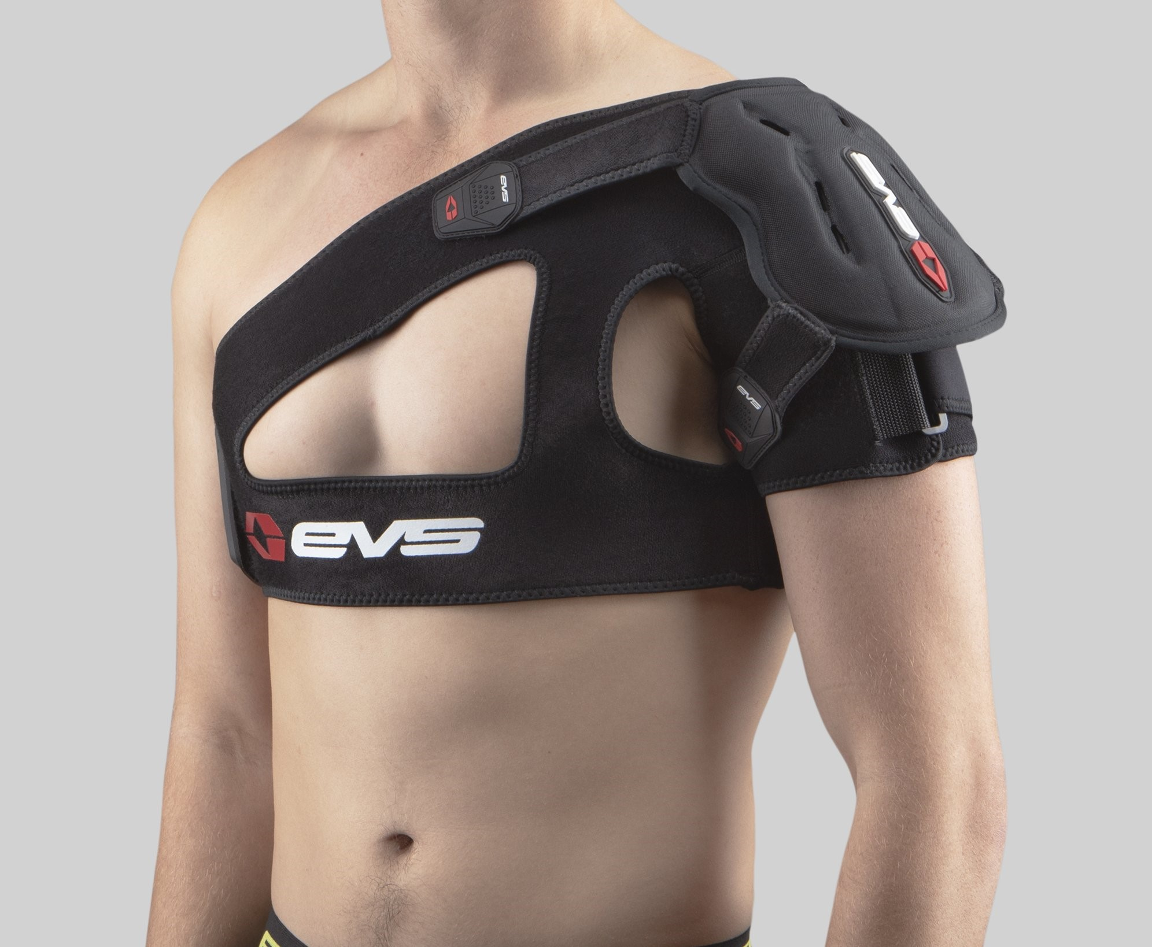
Bracing: Rotator Cuff Tendinosis
Reasonable brace???
Notes:
Certainly not a sling
Would avoid sling use anyway and a shoulder spica, whose is going to use this. Really didn’t come across anything on this for RC issues

Slide 19
Eccentric Strengthening
Forcing muscle to contract while also lengthening
Slow loading, but how slow?
Able to reach higher loads on tendon
Thought to increase shear forces between tendon and surrounding structures
Notes:
The magic of eccentric exercise? slow loading, greater overall load can be put on the tendon, increased shear forces between tendon and surrounding structures. possibly help synchronize mechanoreceptors and neuromodulation of pain

Slide 20
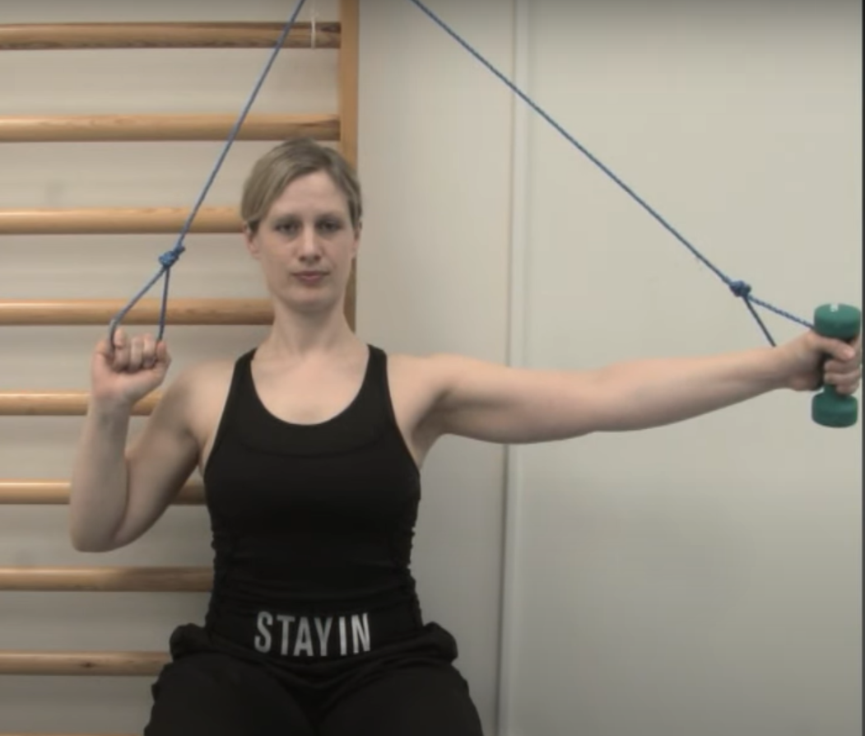
Eccentric Strengthening
Tendinosis
  For other areas of body-Achilles tendon and
    Lateral Epicondylosis
  Anywhere from 30-90% reduction in pain
    12 weeks
Rotator Cuff Tendinosis
  Not as many reviews
  2020 Review showed no benefit over traditional strengthening program
Notes:
Combination of RCT and control trials, VISA-pain and function scale was measure
For the most part this continues to be the most effective approach for tendinosis. Most people have drank the kool aid for eccentric exercises in tendinopathy
6 weeks seems too short of time, likely plan for more like 8-12 weeks
Great to be able to demonstrate these for people that have terrible PT coverage or are too stubborn to go
Lateral Epicondylosis
Review of 12 clinical trials
improvement with eccentric exercises over standard treatment (4-28 week follow up)
50-75% pain reduction at 6 weeks
Achilles tendinosis
Review of 9 clinical trials
30-90% reduction in pain at 12 weeks

Slide 21
Ultrasound-Guided Options
Notes:
50-60% of pain improvement over months in most reviews for needling tendinosis

Slide 22
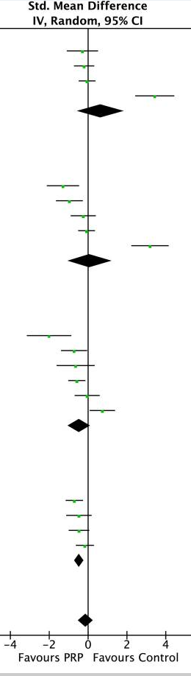
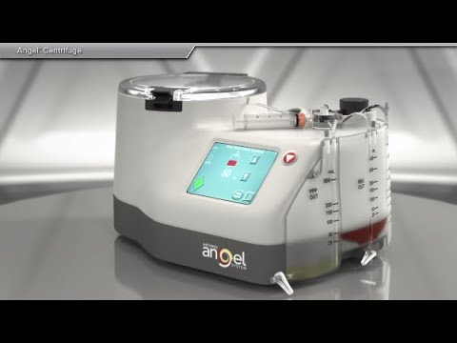
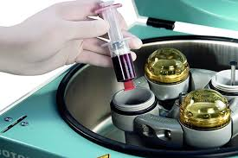
OrthoBiologics: Platelet Rich Plasma
Used to promote:
  Cell recruitment and collagen synthesis
  Leukocyte rich
  High cost $800-1200
2021 Metanalysis
  Initially patients feel worse
  Significantly better than control by 6 and 12 months
Notes:
Data from 8 RCTs (n = 976 participants) were pooled to determine effects of PRP on shoulder pain. Since studies varied in the follow-up outcome assessment periods, data from studies with similar follow-up time points were pooled and analysed. Pooled data revealed no significant difference in VAS pain scores between patients treated with PRP and controls at 1 and 3-month follow-up. However, a significant difference in favour of PRP was observed at 12 months post-intervention

Slide 23
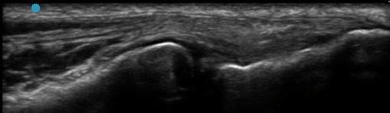
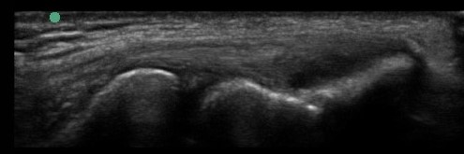
US-Guided Needling
RCT 2021: US guided percutaneous needling with or without PRP
  Without PRP group less pain at 6 weeks
  Efficacy equal long term, 52 weeks
Smaller studies (40-100 patients)
  80% with good to excellent improvement
Larger systematic review
  with 30-60% improvement in pain over 6 months
Normal Common Extensor Tendon
Tendinosis Common Extensor Tendon
Notes:
Pooled meta analysis for us guided tendon needling 50-60% effective with good to excellent pain relief
Much more data for lateral epicondylitis, not much out there for RC but somewhat applicable
Not a quick fix, usually counsel at 6 weeks even if there pain is a little improved then that would be a success and we should continue the course. Consider repeat at 3 months if minimal change
Lat epi-study of 60 people 80% excellent or good improvement after 28 months
Not a fant of using tenotomy in the name of this since Its a little misleading. For coding purposes this is not tenotomy. In coding verbage usually say a tenotomy has to involve a scalpel

Slide 24
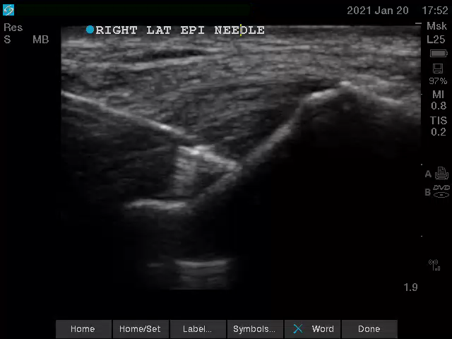
US-Guided Fenestration
Liberal local anesthetic
15-30 passes in different areas of the tendon with 18 gauge needle
Notes:
Marginal benefit with PRP but then we’re outside of insurance coverage. Always offer this and rarely use PRP for lat epi needling

Slide 25
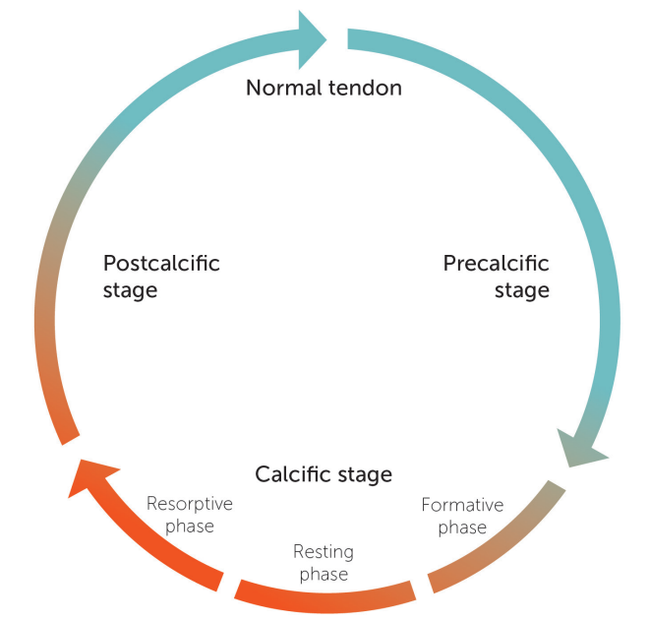
Calcific Rotator Cuff Tendinosis: US-Guided Barbotage
The pinnacle of tendinosis
Mesenchymal cells become chondrocytes instead of tencytes
X-ray studies show:
  <50% with calcifications have pain
Primarily occurs in RC
  Supraspinatus most common
  Infraspinatus distant second
Notes:
Resting phase-dormant, no pain unless so large gets mechanical impingement, greater than 1 cm at least
Less than half of people have symptoms with deposits
Resorpitive phase-more painful phase, increased vascularity and macrophages recruited
Post calcific-granulation tissue, fibroblasts come in and eventually end with complete tendon healing
Resolution can take years, 20% fail conservative management

Slide 26
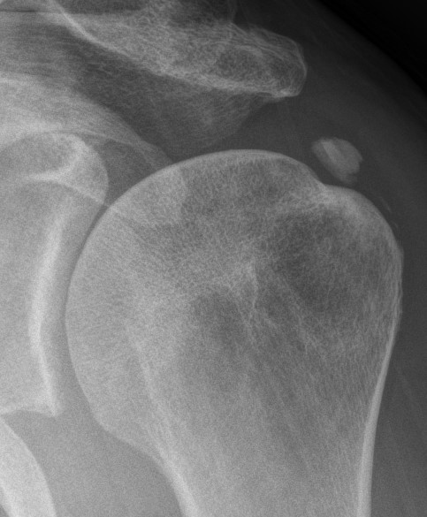
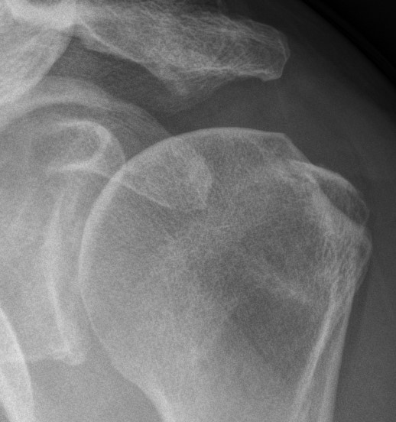
Calcific Rotator Cuff Tendinosis: US-Guided Barbotage
2019 review and meta analysis US lavage v ECSW showed:
  Superior pain and calcification disappearance rates compared to ECSW at a year
  Significant pain and calcific reduction at 6 weeks
  90% calcific reduction and pain at 1 year follow up compared to ~50% for ECSW
Pre-procedure
12 weeks post
Notes:
7 studies included
ECSW sounds quite painful from lectures I have heard including the ones at AMSSM and this is much less painful in my opinion
Usually do a follow up x ray 6 weeks later before procedure to see if there is any change. If they REALLLY want to do it then go ahead and schedule it in next couple of weeks

Slide 27
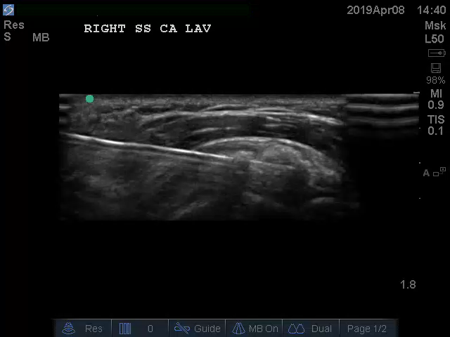
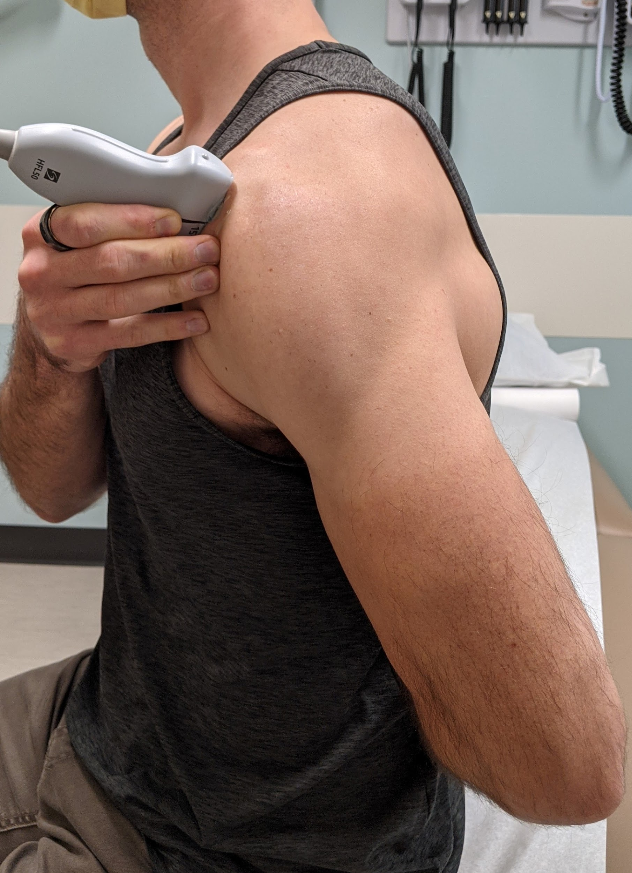
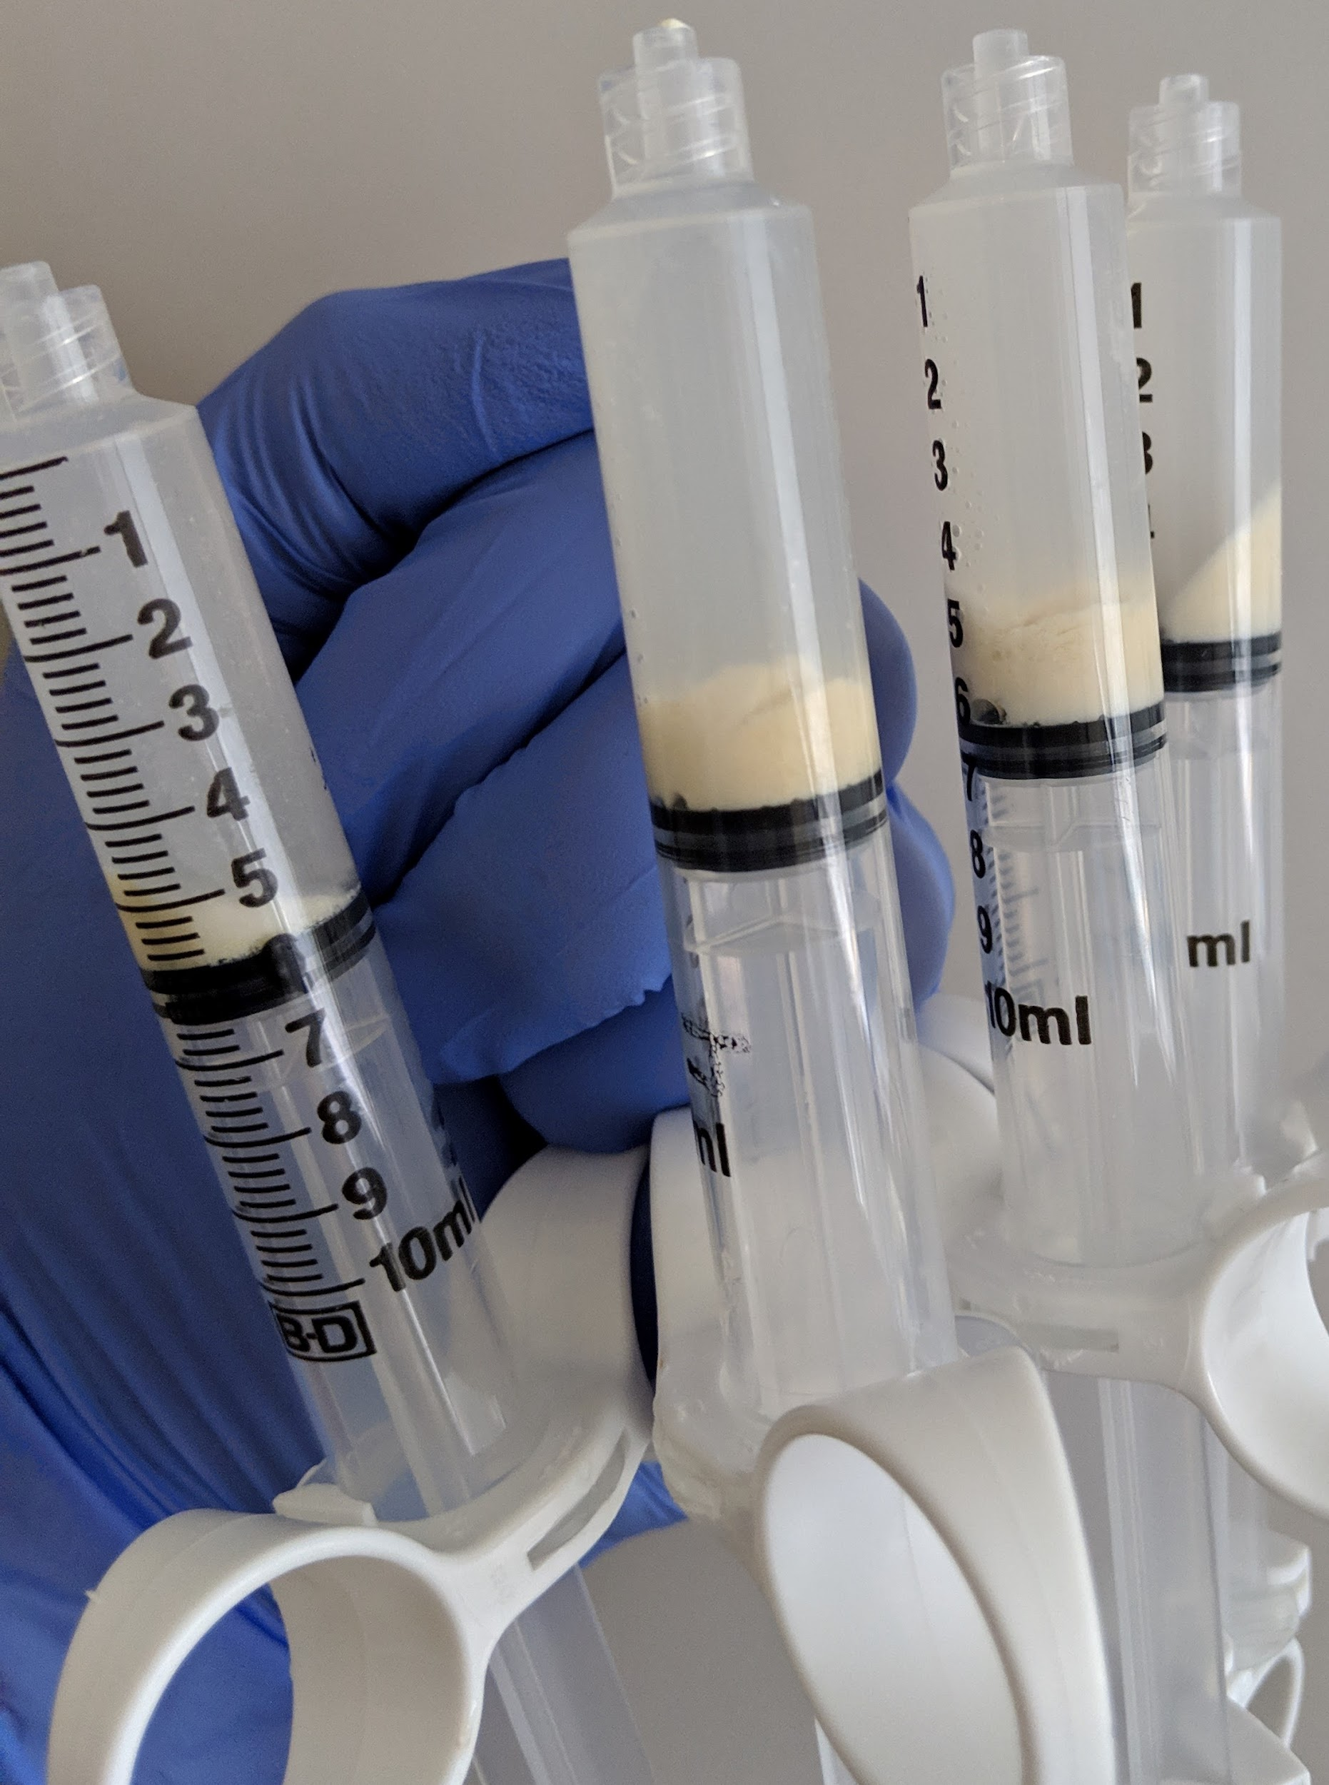
Calcific Rotator Cuff Tendinosis: US-Guided Barbotage
Notes:
Have people in crass position lateral decub for stability purposes. Holding modified crass position is too hard to hold for the length of the procedure. Do a consult beforehand to US area and make sure they can actually get in this position
Only one needle insertion, need to the deposit intake and multiple fenestrations make it very difficult to create the pressure needed to get the crystal extraction. I try to compare it to hydro fracking oil but most patients get a glazed look in their eyes when I say that

Slide 28
Conclusion
Chronic Tendinopathy
  Majority of what we see in clinic is chronic tendinosis, not tendinitis
  Treatment will likely be at least 3 months
Treatments
  Recommend:
    Nitro Patches
    Bracing (depending on the site)
    Eccentric exercises
    US-guided procedures if others fail
  Use sparingly if needed:
    NSAIDs
    Corticosteroid Injections
    Graston-type techniques
Notes:
Manage expectations! Prepare patients for a reasonable goal of 3 months for resolution and maybe longer
Eccentric exercises is the main fire and these other treatments help stoke it

Slide 29
Questions?

Slide 30
Sources
A Hamid MS, Sazlina SG. Platelet-rich plasma for rotator cuff tendinopathy: A systematic review and meta-analysis. PLoS One. 2021 May 10;16(5):e0251111. doi: 10.1371/journal.pone.0251111. PMID: 33970936; PMCID: PMC8109792.
Kane, S. F., Olewinski, L. H., Tamminga, K. S. (2019) Management of Chronic Tendon Injuries. Am Fam Physician. 2019 Aug 1;100(3):147-157.
Challoumas D, Kirwan PD, Borysov D, et alTopical glyceryl trinitrate for the treatment of tendinopathies: a systematic review British Journal of Sports Medicine 2019;53:251-262.
Praet S.F.E., Purdam C.R., Welvaert M., Vlahovich N., Lovell G., Burke L.M., Gaida J.E., Manzanero S., Hughes D., Waddington G. Oral Supplementation of Specific Collagen Peptides Combined with Calf-Strengthening Exercises Enhances Function and Reduces Pain in Achilles Tendinopathy Patients. Nutrients. 2019;11:76. doi: 10.3390/nu11010076.
Chan, K. M., Fu, S. C. (2009) Anti-inflammatory management for tendon injuries - friends or foes? Sports Med Arthrosc Rehabil Ther Technol. 2009; 1: 23.
Connizzo BK, Yannascoli SM, Tucker JJ, Caro AC, Riggin CN, Mauck RL, Soslowsky LJ, Steinberg DR, Bernstein J. The detrimental effects of systemic Ibuprofen delivery on tendon healing are time-dependent. Clin Orthop Relat Res. 2014 Aug;472(8):2433-9. doi: 10.1007/s11999-013-3258-2. PMID: 23982408; PMCID: PMC4079885.
Su, B., O'Connor, J.P. (2013) NSAID therapy effects on healing of bone, tendon, and the enthesis. Journal of Applied Physiology. Volume 115, Issue 6. Pages 892-899.
Allison GT, Purdam C Eccentric loading for Achilles tendinopathy — strengthening or stretching?British Journal of Sports Medicine 2009;43:276-279.
Witvrouw E, Mahieu N, Roosen P, et al The role of stretching in tendon injuries British Journal of Sports Medicine 2007;41:224-226.
Dimitrios S. Exercise for tendinopathy. World J Methodol. 2015;5(2):51-54. Published 2015 Jun 26. doi:10.5662/wjm.v5.i2.51
Dimitrios S, Pantelis M, Kalliopi S. Comparing the effects of eccentric training with eccentric training and static stretching exercises in the treatment of patellar tendinopathy. A controlled clinical trial. Clin Rehabil. 2012 May;26(5):423-30. doi: 10.1177/0269215511411114. Epub 2011 Aug 19. PMID: 21856721.
Coombes, B.K., Bisset, L., Vicenzino, .Efficacy and safety of corticosteroid injections and other injections for management of tendinopathy: a systematic review of randomised controlled trials,The Lancet,Volume 376, Issue 9754,2010,Pages 1751-1767,ISSN 0140-6736.
Bass E. Tendinopathy: why the difference between tendinitis and tendinosis matters. Int J Ther Massage Bodywork. 2012;5(1):14-17. doi:10.3822/ijtmb.v5i1.153
Khan, K.M., Cook, J.L., Taunton, J.E., Bonar, F. Overuse Tendinosis, Not Tendinitis. THE PHYSICIAN AND SPORTSMEDICINE - VOL 28 - NO. 5 - MAY 2000
Cheatham SW, Lee M, Cain M, Baker R. The efficacy of instrument assisted soft tissue mobilization: a systematic review. J Can Chiropr Assoc. 2016;60(3):200-211.
Kingma JJ, de Knikker R, Wittink HM, Takken T. Eccentric overload training in patients with chronic Achilles tendinopathy: a systematic review. Br J Sports Med. 2007;41(6):e3. doi:10.1136/bjsm.2006.030916

Slide 31
Sources
Cullinane FL, Boocock MG, Trevelyan FC. Is eccentric exercise an effective treatment for lateral epicondylitis? A systematic review. Clin Rehabil. 2014 Jan;28(1):3-19. doi: 10.1177/0269215513491974. Epub 2013 Jul 23. PMID: 23881334.
Yang Z, Wang S. Effectiveness of Eccentric Exercise for the Management of Rotator Cuff Tendinopathy: A Critical Review. Orthopedics and Sports Medicine: Open Access Journal. January 08, 2020. DOI: http://dx.doi.org/10.32474/OSMOAJ.2020.03.000162
Louwerens J. EVALUATING TREATMENT OPTIONS FOR CALCIFIC TENDINITIS OF THE ROTATOR CUFF. https://www.orthopeden.org/downloads/837/proefschrift-jan-louwerens.pdf
Joseph, M.F., Taft, K., Moskwa, M., Denegar, C.R. Deep Friction Massage to Treat Tendinopathy: A Systematic Review of a Classic Treatment in the Face of a New Paradigm of Understanding. November 2012. Journal of Sport Rehabilitation 21(4):343-53
Scott LA, Munteanu SE, Menz HB. Effectiveness of orthotic devices in the treatment of Achilles tendinopathy: a systematic review. Sports Med. 2015 Jan;45(1):95-110. doi: 10.1007/s40279-014-0237-z. PMID: 25108348.
Shahabi S, Bagheri Lankarani K, Heydari ST, Jalali M, Ghahramani S, Kamyab M, Tabrizi R, Hosseinabadi M. The effects of counterforce brace on pain in subjects with lateral elbow tendinopathy: A systematic review and meta-analysis of randomized controlled trials. Prosthet Orthot Int. 2020 Oct;44(5):341-354. doi: 10.1177/0309364620930618. Epub 2020 Jul 8. PMID: 32635812.
Kroslak M, Pirapakaran K, Murrell GAC. Counterforce bracing of lateral epicondylitis: a prospective, randomized, double-blinded, placebo-controlled clinical trial. J Shoulder Elbow Surg. 2019 Feb;28(2):288-295. doi: 10.1016/j.jse.2018.10.002. PMID: 30658774.
David Krey, James Borchers & Kendra McCamey (2015) Tendon needling for treatment of tendinopathy: A systematic review, The Physician and Sportsmedicine, 43:1, 80-86, DOI: 10.1080/00913847.2015.1004296
UYGUR, E., AKTAŞ, B., ÖZKUT, A. et al. Dry needling in lateral epicondylitis: a prospective controlled study. International Orthopaedics (SICOT) 41, 2321–2325 (2017). https://doi.org/10.1007/s00264-017-3604-1
McShane JM, Nazarian LN, Harwood MI. Sonographically guided percutaneous needle tenotomy for treatment of common extensor tendinosis in the elbow. J Ultrasound Med. 2006 Oct;25(10):1281-9. doi: 10.7863/jum.2006.25.10.1281. PMID: 16998100.
Barnes DE, Beckley JM, Smith J. Percutaneous ultrasonic tenotomy for chronic elbow tendinosis: a prospective study. J Shoulder Elbow Surg. 2015 Jan;24(1):67-73. doi: 10.1016/j.jse.2014.07.017. Epub 2014 Oct 8. PMID: 25306494.
Kirschner, J., Cheng, J., Hurwitz, N., Santiago, K., Lin, E., Beatty, N., Kingsbury, D., Wendel, I., Milani, C. Ultrasound‐guided percutaneous needle tenotomy (PNT) alone vs. PNT plus platelet‐rich plasma injection for the treatment of chronic tendinosis: a randomized controlled trial. PM&R. 28 February 2021 https://doi.org/10.1002/pmrj.12583
Jones D, Brolinson PG, Patton S, Wong C (2017) Hydrodissection of an Achilles Tendinopathy on a Professional Athlete. MOJ Orthop Rheumatol 8(1): 00297. DOI: 10.15406/mojor.2017.08.00297
Boesen AP, Hansen R, Boesen MI, Malliaras P, Langberg H. Effect of High-Volume Injection, Platelet-Rich Plasma, and Sham Treatment in Chronic Midportion Achilles Tendinopathy: A Randomized Double-Blinded Prospective Study. Am J Sports Med. 2017 Jul;45(9):2034-2043. doi: 10.1177/0363546517702862. Epub 2017 May 22. PMID: 28530451.
van der Vlist A C, van Oosterom R F, van Veldhoven P L J, Bierma-Zeinstra S M A, Waarsing J H, Verhaar J A N et al. Effectiveness of a high volume injection as treatment for chronic Achilles tendinopathy: randomised controlled trial BMJ 2020; 370 :m3027 doi:10.1136/bmj.m3027
Dubois B, Esculier J Soft-tissue injuries simply need PEACE and LOVE. British Journal of Sports Medicine 2020;54:72-73.

Slide 32
Sources
Chaudhry FA. Effectiveness of dry needling and high-volume image-guided injection in the management of chronic mid-portion Achilles tendinopathy in adult population: a literature review. Eur J Orthop Surg Traumatol. 2017;27(4):441-448. doi:10.1007/s00590-017-1957-1
Zhang T, Duan Y, Chen J, Chen X. Efficacy of ultrasound-guided percutaneous lavage for rotator cuff calcific tendinopathy: A systematic review and meta-analysis. Medicine (Baltimore). 2019;98(21):e15552. doi:10.1097/MD.0000000000015552
Lafrance S, Doiron-Cadrin P, Saulnier M, et alIs ultrasound-guided lavage an effective intervention for rotator cuff calcific tendinopathy? A systematic review with a meta-analysis of randomised controlled trialsBMJ Open Sport & Exercise Medicine 2019;5:e000506. doi: 10.1136/bmjsem-2018-000506
Bennett A, Watson T, Simmonds J17 The Efficacy Of The Use Of Manual Therapy In The Management Of Tendinopathy: A Systematic ReviewBritish Journal of Sports Medicine 2014;48:A11-A12.
Cook JL, Purdam CR Is tendon pathology a continuum? A pathology model to explain the clinical presentation of load-induced tendinopathyBritish Journal of Sports Medicine 2009;43:409-416.
Cook JL, Rio E, Purdam CR, et alRevisiting the continuum model of tendon pathology: what is its merit in clinical practice and research?British Journal of Sports Medicine 2016;50:1187-1191.
Zhu, J., Jiang, Y., Hu, Y. et al. Evaluating the long-term effect of ultrasound-guided needle puncture without aspiration on calcifying supraspinatus tendinitis. Adv Therapy 25, 1229–1234 (2008). https://doi.org/10.1007/s12325-008-0115-x
Malanga, G., Mautner, K., et al. Atlas of Ultrasound-Guided Musculoskeletal Injections. McGraw-Hill Education; 2014
Image:
https://www.livestrong.com/article/13722060-exercises-stretches-tight-shoulders/
https://miamiwellness.com/shoulder-injection/
https://instituteforathleticmedicine.com/our-services/orthobiologics-stem-cell-therapy-prp/
https://www.arthrex.com/orthobiologics/arthrex-angel-system
https://www.hortonsoandp.com/injection-alternatives-in-tennis-elbow-treatment-using-orthotic-braces/
https://www.physio-pedia.com/Tennis_Elbow_Management
https://www.youtube.com/watch?v=TE2Kfr7MCB8
https://larsonsportsortho.com/what-is-tendinitis/shutterstock_55046425/
https://www.vitalproteins.com/products/collagen-peptides#
https://rehab-u.com/blog/stop-stretching-for-tendinopathy/
https://limitless.physio/blog/2019/6/20/stop-stretching-for-tendonitis-do-this-instead
https://www.advancedpaindoc.com/service/intra-articular-joint-steroid-injections/?hcb=1
https://www.tennistips.org/best-tennis-elbow-strap/
https://www.evs-sports.com/products/sb04-shoulder-support
https://www.sourceortho.net/aircast-airheel-brace/?sku=09AM&gclid=Cj0KCQjwvYSEBhDjARIsAJMn0ljxXNYkTidSGA7C-lDTPI-DMN_ar1F7e3uFdbcpBAW-wAwseXW6LEsaApl7EALw_wcB
https://www.wodconnect.com/blog/posts/increase-mobility-while-improving-performance-strengthen-to-lengthen

