Slide 1
ROLE OF A SPORTS SCIENTISTS IN THE MANAGEMENT OF SPORTS INJURIES.
The missing link in sports injury management in Kenya?
Dr Kiptolo Boit

Slide 2
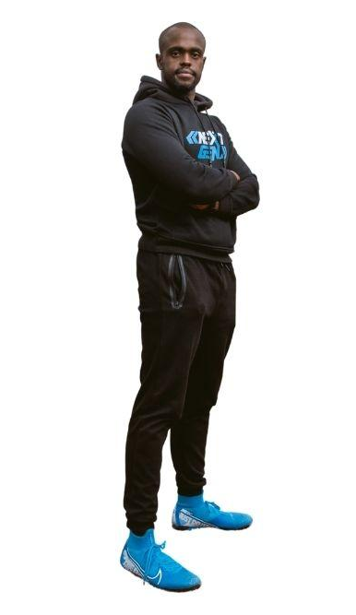
Dr. Kiptolo Boit
Former Kenya International Swimmer
CEO Nextgen Multi-Sport Academy
CEO Nextgen Health & Wellness
Lecturer Kenyatta University

Slide 3
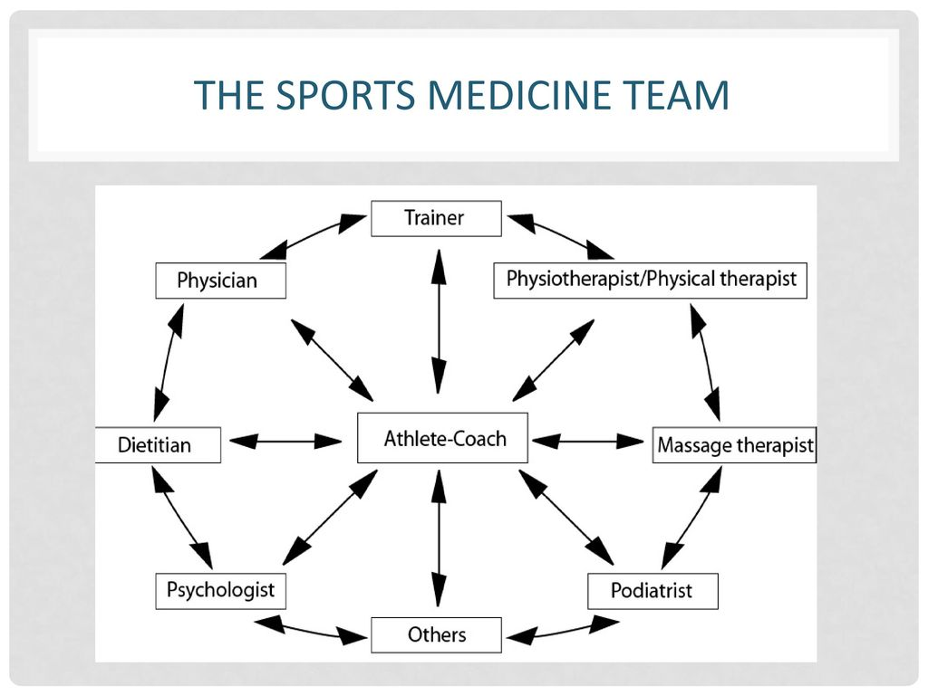
What really is the role of a sports scientist in injury management????

Slide 4



Slide 5
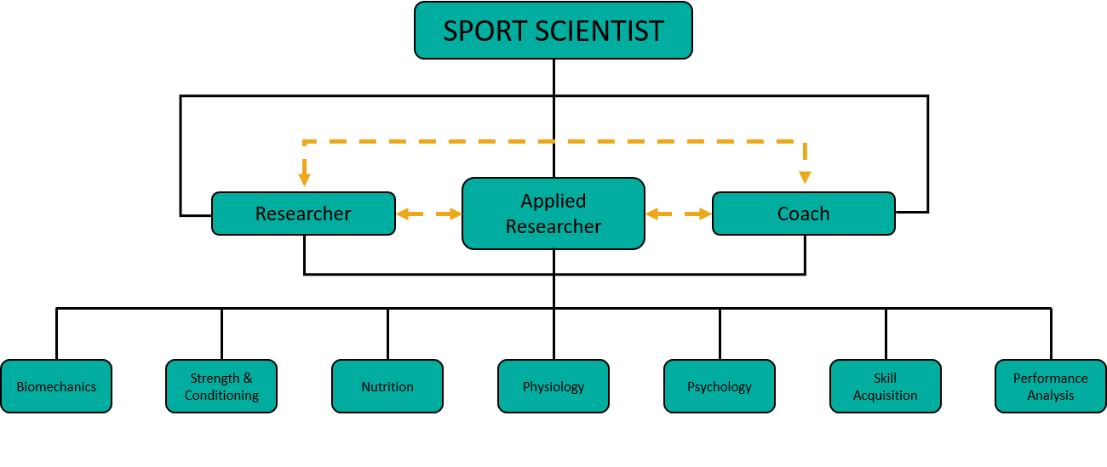

Slide 6
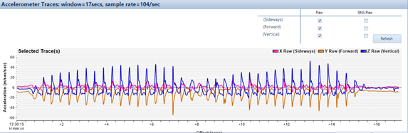
Injury prevention, assessment & management

Slide 7
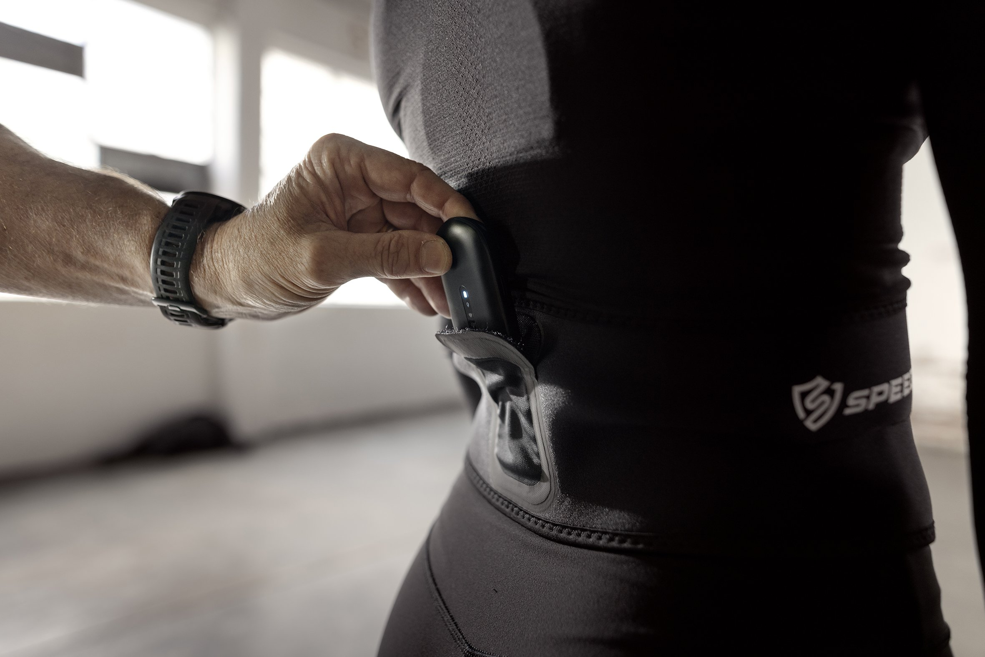
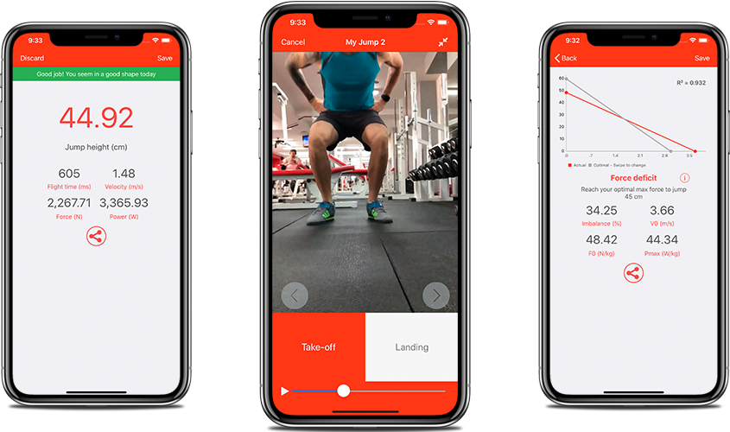
Injury prevention, assessment & management

Slide 8
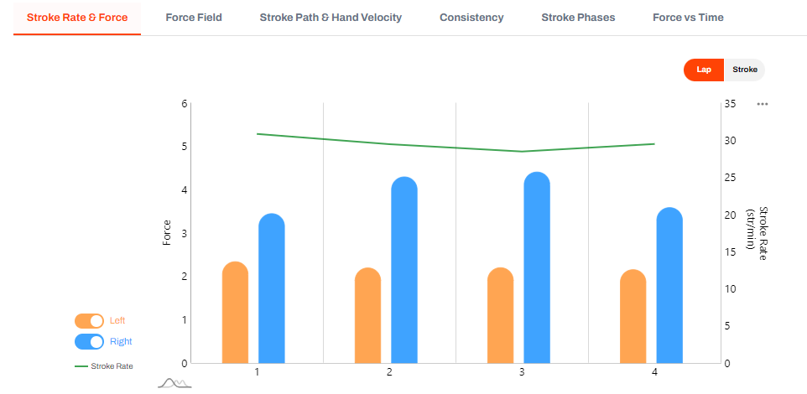
Injury prevention, assessment & management

Slide 9
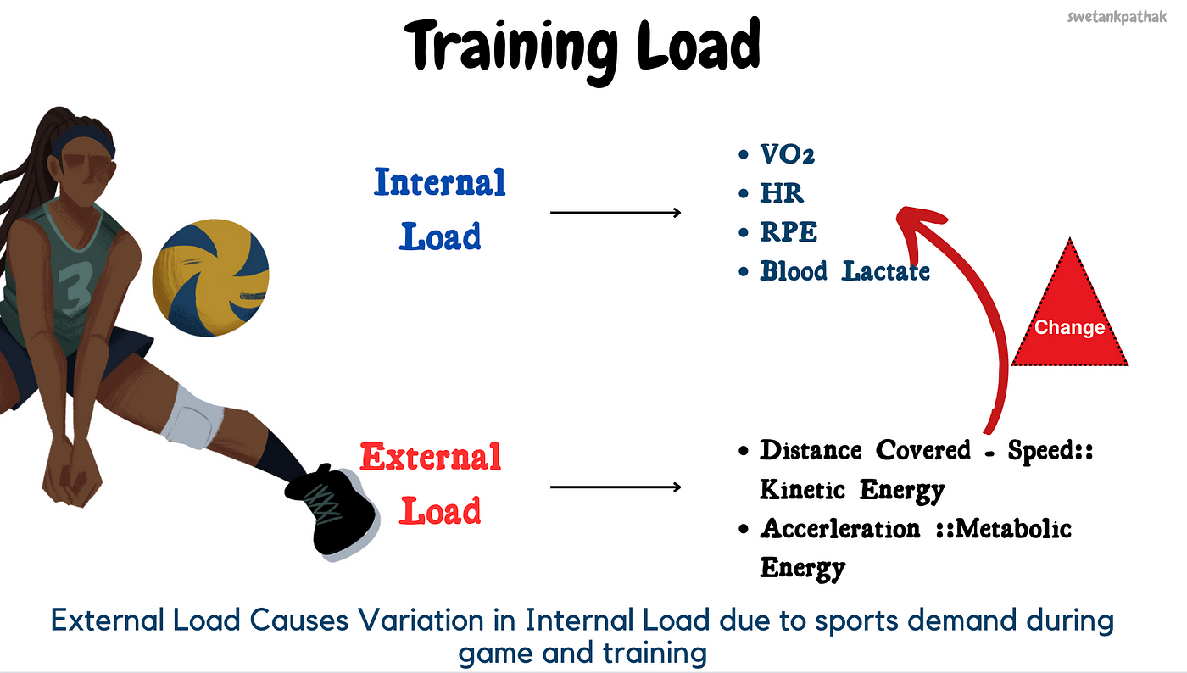
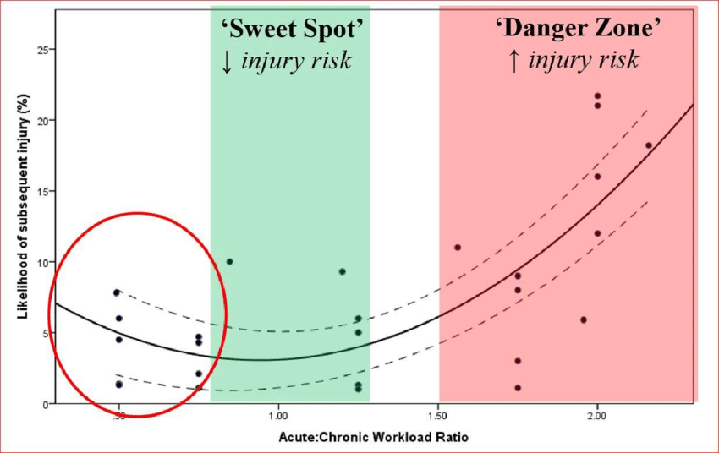
Load management

Slide 10
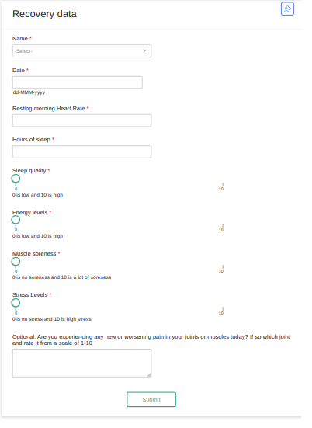

Managing recovery, sleep and wellness

Slide 11
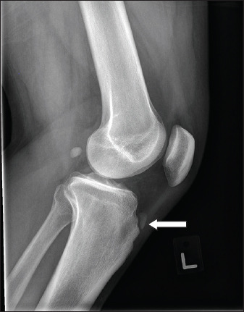
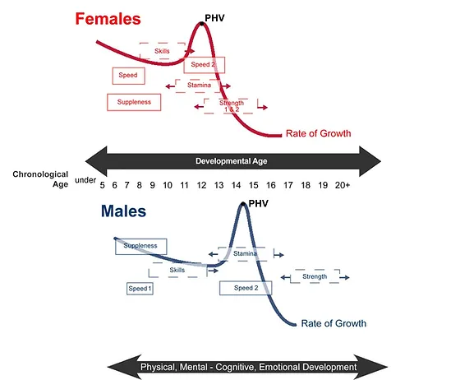
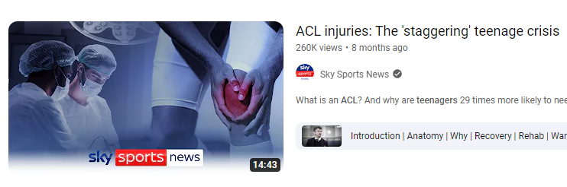
Policies around injury prevention and management

Slide 12
Then what is the role of a sports scientist in the team setting?

Slide 13
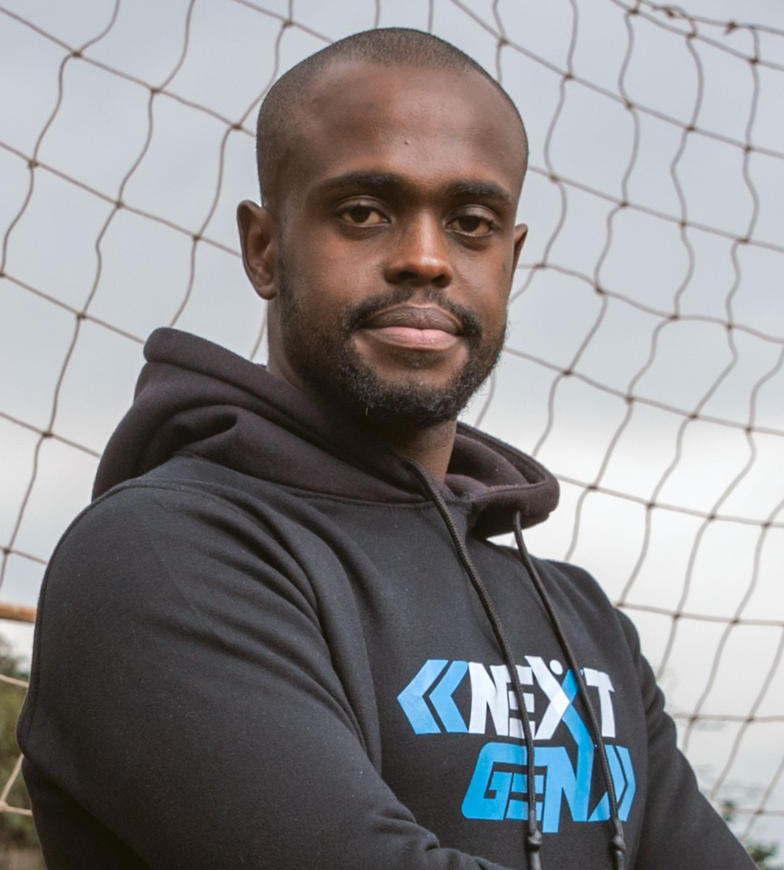
END
0706807219
QUESTIONS?
Photo by Pexels

