Slide 1
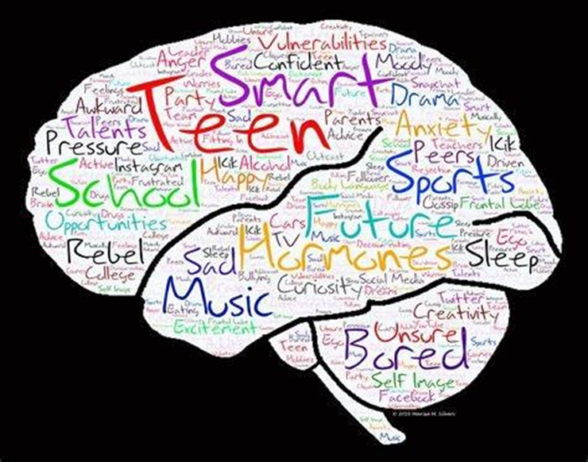
Sports Psychology
Dr. Njeri Karianjahi
Consultant Paediatrician
Adolescent Medicine Specialist

Slide 2
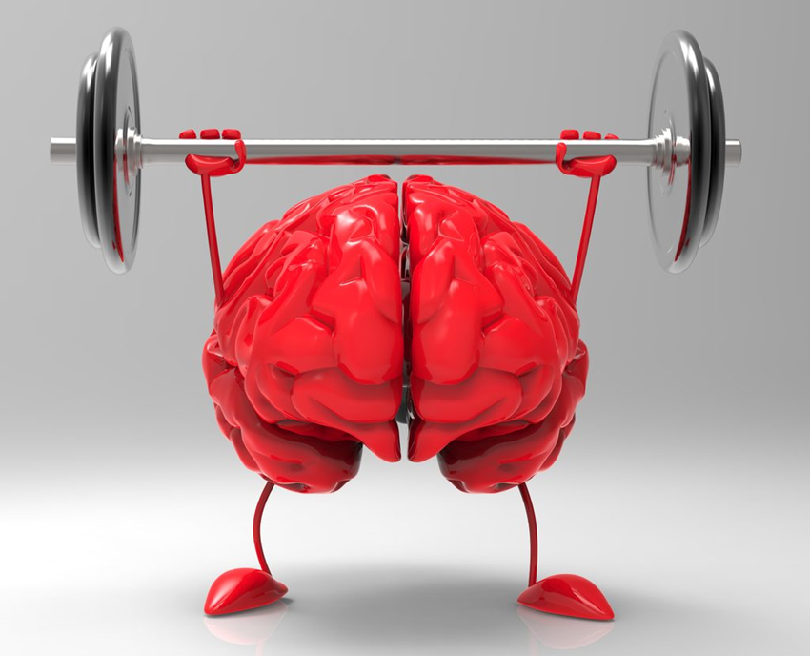
Introduction
The state of mental health in Kenya
Life course approach
Adolescent brain development
Sports psychology
Benefits of sports psychology

Slide 3
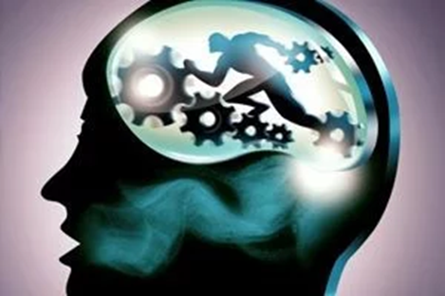
It’s not about reducing pressure it’s about building the capacity to embrace more.”
Jonah Oliver

Slide 4

The state of mental health in Kenya
2 out of 5 adolescents had a mental health problem.
1 in 8 adolescents meets a diagnosis for a mental health disorder.
Kenya National Mental Health Survey, 2021.

Slide 5
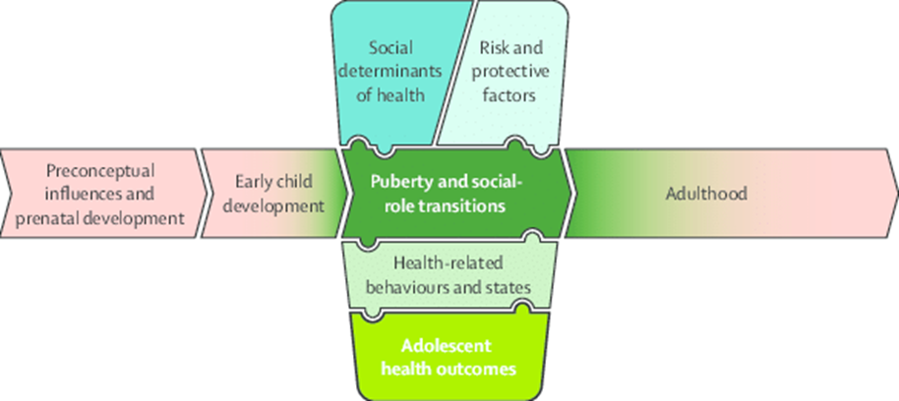
Life course Approach
Conceptual Framework for adolescent health(From Sawyer SM, Bearinger LH, et al. Adolescence: A foundation of future health. Lancet 2012;379(9826):1630-1640.

Slide 6
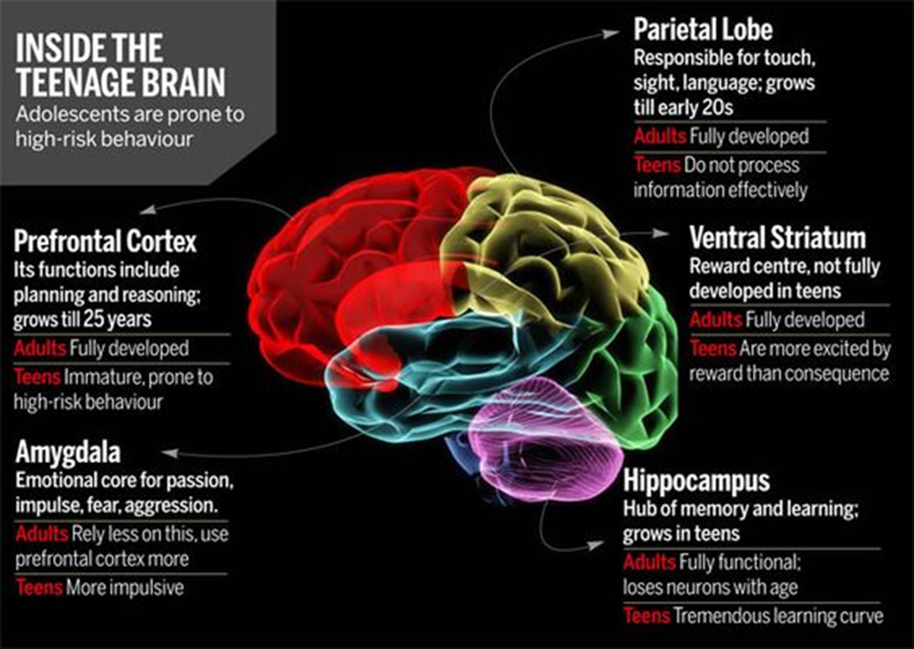
Adolescent Brain Development

Slide 7
Why Sports Psychology
Sports psychology: use of psychology to tackle
Optimising performance
Wellness of athletes
Developmental aspects of sports participation
Social aspects of sports participation
Systems around sports settings and organisations
https://www.apa.org/ed/graduate/specialize/sports

Slide 8
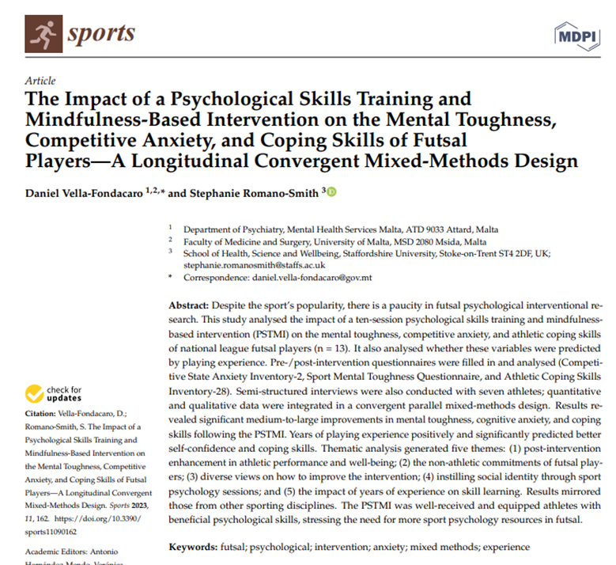
Goal setting
Motor Imagery
Mindfulness/ Arousal Regulation
Self Talk

Slide 9

Goal Setting Theory
Goals improve performance through:
Directs efforts
Energise an individual in a task
Persistence in tasks
Adoption of task-relevant strategies.
https://selfdeterminationtheory.org/wp-content/uploads/2019/08/2018_HealyTinckell-SmithNtoumanis_OxfordREP.pdf
Conscious goals Task Perform

Slide 10
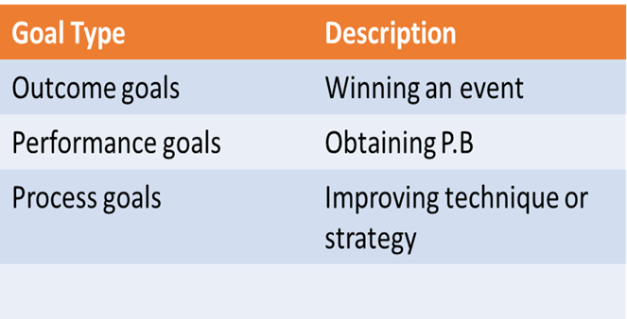
Goal Types
https://selfdeterminationtheory.org/wp-content/uploads/2019/08/2018_HealyTinckell-SmithNtoumanis_OxfordREP.pdf

Slide 11
Goal Setting Theory
Principles of effective goal setting:
Specific
Measurable
Challenging (Achievable)
Realistic
Time-bound-short, mid and long term
Continually reevaluating goals

Slide 12
Motor Imagery
The act of rehearsing voluntary movements without engaging in the actual corresponding actions.
Has positive impact on psychological states e.g reducing anxiety, increasing self confidence and self efficacy, use as a coping strategy, maintaining skills
Mental preparation technique
Morone G. et.al,2022

Slide 13
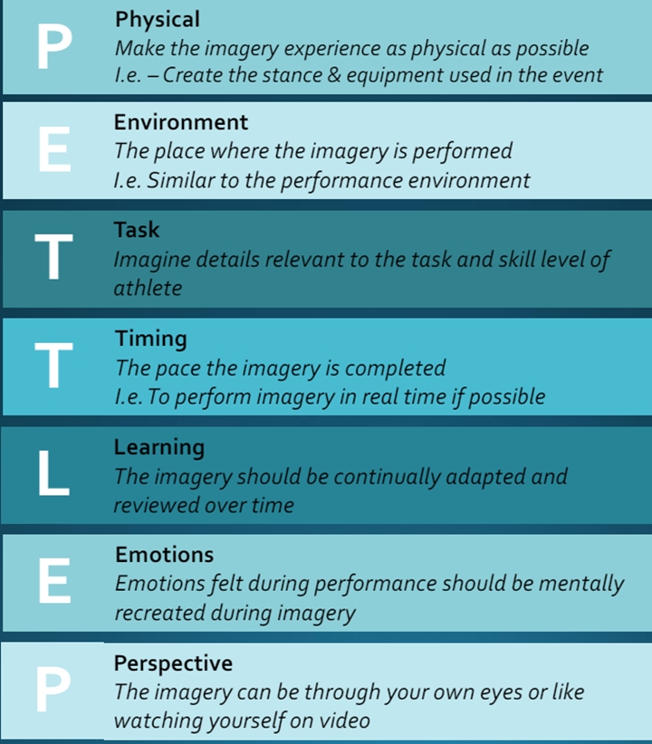

Slide 14
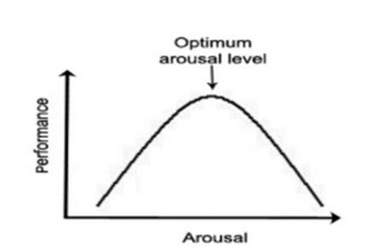
Arousal Regulation
Arousal Regulation: physiological and psychological activation level.
Scale from deep sleep to intense excitement.
https://www.wiu.edu/coehs/performance_psychology/leap/resources/anxiety/Arousal%20Regulation.pdf
https://rangeofmotion.net.au/arousal-regulation-psychological-skills-training/

Slide 15
Excess arousal caused by:
Competitive situation
Fear of failure
Being watched or judged by others.
Impacts:
Excessive arousal=muscle tense, coordination difficulties
Excessive arousal=Reduced attention and concentration

Slide 16
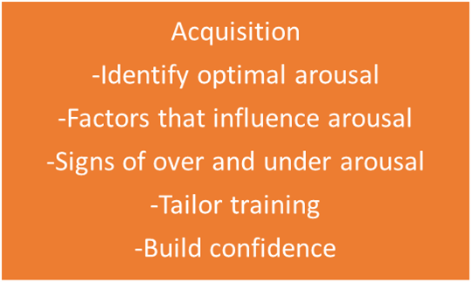
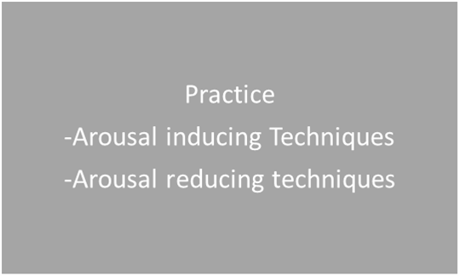
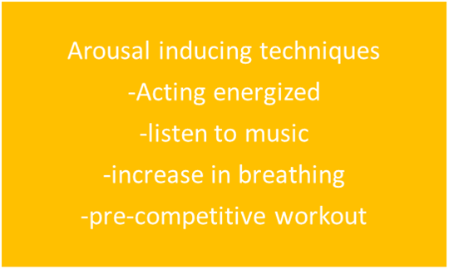
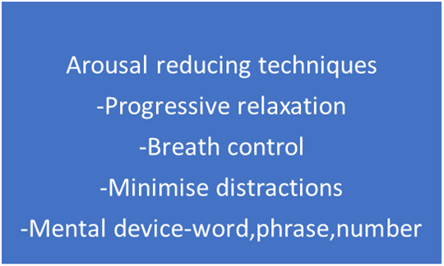
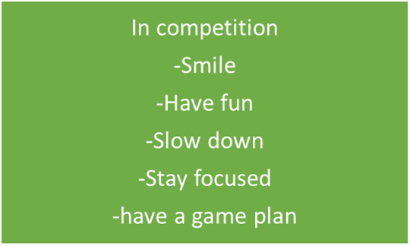
Arousal Regulation
https://rangeofmotion.net.au/arousal-regulation-psychological-skills-training

Slide 17
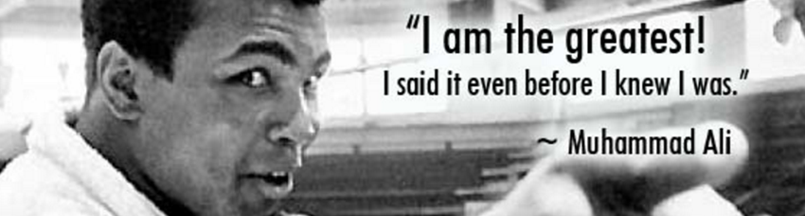
Self Talk
Self talk is defined as statements addressed to the self-Hardy,2006
Types of self talk:
Calming
Instructional
Motivational
Focus
https://oxfordre.com/psychology/display/10.1093/acrefore/9780190236557.001.0001/acrefore-9780190236557-e-157
https://www.coachestoolbox.net/mental-toughness/positive-self-talk-for-your-athletes

Slide 18
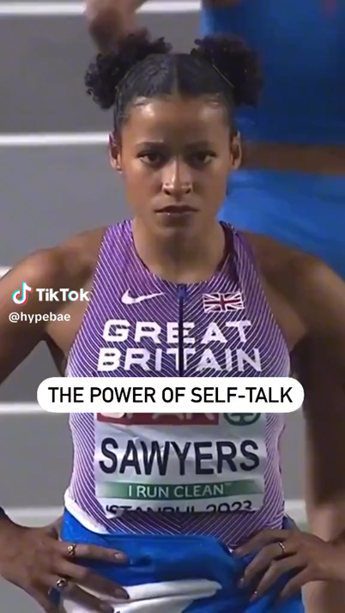
Which Type of Self Talk is This?

Slide 19
Benefits of Sports on Academic Achievement
Better at reading and maths
Higher grade point averages
Improved attention, planning, problem-solving, working memory, inhibitory control
Spatial learning in older adolescent males
Herting MM, Chu X. Exercise, cognition, and the adolescent brain. Birth Defects Res. 2017 Dec 1;109(20):1672-1679. doi: 10.1002/bdr2.1178. PMID: 29251839; PMCID: PMC5973814.

Slide 20
Benefits of Psychological Skills Training on Sports
Improve performance and confidence
Helps deal with emotions better
Tools to deal with the pressure of competition
Recovery from injuries
Sports specific technique acquisition

Slide 21
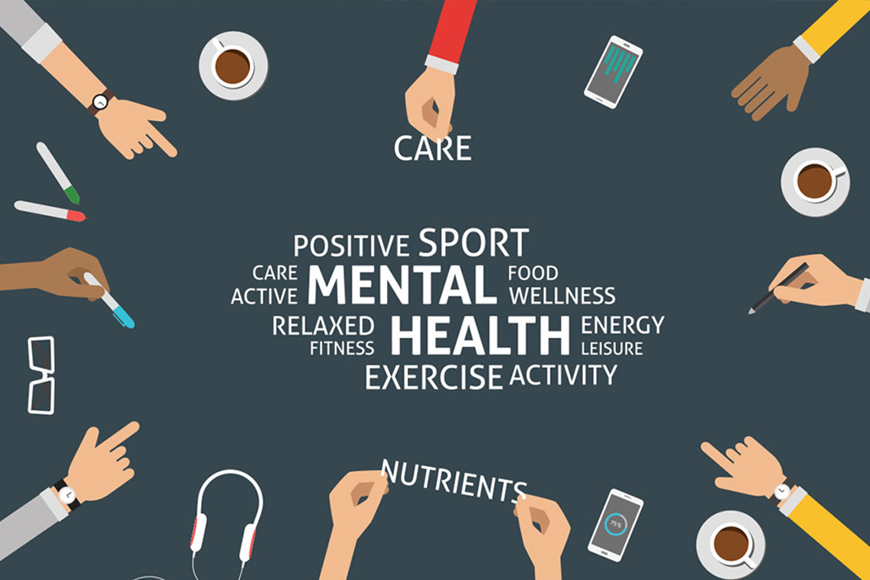
Questions?

Slide 22
Connect with us!
nkarianjahi@gerties.org
Adolescent/Teen medicine clinic:
Call: 0207206000
Tuesdays 12noon-5pm Junction clinic
Thursdays 12noon-5pm Muthaiga
Psychology clinic: Mondays-Fridays

