Slide 1
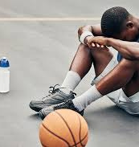
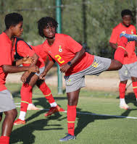
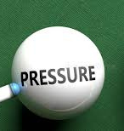
Inside the Mind
Performing under Pressure and Enjoyment of Sport for the Young Athlete
BY ROWENA TIROP, SPORT AND EXERCISE PSYCHOLOGIST, MSC

Slide 2
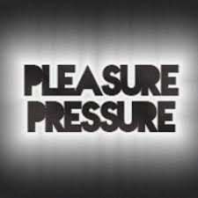
The Dual Nature of Sport - Pressure vs. Pleasure
  “Approximately 70% of youth athletes drop out of organized sport by age 13" (National Alliance for Youth Sports, cited in Gould, 2019). Why? "It's not fun anymore" is the #1 reason cited (Gould & Carson, 2008; Fraser-Thomas et al., 2005).
  "High levels of perceived pressure are significantly correlated with **increased anxiety, burnout, and decreased enjoyment" (Scanlan et al., 1991; Smith et al., 2007).
  "Excessive parental pressure is linked to higher levels of pre-competitive anxiety and lower self-esteem in young athletes" (Knight et al., 2011; O'Rourke et al., 2011).

Slide 3
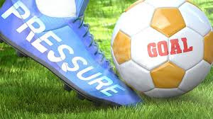
What is Performing under Pressure?
  It is managing the mental and emotional stress that come up in high stakes situations, games.
  Its performing in the moments that matter to you and the moments where you perceive the stakes are high.
  It is about maintaining focus, confidence and control to execute skills effectively despite the pressure.

Slide 4
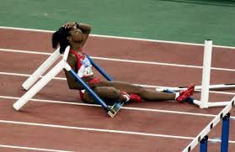
Definition:
  A sudden drop in performance under pressure
  Caused by anxiety overriding skill execution
  Happens when there is reinvestment - an athlete consciously controls movements that are normally automatic. Analysis paralysis.
Causes of Choking
  Performance Anxiety – fear of failure or mistakes
  High-Pressure Situations – finals, penalties, or “must-win” moments
  Overthinking – focusing too much on technique or outcome
  Fear of Judgment – pressure from parents, coaches, or peers
  Low Self-Confidence – lack of belief in abilities
  Poor Coping Skills – weak emotional regulation, no mental strategies
  Unrealistic Expectations – pressure to be perfect or always win
  Lack of Mental Preparation – focus only on physical training
Choking in Sport

Slide 5
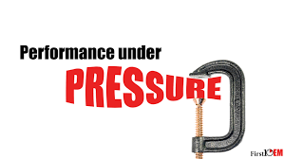
Where does Pressure come from?
  Self-Imposed: Personal expectations, fear of failure, perfectionism.
Coach-Driven: High expectations, critical feedback, playing time uncertainty, over-emphasis on outcome.
Parental Influence: Over-involvement, critical comments, vicarious living, emotional reactions.
Peer/Social: Teammate comparisons, social status, social media scrutiny.
Organizational: Scholarship pressure, selection processes, intense schedules.

Slide 6
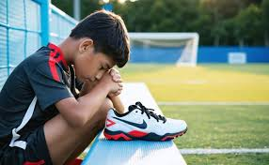
Effects of unmanaged pressure
  Performance Anxiety: Intense emotional distress before, during, or after performance. Can manifest in somatic (stomachaches, headaches), cognitive (worry, negative thoughts), and behavioral (avoidance) symptoms (PMC, 2025).
  Fear of Failure: A pervasive apprehension about not meeting expectations, leading to self-criticism and reduced self-efficacy (Frontiers in Psychology, 2025).
  Burnout: Emotional and physical exhaustion, often leading to devaluation of the sport and reduced sense of accomplishment (ResearchGate, 2017).
  Early Dropout: The ultimate consequence, as young athletes lose intrinsic motivation and perceive the activity as a source of stress rather than enjoyment (BPAS Journals, 2023).
  Identity collapse: “I’m only valuable if I win”

Slide 7
How to manage pressure
1. Understanding Pressure and Stress:
  Acknowledge Pressure: Recognize that pressure is a normal part of sports and can come from various sources like coaches, parents, peers, and even social media.
  Stress as a Motivator: Teach athletes to view pressure as a challenge that can be overcome, rather than a threat that causes anxiety.
2. Building Confidence and Mental Toughness:
  Positive Self-Talk: Encourage athletes to use positive affirmations and replace negative thoughts with positive ones.
  Visualization: Have athletes visualize themselves succeeding in high-pressure situations to build confidence and reduce anxiety.
  Practice Under Pressure: Create simulated pressure situations in training to help athletes become more comfortable with pressure.
  Reframing: Help athletes reframe stressful situations by focusing on what they can control and their strengths.
  Mindset Training: Implement interventions like the "Mindset: Performing Under Pressure" program, which uses a multimodal approach to educate athletes about stress, challenge irrational beliefs, and encourage a positive mindset.

Slide 8
How to manage pressure
3. Stress Management Techniques:
  Breathing Exercises: Teach deep breathing techniques, like taking slow, deep breaths, to calm the nervous system.
  Mindfulness: Encourage mindfulness practices to help athletes stay present and focused in the moment.
  Relaxation Techniques: Incorporate relaxation exercises to help athletes manage anxiety and stress.
4. Creating a Supportive Environment:
  Role Models: Encourage athletes to look up to role models who demonstrate mental toughness and resilience.
  Open Communication: Foster open communication between athletes, coaches, and parents to address concerns and build trust.
  Positive Feedback: Provide constructive feedback and focus on effort and improvement rather than solely on outcome

Slide 9
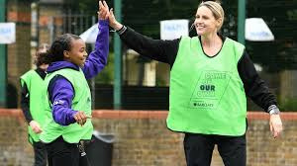
Enjoyment in Sport
What Does Enjoyment Mean? (Scanlan & Simons, 1992; Scanlan et al., 1993):
  Positive feelings (excitement, happiness).
  Perceived competence ("I can do this!").
  Sense of mastery and learning.
  Positive social interactions (friendships, team cohesion).
  Challenge and excitement.
Why It's Non-Negotiable (Based on SDT - Deci & Ryan, 2000; Visek et al., 2015):
  Fuels Intrinsic Motivation: Drives effort and persistence for its own sake.
  Predicts Continued Participation: Kids stick with what they enjoy.
  Enhances Learning & Skill Acquisition: Positive states facilitate cognitive function.
  Builds Resilience: Enjoyment buffers against stress and setbacks.
  Correlates with *Better Performance* Athletes who enjoy their sport tend to perform better long-term (Visek et al., 2015).
"Having fun" is the main reason most children like to participate in sports; however, parents often perceive the main reason as "winning" (PMC, 2013).

Slide 10
How pressure can squeeze out enjoyment
THE NEUROPSYCHOLOGICAL IMPACT: WHEN PRESSURE OVERWHELMS
Mechanisms (Based on Cognitive-Affective Models - Lazarus, 1999; Smith, 1986):
  Threat Appraisal: Pressure perceived as threat → Activates stress response (Cortisol ↑) → Anxiety ↑, Focus ↓, Performance ↓.
  Shift to Extrinsic Motivation: Focus shifts to external rewards/avoiding punishment → Undermines intrinsic joy and autonomy (Deci & Ryan, 2000).
  Ego Orientation: Pressure fosters focus on outperforming others → Fear of failure ↑, Self-worth contingent on winning ↓ (Duda, 2001).
  Reduced Autonomy: Feeling controlled by others (coaches, parents) → Vital psychological need unfulfilled → Enjoyment ↓ (Ryan & Deci, 2017).

Slide 11
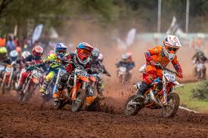
Recognizing when pressure is taking over
Behavioral & Emotional Indicators (Gould et al., 1996; Raedeke & Smith, 2001):
  Athlete: Increased anxiety before/during competition, physical complaints (headaches, stomach aches), withdrawal from teammates/family, perfectionism, excessive anger/frustration after mistakes, drop in performance, talking about quitting.
  Coach/Parent: Over-emphasis on winning/rankings,
  constant criticism (even "constructive"), comparing to others,
  living vicariously, neglecting other life aspects,
  inability to accept loss.

Slide 12
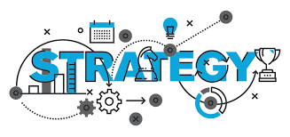
What can we do
Strategies
Strategy 1: Foster a Mastery Motivational Climate (Ames, 1992; Duda, 2001)
Coach/Parent Actions:
  Focus on Effort, Improvement & Learning: "Great job sticking with that drill!" vs. "Why did you miss?"
  Define Success Broadly: Skill mastery, teamwork, resilience, personal bests.
  Use Task-Oriented Feedback: Specific feedback on technique and effort.
  Value Mistakes as Learning: "What did you learn from that?" Normalize errors as part of growth.
  Minimize Social Comparison: Avoid public comparisons between athletes.
Mastery climates consistently linked to higher enjoyment, intrinsic motivation, persistence, and lower anxiety (Harwood et al., 2015).
Strategy 2: Enhance Autonomy & Ownership (Ryan & Deci, 2017)
Coach/Parent Actions:
  Offer Meaningful Choices: Within practice structure (e.g., "Which drill do you want to start with?").
  Encourage Input & Problem Solving: "How do you think we could approach this?"
  Explain the "Why": Connect drills to skill development and personal goals.
  Avoid Controlling Language: Minimize "must," "should," "have to."
  Respect Their Voice: Listen to their concerns and preferences about their sport experience.
Autonomy support is a fundamental pillar of intrinsic motivation and enjoyment (Deci & Ryan, 2000).

Slide 13

What can we do
Strategies
Strategy 3: Develop Coping Skills & Emotional Literacy (Gould & Carson, 2008; Tamminen et al., 2013)
Coach/Psychologist Actions:
  Normalize Pressure & Anxiety: "It's okay to feel nervous; let's talk about how to use that energy."
  Teach Foundational/ Mental Skills: Goal setting (process > outcome), relaxation techniques (breathing),
  positive self-talk, imagery, mindfulness.
  Focus on Controllables: "Focus on your effort and your next pass, not the scoreboard."
  Develop Pre-Performance Routines: Creates predictability and focus.
Mental skills training effectively reduces competitive anxiety and enhances coping, leading to greater enjoyment and performance (Brown & Fletcher, 2017).
Strategy 4: Reframe Parental Involvement (Holt et al., 2008; Knight et al., 2011)
Parent Actions:
  Be Unconditionally Supportive: "I love watching you play" regardless of outcome.
  Listen More, Critique Less: Ask "Did you have fun?" or "What did you enjoy?" before "Did you win?"
  Respect Coaching & Officiating: Avoid sideline coaching or criticizing refs.
  Maintain Perspective: It's *their* journey, not yours. Keep sport in balance with family, school, social life.
  Provide Emotional Safety: Be a calm harbor after tough games.
Positive parental involvement (supportive, autonomy-promoting) strongly predicts enjoyment and continued participation (Knight et al., 2016).

Slide 14

What can we do
Strategies
Strategy 5: Prioritize Recovery & Balance (Gould, 2019)
Coach/Parent/Athlete Actions:
  Enforce Rest Days & Off-Seasons: Prevent physical and mental burnout.
  Encourage Multi-Sport Participation (Especially Early): Develops diverse skills, prevents overuse, reduces pressure.
  Protect Time for Non-Sport Activities: Friends, family, hobbies, academics.
  Monitor Workload: Pay attention to signs of fatigue and disengagement.
  Promote Sleep & Nutrition: Fundamental for physical recovery and mental resilience.
According to research specialization before adolescence, insufficient rest, and imbalance are key risk factors for burnout and dropout (Jayanthi et al., 2013; Brenner & Council on Sports Medicine and Fitness, 2016).

Slide 15

Tools for pressure moments
Quick Reset Techniques:
Deep Breathing: "4-7-8 Method" (Inhale 4s, Hold 7s, Exhale 8s).
Cue Words: "Strong," "Breathe," "Now."
Physical Anchors: Tap wrist (reminder of preparation).

Slide 16
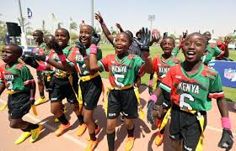
Enjoyment fuels performance
The Positive Cycle:
Lower Pressure + Higher Enjoyment → Increased Intrinsic Motivation → Greater Effort & Persistence → Enhanced Skill Development & Resilience → Improved Performance → Reinforced Enjoyment
Long-Term Outcomes:
* Lifelong love of physical activity.
* Development of resilience, teamwork, goal-setting.
* Greater psychological well-being.
* Sustainable athletic achievement for those who
pursue elite paths.

Slide 17
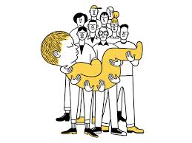
Moving Forward…
  Coaches: Build mastery climates, teach skills, support autonomy.
  Parents: Be the unconditional fan, listen, keep perspective.
  Athletes: Communicate your needs, focus on effort and learning, prioritize balance.
  Organizations: Educate stakeholders, promote holistic development, enforce rest policies.
Protecting enjoyment isn't coddling; it's cultivating the very foundation upon which long-term success, health, and a love for sport are built for our young athletes.
It takes a village!

Slide 18
THANK YOU FOR YOUR ATTENTION!

