Slide 1
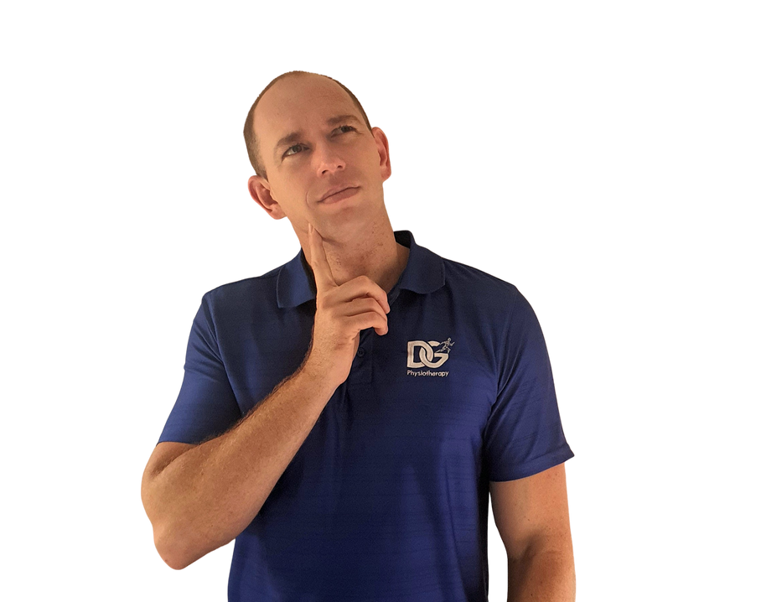

Who am I?
  Dayne Goetsch
  Physiotherapist
  Practice in Hillcrest, KwaZulu-Natal, South Africa
  Focus on MSK with a treat the cause approach
  Injury is better than cure!

Slide 2
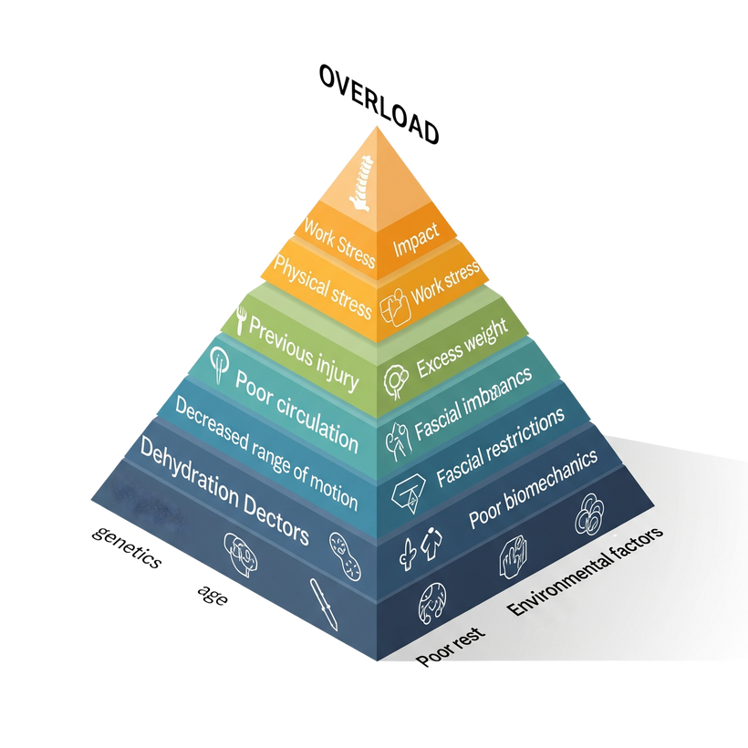

Injury Prevention for Young Athletes
  What causes injury?
Diet

Slide 3
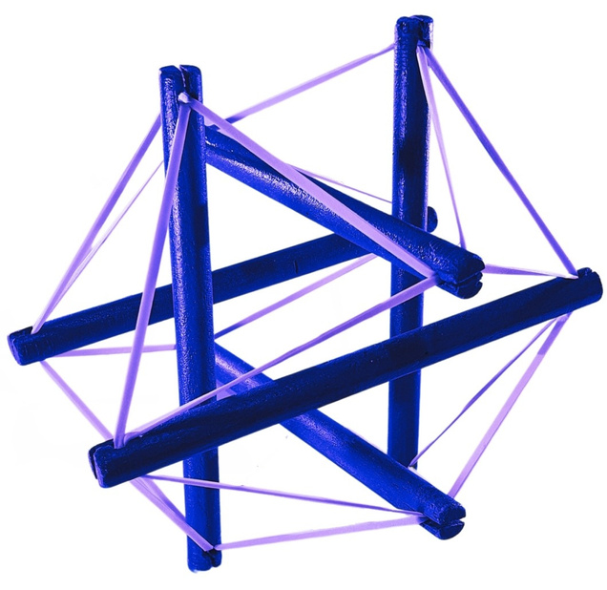

Tensegrity
Tension + integrity

Slide 4
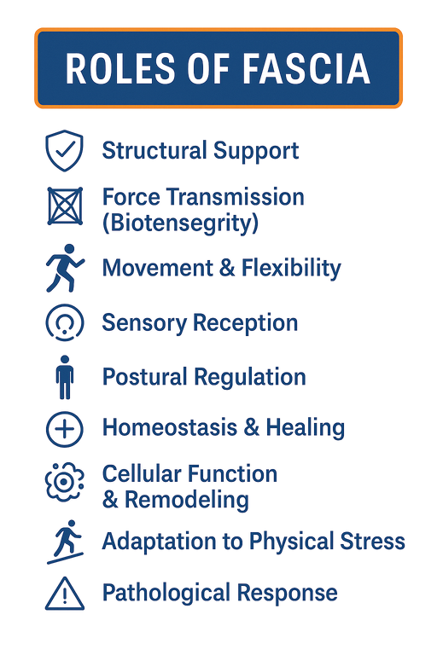
Fascia? What does it do?
Kodama, Y.; Masuda, S.; Ohmori, T.; Kanamaru, A.; Tanaka, M.; Sakaguchi, T.; Nakagawa, M. Response to Mechanical Properties and Physiological Challenges of Fascia: Diagnosis and Rehabilitative Therapeutic Intervention for Myofascial System Disorders. Bioengineering 2023, 10, 474. https://doi.org/10.3390/bioengineering10040474.

Slide 5
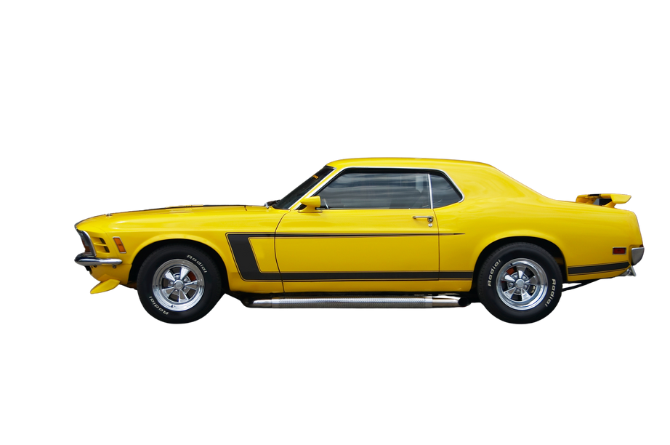

Fascia & Movement
  To prevent injury, avoid overloading the body.

Slide 6
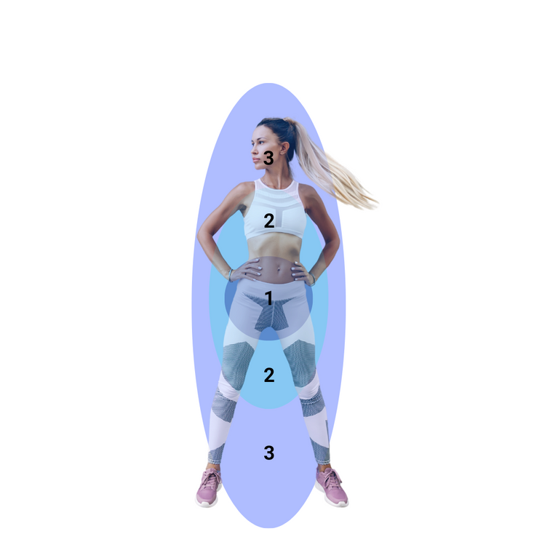
Body Priorities
  Priority order in the body: breathing and movement.

Slide 7
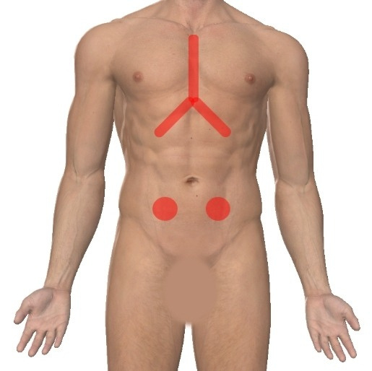
Diaphragm Release
Be Activated- The Douglas Heel Method

Slide 8
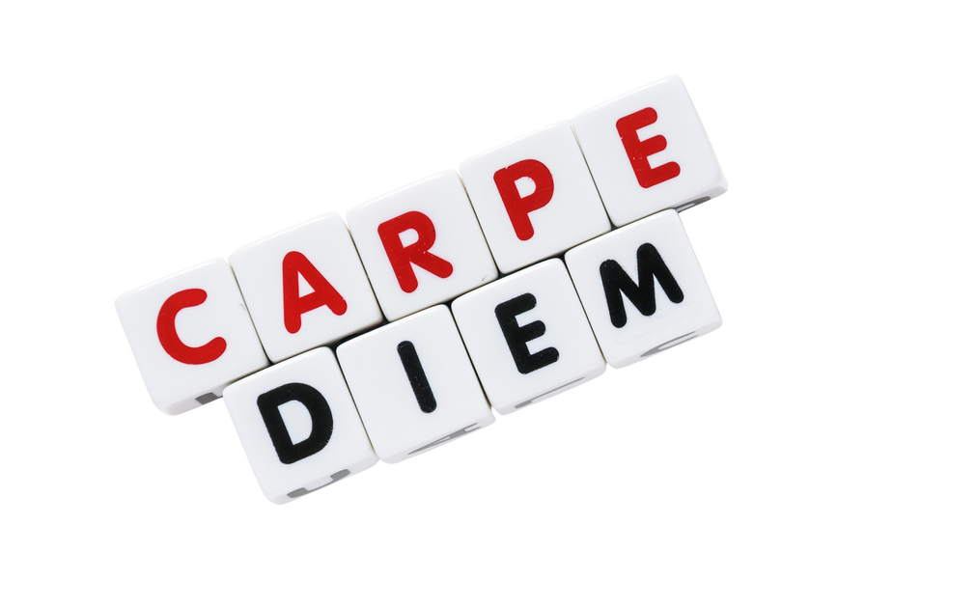
Conclusion

Slide 9

Questions

