Slide 1

Groin and Pelvis Injuries in Athletes
Chris Nelson, MD CAQSM
Assistant Professor
Family and Community Medicine
Wake Forest University

Slide 2
Disclosures
I have no financial relationships with commercial interests/organizations that provide goods or services directly or indirectly to patients that relates to this presentation.

Slide 3
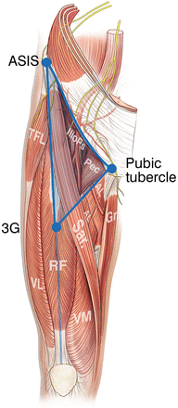
Overview
Hip and Groin Injuries
Injury Grading
Incidence
Typical Presentations
Ultrasound Pathology Examples
Recovery and Rehab Projections

Slide 4
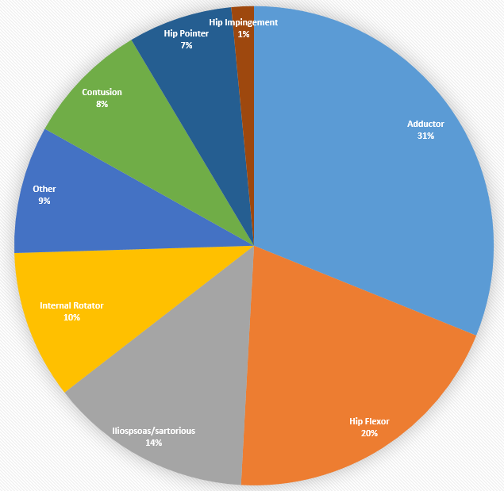
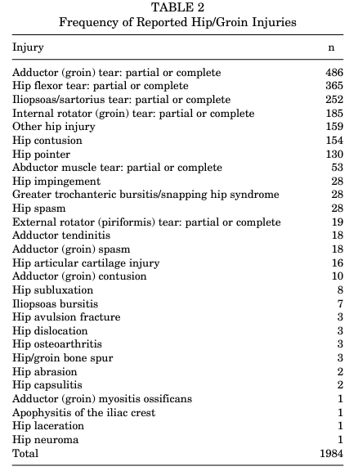
Hip & Pelvic Injury Incidence
1984 injuries total in a NCAA Division I athletes
39% time loss injury
1% required surgery
67% in practice
Greatest in competition injuries
  Men’s track
Highest rate severe
  Women’s track
Notes:
Why does it matter-common and larger time loss for athletes
Made the graph because the paper used a chart

Slide 5
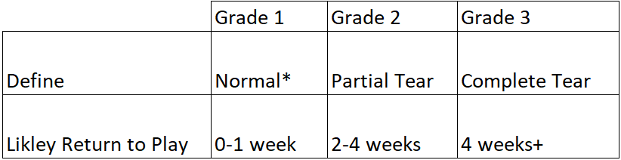
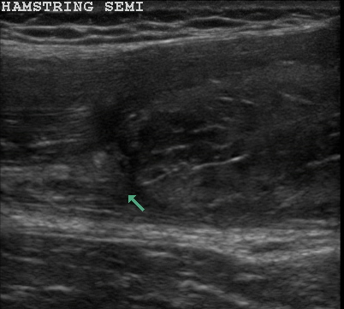
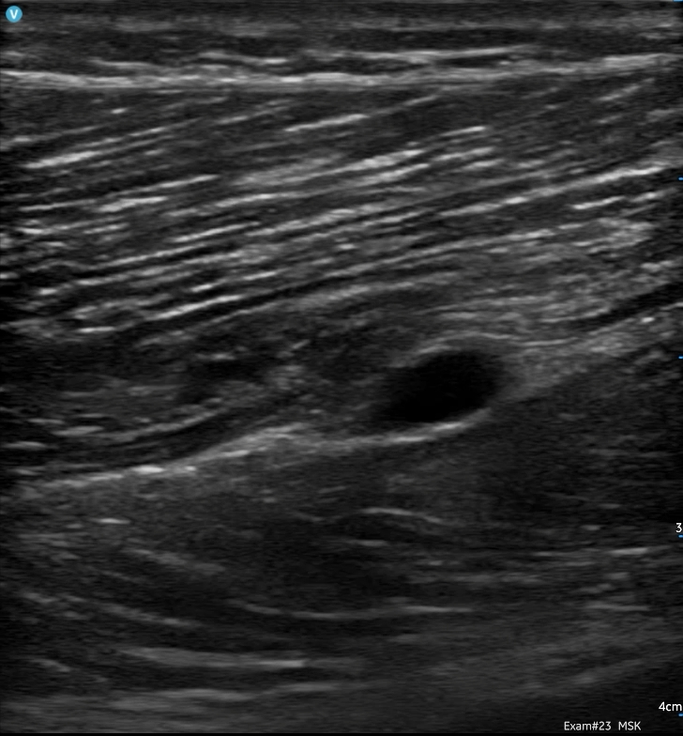
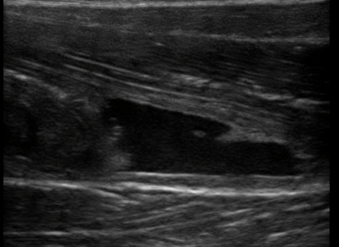
Notes:
Normal-Bicep longitudinal
Hamstring and rectus with a IM grade 2
Grade 3, full thickness
Then some differentiate to other grading based on retraction

Slide 6
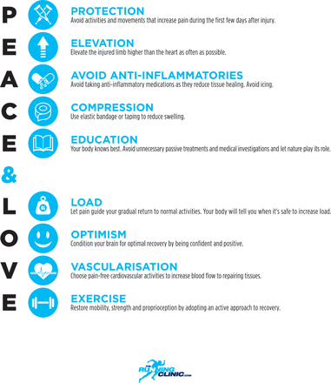
Immediately after Injury
Sub-Acute
Notes:
inhibiting inflammation using medications may negatively affect long-term tissue healing, especially when higher dosages are used. Standard of care for soft- tissue injuries should not include anti- inflammatory medications.
Think of this like permissive fevers for pediatric patients
Active Recovery approach
: nurturing an external locus of control or the ‘need to be fixed’ can lead to therapy-dependent behaviour. Better education on the condition and load management will help avoid overtreatment.
Police article bjsm
Progressive mechanical loading is more likely to restore the strength and morphological characteristics of collagenous tissue.⁴ ⁵ Indeed, early mobilisation with accelerated rehabilitation is effective after acute ankle strain.⁷

Slide 7
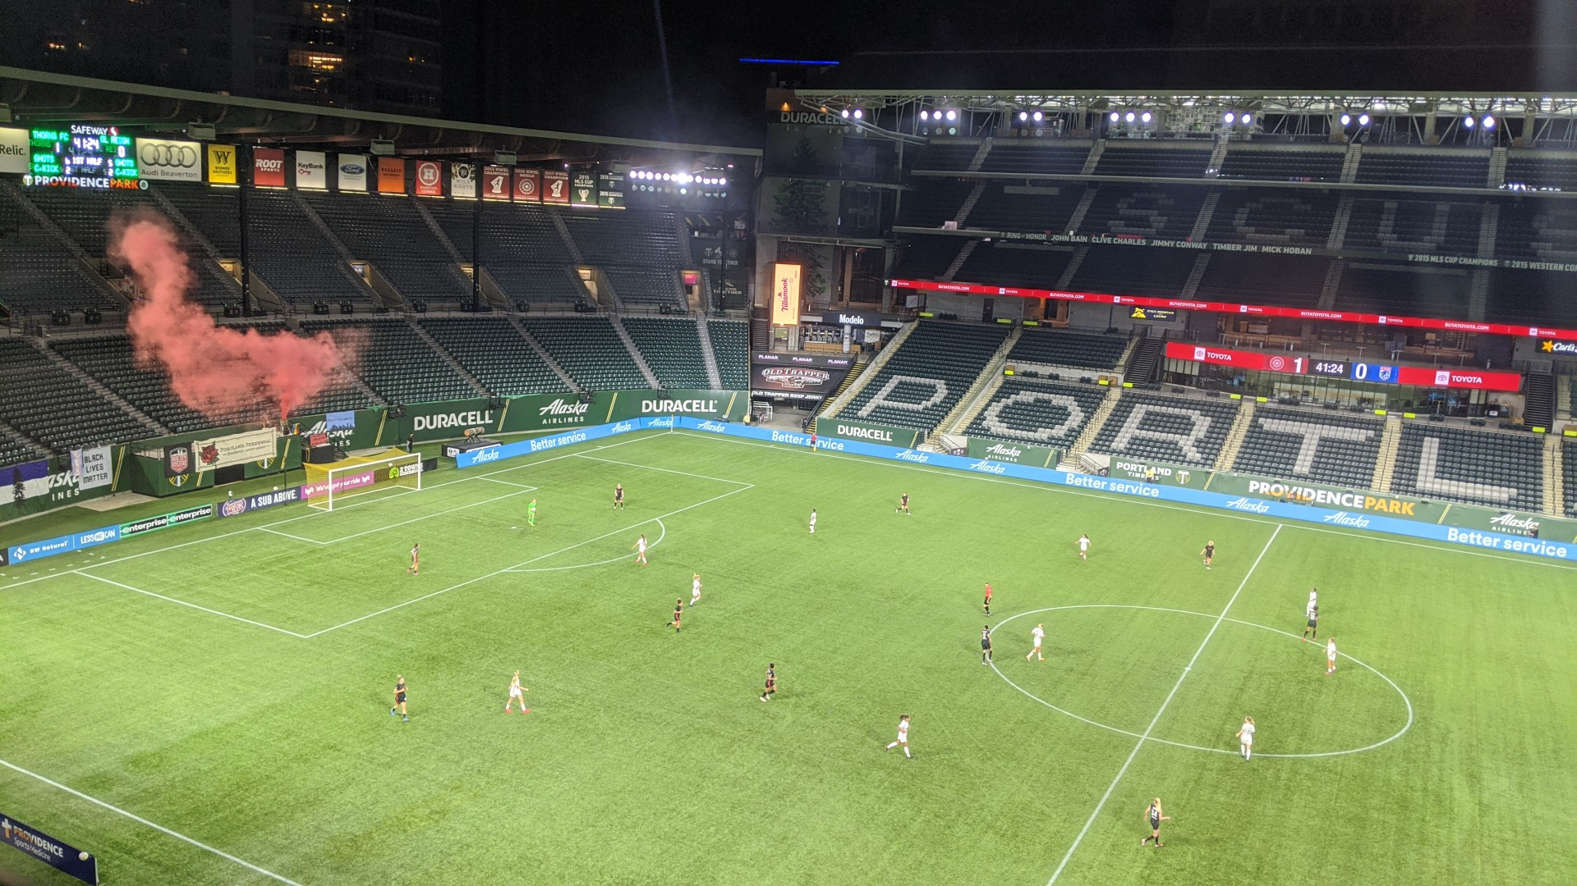
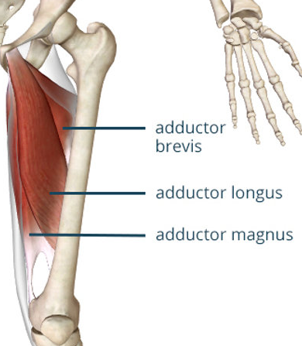
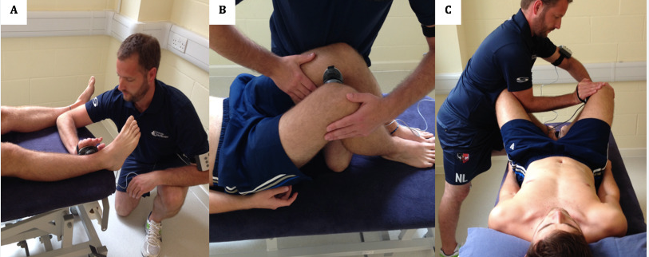
Adductors
Most common hip injury for NCAA D1
Multidirectional Sports
  Real football
18% of all soccer injuries.
Physical Exam
  Insidious pain medial to groin triangle
  TTP at adductor origin
  + Squeeze test
  Painful passive abduction

Slide 8
Adductor Grade 3
Pubis

Slide 9
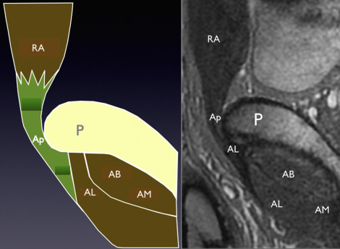
Sports Hernia
  Many many names:
    Gilmore’s groin, ‘slap shot gut’ –hockey
  Strictest definition would be aponeurosis tear
  36 weeks duration
Physical Exam
Unique:
Painful sit-up
Overlap with Adductor Injury:
  Insidious pain medial to groin triangle
  TTP at adductor origin
  + Squeeze test
  Painful passive abduction

Slide 10
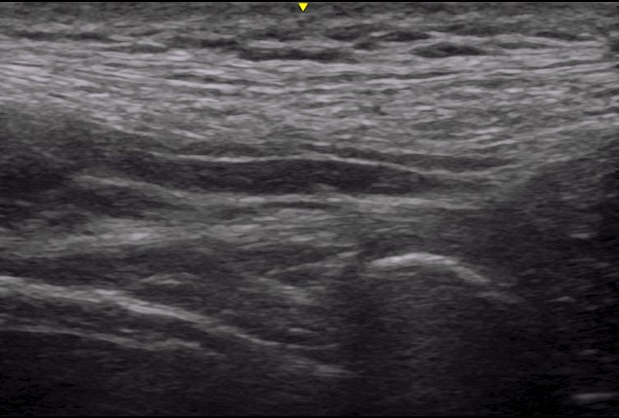
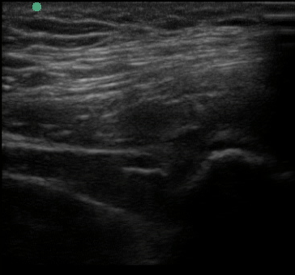
Sports Hernia
Rectus Abdominis
Pubis
Pubis
Long Axis: Normal

Slide 11
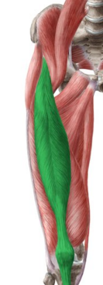
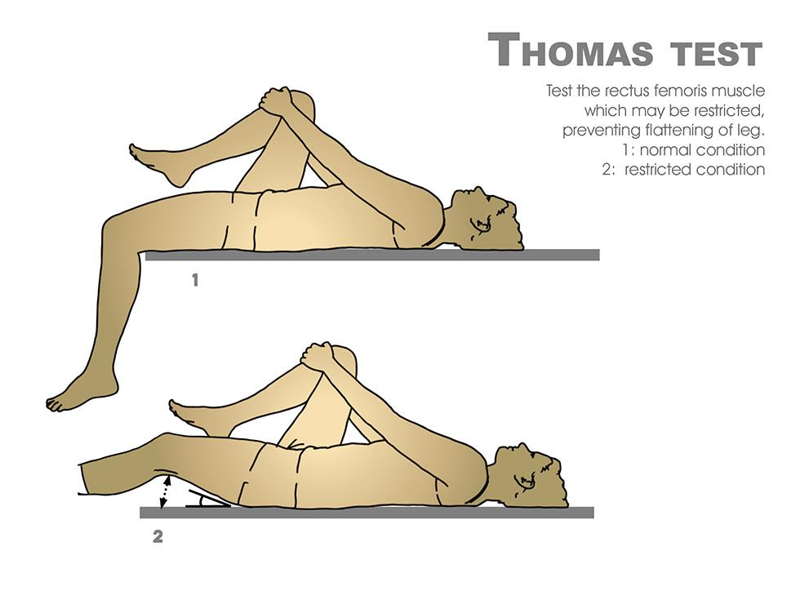
Hip Flexor
Rectus Femoris most common
  Also Iliopsoas, sartorious
Sprinting, running athletes
Physical Exam
  In the groin triangle
  Triggered by rising from chair
  TTP over iliopsoas proximal rectus
  Thomas stretch painful

Slide 12
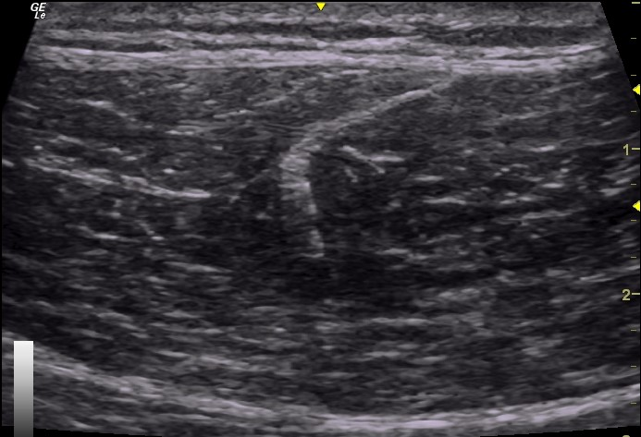
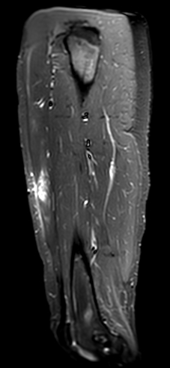
Rectus: De-Gloving Injury
Short Axis
Short Axis: Normal
Long Axis

Slide 13
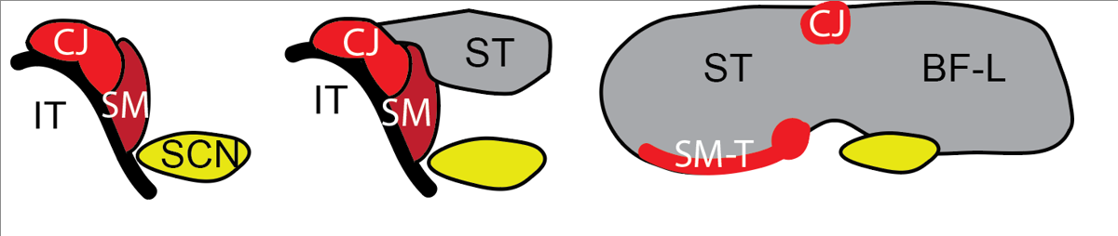
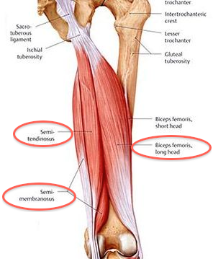
Proximal Hamstring
Semimembranosus, Semitendinosus, Bicep Femoris
Acute
  Eccentric contraction in terminal swing phase of running, when the hamstring muscles eccentrically
  Audible pop
Chronic
  Runners, any distance
  Insidious onset
  Age 30 yrs +
  Tendinopathy RTP 8-10 weeks
Notes:
contract to decelerate the swinging limb and prepare for foot strike.

Slide 14
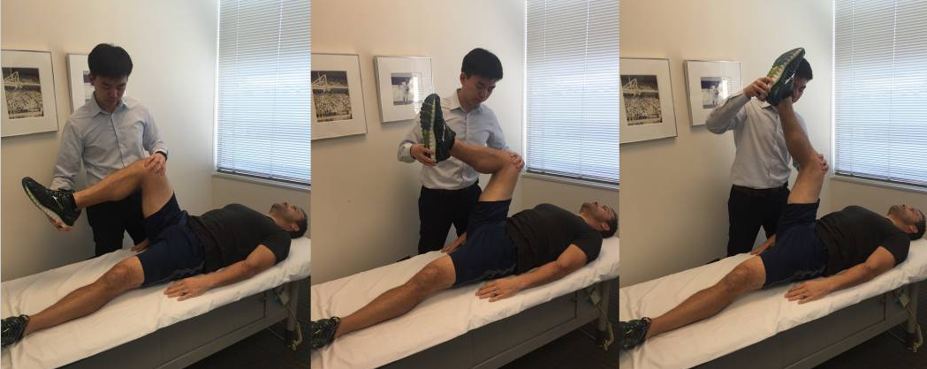
Proximal Hamstring
Physical Exam
Palpation-pain, defect
Resisted knee flexion
Ecchymosis
Bent knee stretch:
  Hip and knee are flexed to end range, then the knee is passively extended

Slide 15
Ultrasound: Hamstring
Grade 2 Tear
Long Axis: Normal
Notes:
Sonography is as useful as MRI in depicting acute hamstring injuries, cheaper for serial exams
longitudinal length of the strain as measured on MRI is a strong predictor for the amount of time needed until an athlete can return to competition
MRI negative group had a significantly faster RI (6.6 days) compared with the MRI positive group (20.2 days). Both the length and cross sectional area (CSA) of the MRI positive lesions were measured. The length of the lesion had a stronger correlation coefficient with the RI (0.84) than did the CSA (0.76)

Slide 16
Ultrasound: Hamstring
US imaging as useful as MRI
  Acute more than serial exams
Strain Length > Cross Sectional Area
  Time loss
  Return to play
MRI negative
  6.6 days RTP
MRI positive group
  20.2 days RTP
Notes:
From a study all the way back in 2004

Slide 17
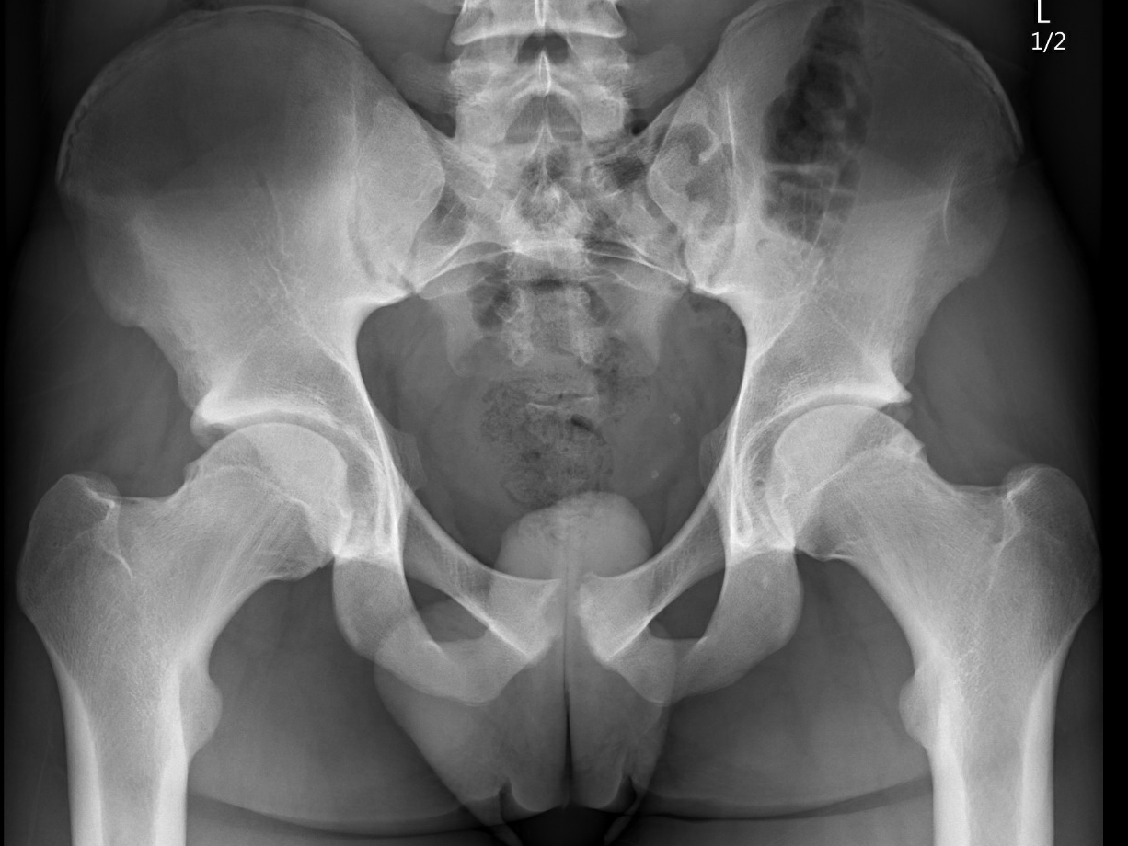
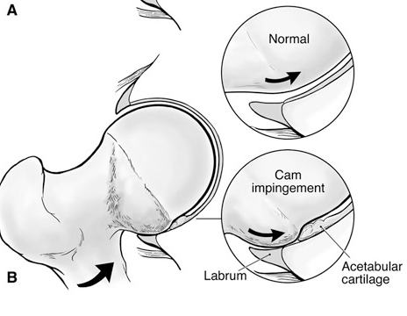
Femoroacetabular Impingement (FAI)
Overall Incidence
  NCAA Division I cohort
    3% symptomatic FAI
Pincer
  Incidence
    Female=Male
    Asymptomatic pincer 67%
  Labrum injury first
Cam
  Incidence
    Men 3:1
    Asymptomatic cam 23%
  Cartilage injury first
Notes:
Exercise often makes symptoms of FAI show up sooner and many people will remain asymptomatic so screening is likely not helpful
With hip flexion, the prominent rim of the acetabulum crushes the labrum against the femoral neck (Figure 1). This cyclical submaximal repetitive microtrauma leads to breakdown and failure of the acetabular labrum.

Slide 18
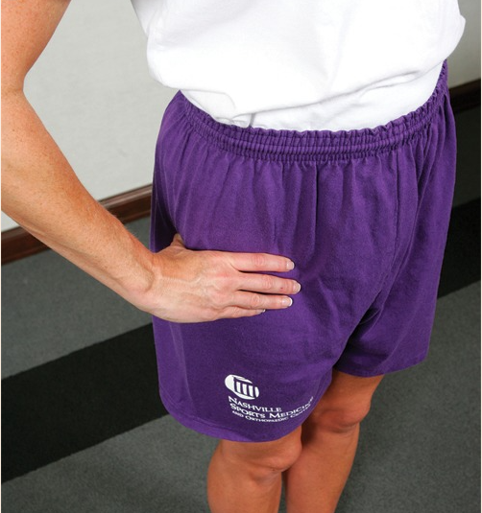
Femoroacetabular Impingement (FAI)
History:
Often report “tight hips”
“C sign”
Stabbing pain
Catching
  turning, twisting, pivoting
Pain rising from chair
  Flexed hip with resistance
Usually gradual
  can be acute

Slide 19
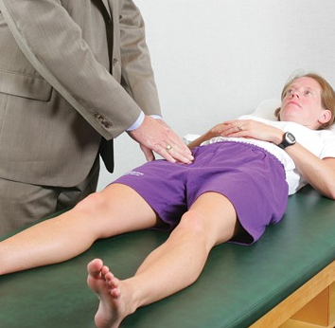
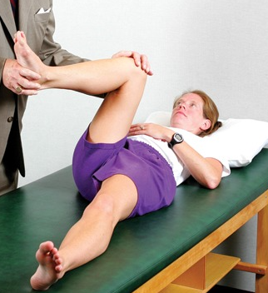
Femoroacetabular Impingement (FAI)
Physical exam
60% of athletes treated for 7 mos before recognized as intraarticular problem
+log roll
Reduced internal rotation…Not Always
  (<30° with hip flexed to 90)
FLAIR aka FADIR
Notes:
Looking for things that are specific to intraarticular pathology

Slide 20
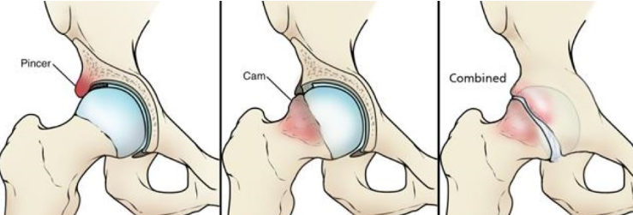
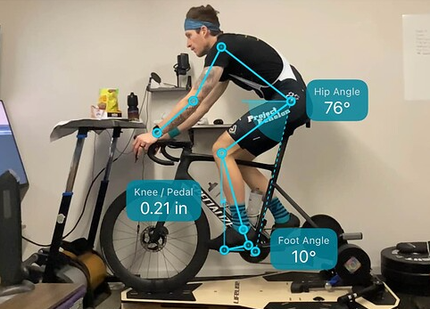
FAI
Treatment
  25-50% treated surgically
    Athletes not more likely to choose surgery than non-athletes
  Bony restrictions
    make rehab-mobilization often ineffective
  Activity or dose modification
Notes:
Hip ok for cycling but not in a tri position, more of an upright torso position-typical road cycling

Slide 21
Sources
Kerbel YE, Smith CM, Prodromo JP, Nzeogu MI, Mulcahey MK. Epidemiology of Hip and Groin Injuries in Collegiate Athletes in the United States. Orthop J Sports Med. 2018 May 11;6(5):2325967118771676. doi: 10.1177/2325967118771676. PMID: 29780846; PMCID: PMC5952296.
Falvey ÉC, King E, Kinsella S, et al. Athletic groin pain (part 1): a prospective anatomical diagnosis of 382 patients—clinical findings, MRI findings and patient-reported outcome measures at baseline. British Journal of Sports Medicine 2016;50:423-430.
Byrd JW. Femoroacetabular impingement in athletes, part 1: cause and assessment. Sports Health. 2010 Jul;2(4):321-33. doi: 10.1177/1941738110368392. PMID: 23015955; PMCID: PMC3445094.
Byrd JW. Femoroacetabular Impingement in Athletes, Part II: Treatment and Outcomes. Sports Health. 2010 Sep;2(5):403-9. doi: 10.1177/1941738110378987. PMID: 23015968; PMCID: PMC3445055.
Collis RW, McCullough AB, Ng C, Prather H, Colditz GA, Clohisy JC, Cheng AL. Rate of Surgery and Baseline Characteristics Associated With Surgery Progression in Young Athletes With Prearthritic Hip Disorders. Orthop J Sports Med. 2020 Nov 24;8(11):2325967120969863. doi: 10.1177/2325967120969863. PMID: 33294476; PMCID: PMC7705795.
Frank JM, Harris JD, Erickson BJ, Slikker W 3rd, Bush-Joseph CA, Salata MJ, Nho SJ. Prevalence of Femoroacetabular Impingement Imaging Findings in Asymptomatic Volunteers: A Systematic Review. Arthroscopy. 2015 Jun;31(6):1199-204. doi: 10.1016/j.arthro.2014.11.042. Epub 2015 Jan 28. PMID: 25636988.
Chu SK, Rho ME. Hamstring Injuries in the Athlete: Diagnosis, Treatment, and Return to Play. Curr Sports Med Rep. 2016 May-Jun;15(3):184-90. doi: 10.1249/JSR.0000000000000264. PMID: 27172083; PMCID: PMC5003616.
Connell DA, Schneider-Kolsky ME, Hoving JL, Malara F, Buchbinder R, Koulouris G, Burke F, Bass C. Longitudinal study comparing sonographic and MRI assessments of acute and healing hamstring injuries. AJR Am J Roentgenol. 2004 Oct;183(4):975-84. doi: 10.2214/ajr.183.4.1830975. PMID: 15385289.
N.J. Gibbs, T.M. Cross, M. Cameron, M.T. Houang, The accuracy of MRI in predicting recovery and recurrence of acute grade one hamstring muscle strains within the same season in Australian Rules football players,. Journal of Science and Medicine in Sport, Volume 7, Issue 2, 2004,. Pages 248-258,
Dubois B, Esculier J Soft-tissue injuries simply need PEACE and LOVE. British Journal of Sports Medicine 2020;54:72-73.
N. Light, K. Thorborg, The precision and torque production of common hip adductor squeeze tests used in elite football, Journal of Science and Medicine in Sport, Volume 19, Issue 11, 2016, Pages 888-892, ISSN 1440-2440,

Slide 22
Images
https://www.precisionpt.org/post/adductors-the-glute-s-sidekick
https://hipfootankle.com/problems-treated/hamstring-pain/
https://orthoinfo.aaos.org/en/diseases--conditions/femoroacetabular-impingement/
https://www.trainerroad.com/forum/t/the-bike-fitting-mega-thread/10527/1297?page=63

