Slide 1
Policy Framework for Sports Medicine and Science
Jeff Mailu MD
President: SMSK

Slide 2
Nothing to Declare
The Presentation takes a Guest talk format

Slide 3
Outline
Sports : Historical Background
A reflection on development of sports medicine
Regulatory Framework and Training currently in Kenya
A proposed policy framework for sports medicine and science

Slide 4
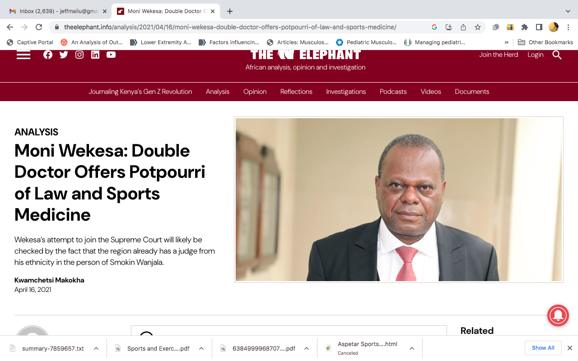
Sports in Kenya : Historical Background
Sporting is as old as humanity and kenya is the cradle : So Karibu nyumbani
Organized sports in modern Kenya emerged in the 1950s especially 1954
Most of the national sports federations came to being in the 1960s
Some of our rugby teams predate football teams that often sprung up as community clubs

Slide 5
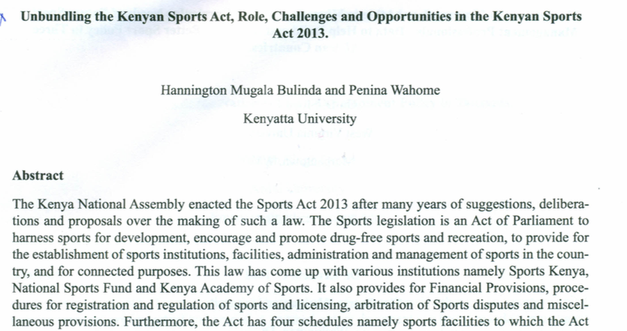
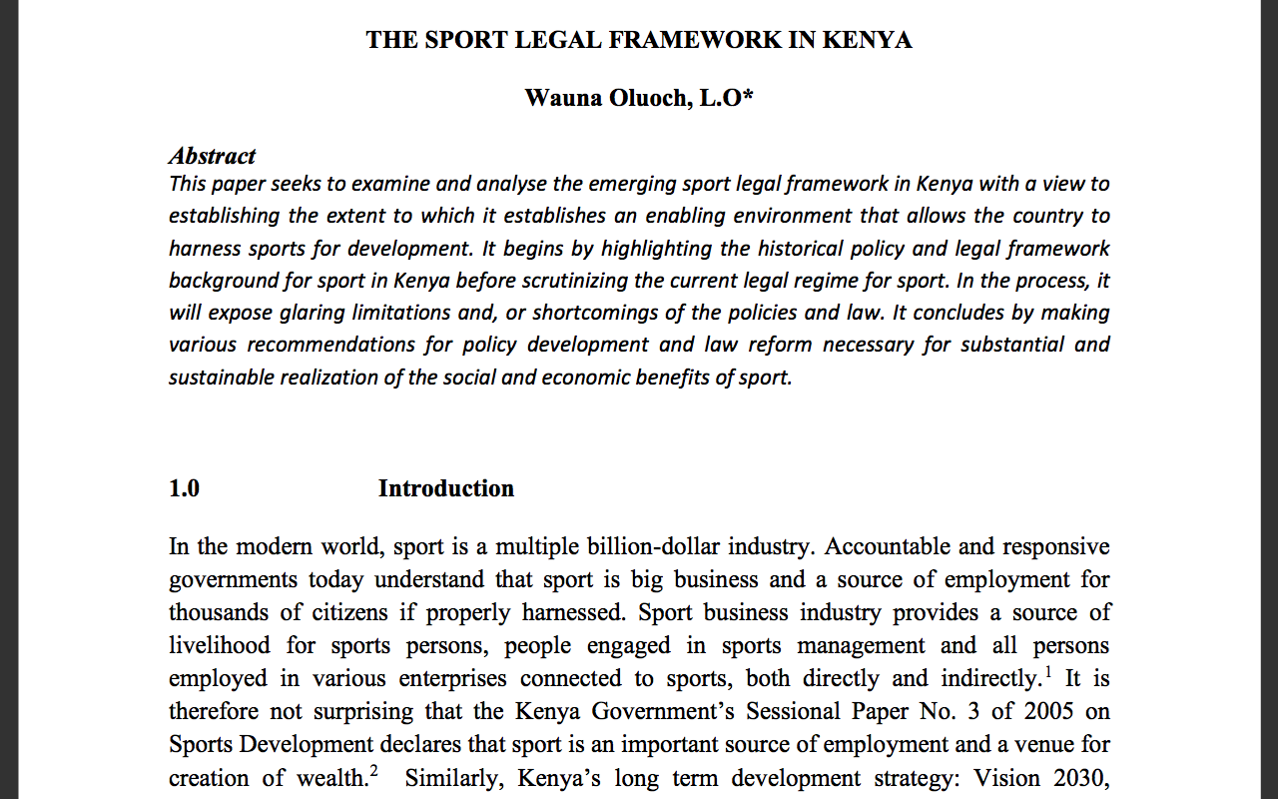

Sports Act No.25 of 2013
Operationalized 2016 : 66 NSFs/KeSSA/KUSA
Framework : National Sports Policy
Medical Committees for NSFs : missing

Slide 6



Slide 7
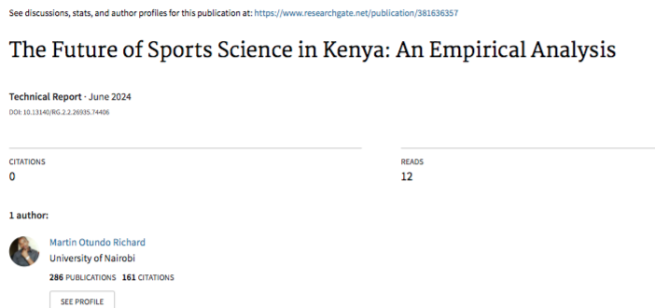
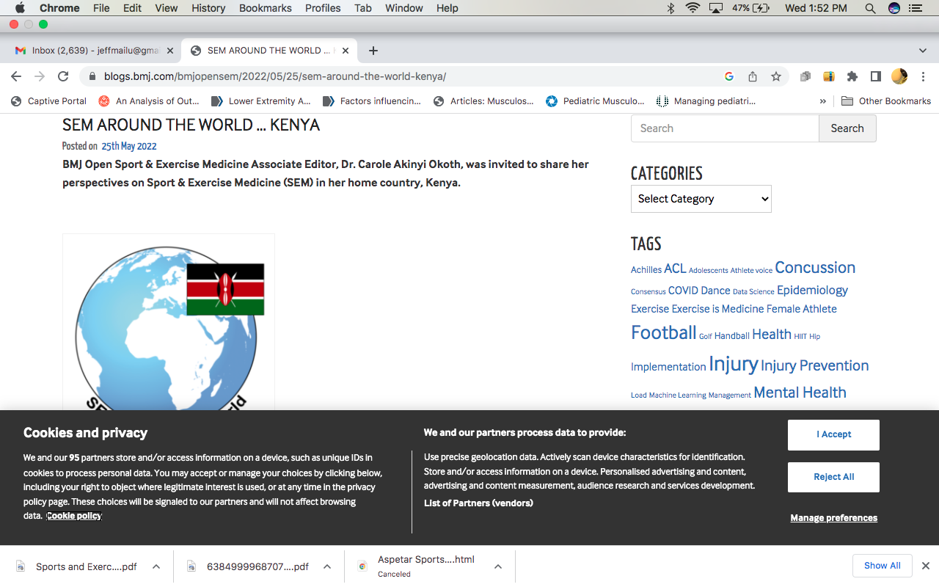
Education in Sports Medicine :
Health Care cadres involved to date:
Nursing
Clinicians /MDs
PTs /PT Assistants
SnCs
First Aiders
Notes:
MMUST, MU, JKUAT, LU, Amref, EAST,KU

Slide 8
SM Mandates and Status
Requirements for Medicare in Sports Policies : KMTC;SGBs : Adhoc
Research: Universities/KEMRI
Education and Training Levels : PT- Diplomate, Bsc,MSc Sports Physio, PhD; Sports Science; MDs - Orthopedics, FM and IMed

Slide 9

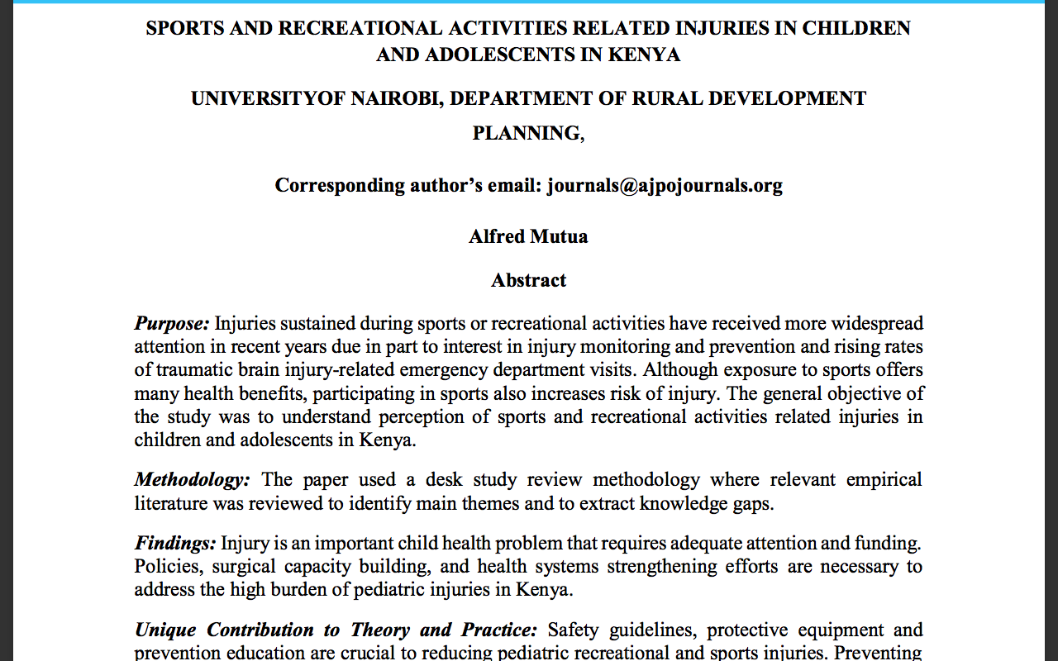

Slide 10

Membership and further engagements
Across board
Regional chapters
Excellence Awards/publish

Slide 11
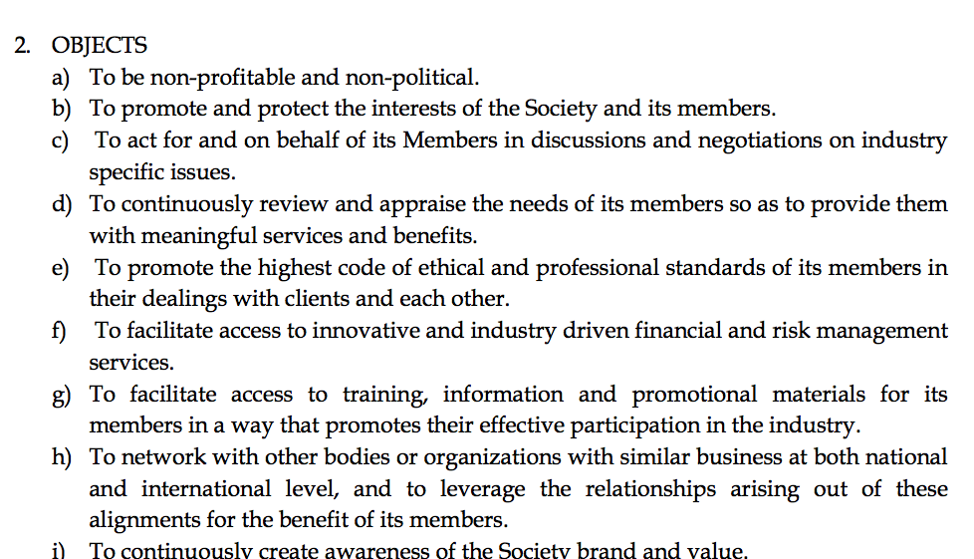
Regulatory and Policy Framework
Nascent journey
HPOA - engagement to focus on how to register, train, regulate and grow the sector and assure of quality and ethics
SMSK
Academicians : Standards
Officials: Credentials committee
Doctors
Sports scientists
Sports nutritionist
Sports physiology
Sports psychologists
Missing: physical education/disability medicine

Slide 12
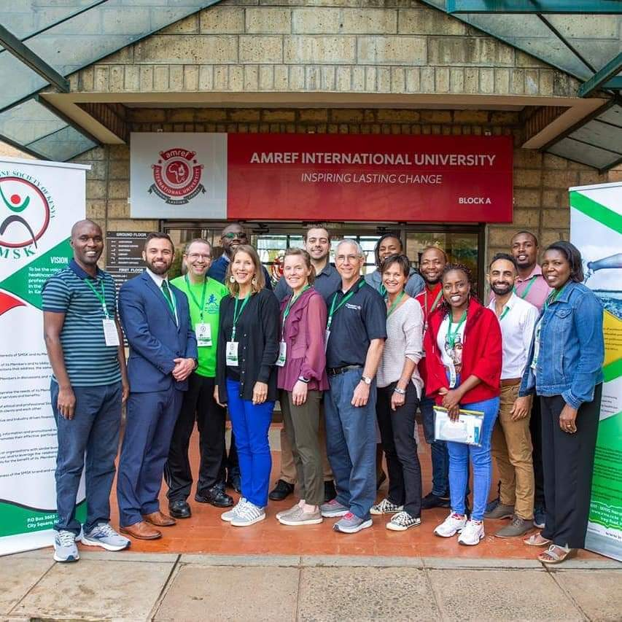
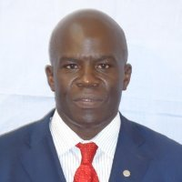
SMSK

Slide 13
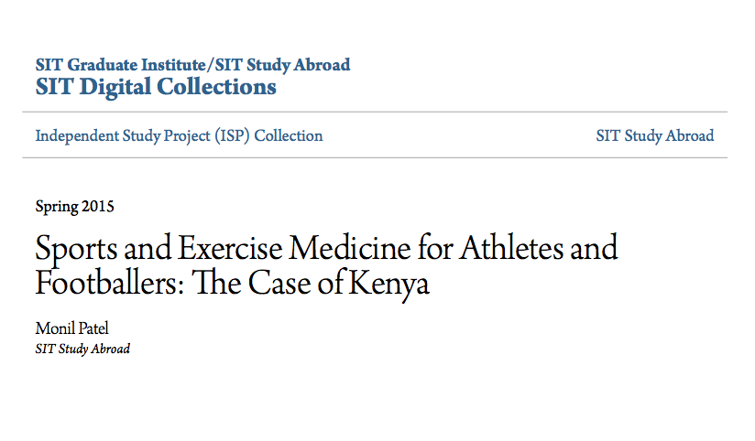

Areas of Advocacy
SGBs - Medical Committees and Pools with substantive engagement: preferably the chair be in the boards
NA : Amendment to the Sports Act to properly require player welfare mandates
Registrar of Sports : Recognition of sports medicine institutions beyond ADAK ? LSK or Accountants Act

Slide 14
Areas of Growth
Regions and Sports Disciplines as envisaged
International affiliations and collaborations, further training and equipping : Uganda, Rwanda, Tanzania, Zambia
Focal strengths for teaching institutions: Would allow infrastructure sharing and stem wastage of scarce resources

Slide 15
Summary of the Policy Framework
Professionals growth and self regulatory level: The Society and its Chapters
National legislative and implementation level: Advocacy for legislation and policies
International: Collaborative level and IFs medical engagements
Universities: Academic and training standards
Publication and research

