Slide 1
LATEST APPROACHES
ON KNEE ACL
REHABILITATION
PROTOCOL
LAMECH BOGONKO
PHD Candidate
MSc Sports Physio
BSc (Hons) Physio
Cert Sports Medicine
East Africa Physiotherapy & Sports Injury Clinic
Kenya 7s Team Physiotherapist

Slide 2
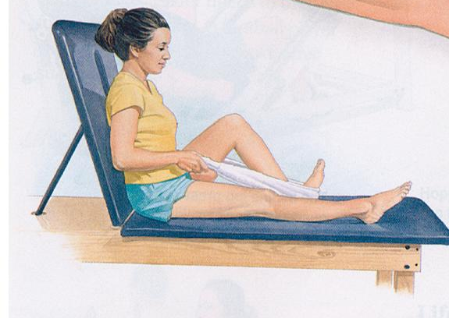
Are there any pre-operative requirements for ACL reconstruction?
Yes
You should have near normal knee range of motion.
Sometimes patients go to physical therapy pre-operatively to get there motion restored before surgery.

Slide 3
Post op care
Wear your brace any time you are up
Sleep in your brace
You may open your brace any time you are seated or lying down
Ice (cryocuff) as much as possible
Elevate your knee above your heart as much as possible
You may put as much weight on your leg as you can tolerate with your crutches immediately post op

Slide 4
POST SURGICAL GOALs
1. Retain Range of Motion
EXERCISE BIKE
LEG EXTENSIONS
LEG FLEXION
3. RANGE OF MOTION
Retain Muscle Size & Strength
STRAIGHT LEG LIFTS
SQUATS/STATIC SQUATS/LEG EXTENSIONS
LEG CURLS/LEG PRESS
2. Reduce Swelling
ICE
ELEVATION
COMPRESSION
4. Cardiovascular Fitness
EXERCISE BIKE
ELLIPTICAL TRAINER
SWIMMING

Slide 5
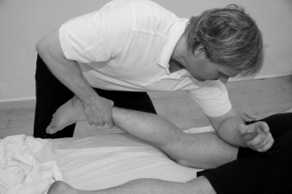
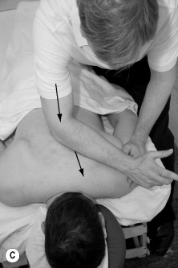
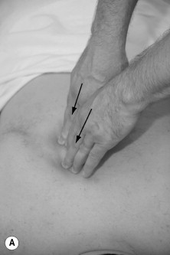
Role of Myo-facial Release
In ACL Knee Rehab
Myofascial release techniques have been anecdotally reported as being effective in relieving restrictions and increasing range of motion.
The focus of myofascial release techniques is on the Fascial system, which consists of embryologic tissue
Fascial tissue is a tough connective tissue that assists the tissue that it surrounds in maintaining its shape.
Myofascial release (MFR) is a system of techniques that is directed at myofascial structures.
Techniques can be described as either direct or indirect.
Direct MFR techniques engage the restrictive barrier, and the tissue is then loaded with a constant force until tissue release/relaxation occurs.
An example of this would be the very common practice of stretching myofascial tissues during warm up or rehabilitation.
Indirect MFR involves gliding the dysfunctional tissues along the path of least resistance (away from the barrier) until free movement is achieved.

Slide 6
Basic Post OP Exercise Prescription
Basic
Exercises
Isometric Quadriceps contractions sets (10X3)
Passive knee extension:
Resisted terminal knee extension:
Wobble board exercises
^{Heel prop using a rolled towel}
^{Prone Hang} -Note the knee is off the edge of the table
^{Wall Slide} -Allow the knee to gently slide down
Stationary Bicycle helps to increase strength
Use the non-injured leg to straighten the knee Passive Flexion allowing gravity to bend the knee to 90 degrees
Straight leg raises - lying (left) and seated (right)
Partial squat using Table for stabilization
^{Toe Raise .}
Leg press using 90-0 degree range
Heel slide - leg is pulled toward the buttocks

Slide 7
Phase I (ACL)
Acute Management/Early Motion and Basic Movement Retraining
This phase begins immediately after surgery and continues for 2-4 weeks, depending on your progress. To promote proper healing it is important not to progress too rapidly.

Slide 8
GOALS
Achieve full active knee extension equal to the uninvolved side
Eliminate swelling
Restore the ability to control the leg while weight bearing
Achieve at least 125 degrees of knee flexion
Be able to lift the leg in all directions without assistance
Normalize walking pattern with the assistance of crutches and/or brace

Slide 9
Phase II
Basic Strength and Proprioception
This phase begins 2-6 weeks after surgery.
It will usually take 3-5 weeks to achieve the goals in this phase.

Slide 10
Goals
Restore proper body alignment and control with basic movements, such as walking without assistance, squats, stationary lunges and single-leg balance
Build lower extremity and core body strength
Develop increased proprioception, starting with stationary postures and then progressing to movements
Achieve active range of motion equal to the uninvolved knee

Slide 11
Phase III
Dynamic Neuromotor Strength, Endurance and Coordination
This phase can be initiated when the goals of phase 2 are met.
On average this will begin 6-8 weeks after surgery.

Slide 12
Goals
Increase the strength of the involved leg. You should be doing strenuous pain-free strengthening at least
3 times per week. Consider doing more sets and repetitions on the involved side to eliminate side- to-side strength differences. Be very cautious not to overuse your non-surgical leg, as this will increase the side-to-side difference. Progress from single plane strengthening and functional exercises to multi- plane strengthening and functional exercises (before progressing the patient should be able to demonstrate good alignment and control with each component of the multi-plane exercise). This is a prerequisite for future progression to cutting and pivoting activities.
Develop eccentric neuromuscular control to allow acceptance of impact activities without increasing symptoms
NB// (before initiating impact activities the patient should not have any swelling, have full knee extension, be able to balance on one leg for 10 seconds and be able to perform a single leg squat to approximately 45-60° of knee flexion with good posture and control).
Develop dynamic flexibility to allow for proper alignment during activities of increasing speed.
Full range of motion is expected.

Slide 13
Phase IV
Athletic Enhancement and Return to Activity
This phase can be initiated when the goals of Phase 3 are met.
This phase will usually begin 12-16 weeks after surgery.

Slide 14
Goals
Progress from double leg impact control to single leg impact control (this should not be initiated before 8 weeks post-op, and should be completed from the double leg progression).
Develop proper technique and appropriate neuromuscular control with start and stop movements and change of direction movements.
This includes cutting and pivoting (this should not be initiated before 8 weeks post-op, and should progress after completing the double leg progression).
Eliminate apprehension that may exist with complex movements related to sports.

Slide 15
Phase V
Sports Performance and Injury Prevention
At the physical therapist or athletic trainer specific exercises based on your sport and specific needs.
These exercises are important for enhancing sports performance and preventing future injuries.
Pre Rehabilitation exercises

Slide 16
Goals
Sport specific exercises
Change of direction game situation
Training set up

Slide 17
SPORTS REHABILITATION
‘‘TAKE HOME’’
Post-operative rehabilitation is essential in optimizing your function and return to sport after an ACL reconstruction
Frequently during an ACL reconstruction, other injuries or pathologies are addressed during surgery .
These additional procedures require special post-operative precautions.
The process of returning to physical and athletic activities is not based on time
It is based on the individual’s ability to achieve certain milestones or criteria .
The time needed to do this will vary from individual to individual .

Slide 18
Typical Post-Op Milestones
  3 months-
  -OK to jog if thigh progressing appropriately
  4-5 months
  -begin some sport specific activities
  6-9 months
    -return to sport/work
  The post-op course varies between patients and your course may be slightly different

Slide 19
Post-op Questions
The thigh (quadriceps muscle) shuts down (goes to sleep) after surgery and it takes time and rehab for it to wake up?
It takes 6-9 months for the quadriceps musculature to fully restore itself after surgery.
Until the thigh muscle is strong again your knee will feel loose even though it is entirely stable
The more frequently the thigh exercises are done the faster the thigh will be strong and the faster you may safely return to full activities.

