Slide 1
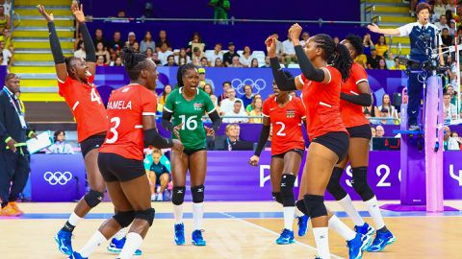

OPTIMAL PERFORMANCE & WELLBEING FOR THE FEMALE ATHLETE
ADDRESSING MENTAL HEALTH & BUILDING RESILIENCE
BY ROWENA TIROP, SPORT AND EXERCISE PSYCHOLOGIST, MSC

Slide 2
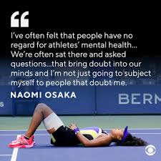
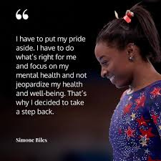
THE WHOLE ATHLETE: BEYOND THE PHYSICAL

Slide 3
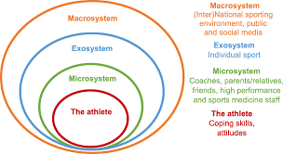
THE WHOLE ATHLETE: BEYOND THE PHYSICAL
Did you know that female athletes are 2-3 times more likely to experience mental health issues than their male counterparts? (Phelps et al., 2016)
According to research, about 35% of female athletes report clinically relevant symptoms of anxiety or depression. (Gouttebarge et al., 2019)
Nearly 30% of female athletes engage in disordered eating behaviours (The National Women’s Law Center, 2021).
80% of sporting organizations worldwide lack structured mental health programs especially for women (IOC Report, 2020)

Slide 4

WHAT IS MENTAL HEALTH?
Mental Health is more than the absence of mental illness. It is an important aspect of our overall well-being. It involves our emotional, psychological and social health. It affects how we think, feel and act as we move through life.
  Emotional Well-being: ability to understand, experience and manage your emotions, feeling the range of emotions in healthy ways and being able to cope with stress and maintaining a positive outlook.
  Psychological Well-being: relates to your cognitive functions and your sense of self. Your ability to think clearly, solve problems, learn new things, make decisions and develop a sense of purpose and self-esteem. It’s about having a realistic perception of yourself and the world around you.
  Social Well-being: involves the ability to form and maintain healthy relationships, contribute to your community and feel connected to others. It includes a sense of belonging,empathy for others and effective communication skills.

Slide 5
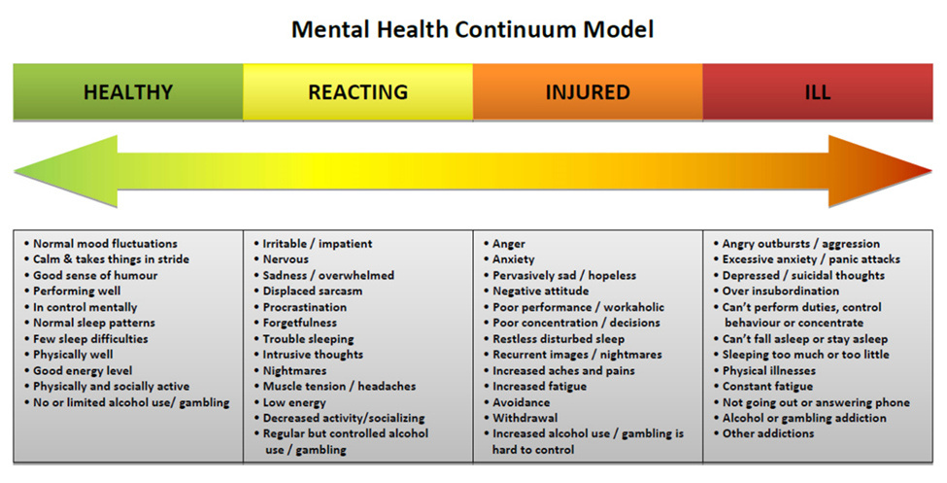
MENTAL HEALTH CONTINUUM

Slide 6
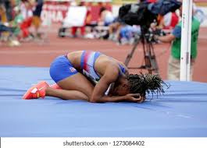
CHALLENGES FACED BY WOMEN IN SPORT
  Body Image & Disordered Eating: Intense pressure to conform to sport-specific or societal ideals, weight demands, comparison culture
  Hormonal Fluctuations: Impact on mood, energy, recovery, injury risk (menstrual cycle, perimenopause, postpartum)
  Energy Balance: Female Athlete Triad or RED-S(Relative Energy Deficiency in Sport)
  Relational Dynamics: Navigating team cohesion, coach-athlete relationships, potential for harassment/abuse.
  Perfectionism & Self-Criticism: Often amplified in high-achieving environments.
  Violence and abuse
  Discrimination
  Career Transitions & Identity: Athlete identity dominance, challenges with retirement or injury.
  Societal Pressures: Balancing sport with other life roles, gender stereotypes and biases ("prove yourself").

Slide 7
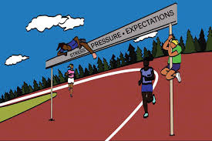
EFFECTS OF MENTAL HEALTH ON PERFORMANCE
Mental health directly impacts physical performance and vice versa.
Negative Impacts:
  Impaired focus, motivation and confidence
  Increased injury risk: Anxiety can lead to overtraining or reckless
  behavior.
  Impaired decision-making & reaction time
  Slower recovery times
  Reduced enjoyment & increased burnout
Impact of Strong Mental Health:
  Enhanced focus under pressure
  Faster adaptation to setbacks
  Sustained motivation & effort
  Improved learning & skill acquisition
  Greater consistency & peak performance

Slide 8
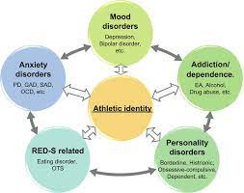
RECOGNIZING SIGNS OF MENTAL HEALTH ISSUES
Take a few moments to think about athletes you know. What signs of mental health issues have you observed?
Common Signs:
  Behavioral changes (withdrawal from team interactions).
  Emotional instability (excessive irritation or mood swings).
  Physical symptoms (fatigue, insomnia, changes in appetite).

Slide 9
HOW TO IDENTIFY MENTAL CHALLENGES
I. Emotional Signs:
These are often among the first indicators that something is amiss
Persistent Sadness or Low Mood: Feeling down, hopeless, or empty for weeks or months, not just a passing mood.
  Loss of Interest or Pleasure
  Irritability or Anger
  Excessive Worry or Fear
  Extreme Mood Swings
  Feelings of Guilt or Worthlessness
  Feeling Overwhelmed
  Numbness or Apathy: A feeling of being disconnected from emotions, people, or surroundings; a lack of care or interest.
II. Behavioral Signs:
These are observable changes in how a person acts.
  Social Withdrawal
  Changes in Sleep Patterns:
  Insomnia
  Hypersomnia
  Disturbed sleep patterns
  Changes in Appetite or Weight:
  Significant weight loss due to lack of appetite.
  Significant weight gain due to overeating or
emotional eating.
  Decreased performance
  Increased Substance Use
  Restlessness or Agitation
  Slowed Movement or Speech
  Reckless or Impulsive Behavior
  Self-Harm
  Talking about Death or Suicidal ideation

Slide 10

HOW TO IDENTIFY MENTAL CHALLENGES
III. Cognitive (Thought) Signs:
Changes in thinking patterns can be subtle but impactful.
  Difficulty Concentrating or Focusing
  Confused Thinking
  Negative or Pessimistic Thinking
  Paranoia or Suspiciousness
  Delusions
  Hallucinations
  Intrusive Thoughts
IV. Physical Signs (often without an obvious physical cause):
The mind and body are connected, and mental distress can manifest physically.
  Chronic Fatigue/Low Energy
  Unexplained Aches and Pains: Headaches, stomach aches, muscle tension, or other bodily pains without a clear medical explanation.
  Digestive Issues: Nausea, vomiting, diarrhea, or constipation.
  Changes in Sex Drive: Noticeable decrease or increase in libido.
  Restlessness/Fidgeting: Physical manifestations of anxiety.
  Shaking or Trembling: Especially in anxious states.

Slide 11
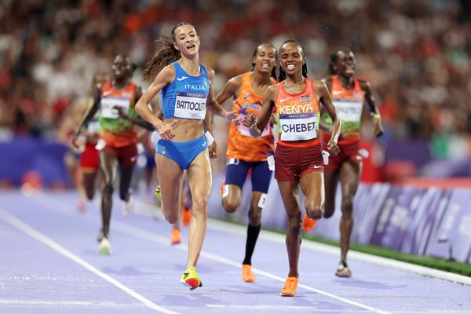
RESILIENCE: THE CORE SKILL FOR CHAMPIONS
What is Resilience? More Than Just "Toughness"
Resilience is the ability to adapt, bounce back from adversity, learn from challenges, and maintain well-being under pressure. You can learn how to be resilient.
Resilience is NOT:
* Ignoring emotions
* Suffering in silence
* Never failing
* Suppressing vulnerability
Resilience IS:
* Acknowledging difficulty
* Seeking support
* Adapting strategies
* Learning from setbacks
* Maintaining self-belief

Slide 12
THE 5 PILLARS OF RESILIENCE
Pillar 1: Self-Awareness & Emotional Regulation
Strategies for Athletes:
  Mindfulness & Body Scanning: Tuning into thoughts, feelings, physical sensations without judgment (e.g., pre-practice breathing).
  Identifying Triggers: Recognizing what sparks stress, anxiety, or negative self-talk (e.g., specific competitions, criticism, fatigue).
  Emotional Labeling: Naming emotions accurately ("I feel frustrated," "I'm anxious").
  Coping Mechanisms: Developing healthy "go-to" strategies (deep breathing, brief visualization, positive self-talk reframes, short breaks).
Pillar 2: Building Mental Skills
Core Skills:
  Goal Setting (SMART & Process-Oriented): Focusing on controllable actions, not just outcomes. Celebrating small wins.
  Positive Self-Talk & Cognitive Restructuring
  Visualization & Imagery
  Focus & Concentration Techniques
  Stress Inoculation Training

Slide 13
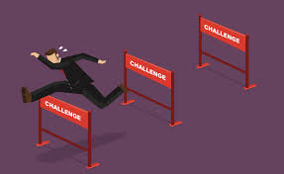
5 PILLARS CONTINUED...
Pillar 3: Strong Support Systems
  Trusted Teammates
  Supportive Coaches
  Sports Doctors, Nutritionists, Psychologists, Physiotherapists, Scientists
  Family & Friends
  Mentors & Role Models
Pillar 4: Physical Wellness as Foundation
Critical Elements:
  Adequate Nutrition & Hydration:
  Prioritizing Sleep & Recovery
  Mindful Movement & Rest
  Listening to Your Body
Pillar 5: Cultivating Identity & Perspective
Strategies:
  Balanced Identity
  Embracing Failure as Learning: Reframing setbacks as essential feedback for growth.
  Focus on Controllables
  Purpose & Values

Slide 14

BUILD YOUR MENTAL HEALTH TOOLKIT
For Athletes:
  Self-Assess: Where are you strong? Where do you need support?
  Choose 1-2 Strategies: Start small (e.g., practice deep breathing daily, reframe one negative thought).
  Communicate: Talk to a trusted coach, teammate, or support staff.
  Prioritize Recovery: Sleep, nutrition, downtime.
For Coaches/Organizations:
  Integrate: Start one conversation, offer one resource, implement one mental skills session.
  Educate Yourself: Learn about female-specific challenges.
  Advocate: Push for resources and support structures.

Slide 15

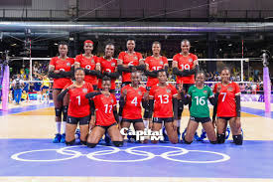
IT TAKES A
VILLAGE...
How can we start:
  Normalize Mental Health: Talk openly, integrate it into training plans, share resources.
  Prioritize Psychological Safety: Foster trust, encourage vulnerability without fear of judgment or repercussion. Create an accepting environment.
  Educate Staff & Athletes: Provide workshops on mental health, resilience skills, body image, nutrition, hormonal health.
  Implement Mental Skills Training: Make it a core part of athlete development, not an add-on.
  Provide Access to Professionals: Partner with sports psychologists, therapists, nutritionists.
  Challenge Stereotypes & Bias: Promote diverse body types, address gender bias, celebrate all contributions.
  Model Healthy Behaviors: Coaches prioritizing their own well-being and work-life balance.

Slide 16
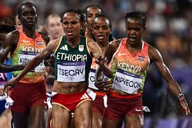
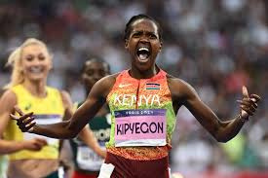
SO WHAT?...
  Female athletes face a lot of challenges externally and internally which increases risk of experiencing psychological distress therefore impacting performance.
  Mental health and resilience building is integral to athletic success and overall well-being.
  Building resilience requires self-awareness, mental skills, support, physical wellness, and perspective.
  A supportive environment is essential; coaches, family, friends & organizations play a vital role.
  Seeking help is a sign of strength and commitment.

Slide 17

THANK YOU FOR YOUR ATTENTION

